Slide 1


TESTING STAFF
Nevada Administration Training & Security Refresher
SPRING
2025
2025
SPRING
Nevada Accountability Assessments
Science, Smarter Balanced Summative, Alternate
Notes:
Testing Staff
2025 WCSD Presentation Slides

Slide 2
Testing Staff
Key Dates – 2025
Date(s) | Details for WCSD
February 19-prior to testing | Preview manuals and accommodations/designated supports protocols Participate in training led by the school principal or school test coordinator NAA Test Administrators complete mandatory on-demand training module (register in MyPGS)
NAA: February 25 | Receive NAA pre-ID secure test materials (initial orders) NAA Test Administrators, after completing training, preview grade level test kits and prepare materials for individual student
Science, Smarter Balanced Summative: March 11-May 2 NAA only: March 11-May 6 | Testing Window (state/district) Students may test on weekdays only (Monday-Friday) On or before the end date: complete online and paper testing; complete transcribing of student responses into DRC INSIGHT (all paper administrations including NAA)
NAA: No later than May 23 | Package and return NAA materials and student video recordings to DRC (UPS shipping)
Notes:
Testing Staff
SAY:
Here are some key dates for spring administrations of the Nevada CRT and NAA. Notice the first day of testing for all administrations. No testing may begin prior to this date, including for the NAA and other paper administrations.

Slide 3
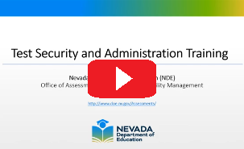


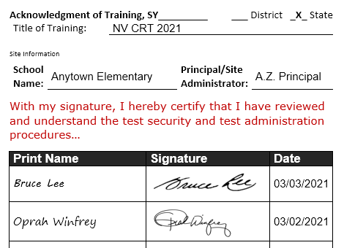
Participate in Training
Sign Confidentiality Agreement
Testing Staff reminder: Guardians or adult relatives and members of the same household of testing students may not be in the same testing room.
Testing staff must acknowledge that they have participated in training, and that they have been informed of and understand procedures and the potential consequences of irregularities in testing.
Testing staff, room proctors, & aides
Sign acknowledgment of training form/log.
Sign confidentiality agreement form.
**Personnel assigned to a testing room and/or handling test materials must first be trained in test security and sign a confidentiality agreement.
Notes:
Testing Staff
SAY:
All personnel assisting with assessment-related activities must receive appropriate training and sign the confidentiality agreement prior to testing.
Note: The Nevada Department of Education training video on test security and administration should be viewed by all testing staff as a “refresher” in test security and by medical aides and sign language interpreters assigned to individual students in the testing room.

Slide 4


Communicate About Testing Policies and Share Test Administration Schedule
At least one month prior…
utilize multiple modes of communication (phone, email, newsletter, etc.) to notify families of students participating in testing, other affected students, and staff.
Before testing, communicate expectations and policies for cell phones and other electronics devices, the testing environment, and personal conduct during testing.
Notes:
Testing Staff
SAY:
The school principal or school test coordinator will inform families, students, and staff about up-coming state assessments at least one month before the start of a testing window. School personnel and students participating in state assessments should understand expectations for the testing environment.

Slide 5

Academic Achievement
--Nevada School Performance Framework (NSPF)
Elementary Schools
% Pooled Proficiency: ELA, Mathematics and Science (20 pts)
% Grade 3 ELA Proficiency (5 pts)
Middle Schools
% Pooled Proficiency: ELA, Mathematics and Science (25 pts)
High Schools
% ELA Proficiency (10 pts)
% Mathematics Proficiency (10 pts)
% Science Proficiency (5 pts)
*High school: ELA & mathematics proficiency calculated from grade 11 cohort; Science calculated from CRT grade 10 cohort & NAA grade 11
Notes:
Informational Slide
Notes:
NSPF Procedures Manual (NDE website): https://nevadareportcard.nv.gov/DI/Resources
Academic Achievement: 25 points
Elementary School:
--ES Pooled Proficiency Measure is worth a maximum of 20 points
*ES Pooled Proficiency measure combines a school’s Math, ELA, and Science results based on student performance on the state CRTs
--RBG3 Measure is worth a maximum of 5 points
*RBG3 – based on the number of grade 3 students reaching proficiency on the CRT ELA assessment (includes Summative and NAA)
Middle School, 6-8:
Middle School Pooled Proficiency Measure is worth a maximum of 25 points
*MS Pooled Proficiency measure combines a school’s Math, ELA, and Science results based on student performance on the state CRTs
High School, 9-12:
--Math and ELA proficiency (ACT with Writing) results will each contribute 10 points (total 20 points)
*HS ELA score measures overall performance on the ACT English, reading, and writing tests weighted approximately equally; reported only for students who take all three tests
--Science results from state CRT will contribute 5 points

Slide 6
Participation ≥ 95%
--All Students Participate in State Assessments
Requirement Annually measure the achievement of not less than 95 percent of all students, and 95 percent of all students in each of 10 subgroups of students who are enrolled during the testing window. Subgroups (7) Race/Ethnicity; seven racial/ethnic categories (1) Students with Disabilities (IEP) (1) English Learners (EL); Current ELs and Former ELs (1) Economically Disadvantaged; eligible for free or reduced-price lunch (FRL)
Assessments
Nevada students participate in either the general (CRT) assessment or alternate (NAA) assessment.
Grades 3-8 ELA & Math: Summative Smarter Balanced OR NAA
Grades 5 & 8 Science: NV CRT OR NAA
High School ELA & Math: ACT (grade 11) OR NAA (grade 11)
High School Science: NV CRT (grade 10*) OR NAA (grade 11)
*Students take the High School Science general assessment once during grade 9 or 10
CRT = Criterion-Referenced Test / NAA = Nevada Alternate Assessment
Notes:
Informational Slide
Notes:
ESSA requires states to assess not less than 95% of all students, and 95% of students in each subgroup, on the state’s Math and ELA assessments (20 USC §6311(c)(4)(E)(i)). Thus, Nevada expects the all-students group, as well as each of the 10 subgroups to achieve 95% participation rates on the state Math and ELA assessments, which includes the Summative (Smarter Balanced), NAA, and ACT with Writing assessments. There may be consequences in the NSPF for not meeting Math and/or ELA participation requirements. Science participation is not a factor in the NSPF, but these rates are reported to the U.S. Department of Education.
--Student Subgroups Used in the NSPF
(7) Race/Ethnicity > students are identified under one of seven racial/ethnic categories: American Indian/Alaska Native, Asian, Black/African American, Hispanic/Latino, Native Hawaiian/Pacific Islander, Two or More Races, and White
(1) Students with Disabilities (IEP)
(1) Current English Learners and Former English Learners (ELs)
(1) Economically Disadvantaged (ED/FRL)
--Students participate in EITHER all subject areas of the general assessment OR all subject areas of the alternate assessment for their grade level or in high school.
--Students may not participate in both the general and alternate assessments within the same school year.
--A student must be eligible for the assessment on the day they begin testing and must finish with the same assessment.

Slide 7

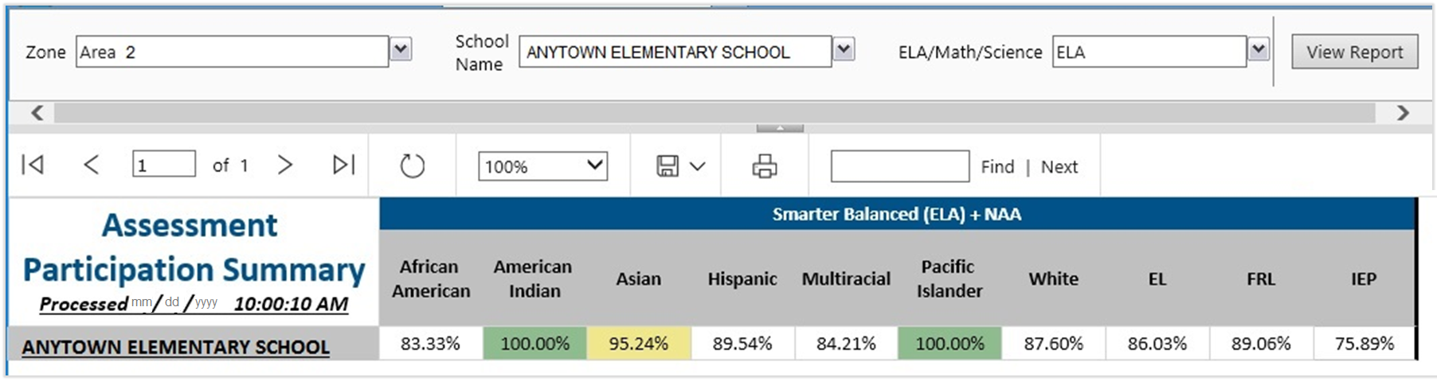
WCSD B.I.G. Report:
“NSPF Assessment Participation”
Assessment participation report tool for Elementary & Middle grades 3-8
Monitor participation status of currently enrolled students by content area assessment
Disaggregated by the 10 student subgroups reported in the Nevada School Performance Framework (NSPF)
TIP: B.I.G. report shows participation status defined for NSPF and may not match test completion status in DRC
Notes:
Informational Slide
Notes:
B.I.G./Business Intelligence Gateway functions within the WCSD network only and is accessible to active WCSD staff based on their hired position/role.
B.I.G. FAQs
If you have a question pertaining to report content or functionality:
--Please contact the Office of Accountability: OfficeOfAccountability@washoeschools.net
If you need to request different schools, change schools or remove schools from your BIG experience:
--Your rights in BIG are based on your right from Infinite Campus.
--Contact the IT Help Desk at 1.775.789.3456 and request that your Infinite Campus rights are updated. Once this change is made in Infinite Campus, your school view will change in BIG (typically, within 24 hours).

Slide 8


Training Notes
_NDE Test Security Procedures
_WCSD Primer (all testing staff)
_Usability, Accessibility, and Accommodations Guide (UAAG)
_NDE Test Security & Administration video (all personnel)
_Test Administrator's Manual (TAM)
_Test Coordinator’s Manual (TCM)
Resources to prepare for your role(s):
Training resources posted to the WCSD website
Assessment Program - Resources: https://www.washoeschools.net/Page/1247
Notes:
Testing Staff
SAY:
Before testing, all testing staff will review test security procedures. Test administrators should read the TAM in advance and tab or highlight pages containing the checklist and scripted read-aloud instructions.
Prepare for Test Administration:
_NDE Test Security Procedures
_WCSD Primer (all testing staff)
_Usability, Accessibility, and Accommodations Guide (UAAG)
_NDE Test Security & Administration video (all personnel)
_Test Administrator's Manual (TAM)
_Test Coordinator’s Manual (TCM)
Assessment > Testing Program - Resources: https://www.washoeschools.net/Page/1247

Slide 9
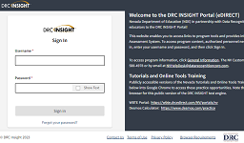
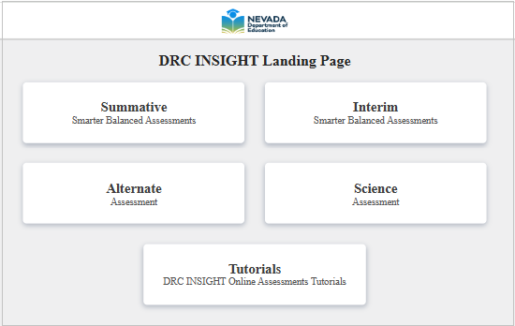


DRC Systems
STC
DRC INSIGHT Test Engine
Online test delivery system with lockdown security features
Installed on student computers in advance of the testing window
Accessed using a desktop icon
DRC INSIGHT (Nevada) Portal
Used by school and district personnel to manage technology for test administration, manage student information, test sessions and materials, and monitor student and test session progress
https://nv.drcedirect.com
Notes:
Testing Staff
SAY:
The DRC INSIGHT Portal and DRC INSIGHT Test Engine are secure systems used for the administration and delivery of the Nevada assessments. Security features protect student and test information to ensure the validity and reliability of assessment results.

Slide 10


Video Presentation
Presentation from the Nevada Department of Education (8 min)
NDE Test Security and Administration Training
https://www.washoeschools.net/Page/452
Notes:
Testing Staff
Testing staff and authorized district or state visitors must participate in test security training. Please view the Nevada Department of Education presentation on NDE Test Security and Administration Training.
Video, 11 minutes
Link: https://youtu.be/5WDSHXC1rOQ

Slide 11
Report Irregularities
Immediately report any confirmed or suspected testing irregularity, non-standard administration, or suspected student plagiarism.
Report Irregularities
  Report incidents to the School Test Coordinator (STC) or School Principal. The STC will relay details to Assessment Support and begin gathering statements and evidence.
  The STC submits details through an online report (Caveon form) with documentation.
  WCSD Assessment Support reviews and submits the report to the Nevada Department of Education.
Report of Testing Irregularity (WCSD): https://www.washoeschools.net/Page/14303
Refer to the WCSD Primer, NDE Test Security Procedures, and the Test Coordinator’s and Test Administrator’s Manuals for each administration.
STC
Notes:
Testing Staff
SAY:
When an irregularity is suspected, an appropriate first course of action is to pause all impacted tests until the incident is reported, investigated, and resolved. Do not dismiss students! Immediate reporting gives the student the best opportunity to continue testing with no impact.
If there is any doubt about whether an incident or behavior is permissible, either for students or adults, always check the Test Administrator’s Manual and seek clarification.
FORM: Report of Testing Irregularity (WCSD): https://www.washoeschools.net/Page/14303

Slide 12
Nevada Test Security
*protect the integrity of the assessment and investment of resources
*assure results are accurate and meaningful
Prior to administering any assessments, personnel will sign an acknowledgement of state assessment training and agreement of confidentiality.
All education personnel involved with testing must maintain the security of all materials including student responses, scratch paper, and student login tickets.
Test Directions and Scripts may not be altered. Strictly follow procedures.
Online tests are not to be viewed by anyone prior to students taking the test. Guard against the copying or recording of any test materials.
Except for the provision of some accommodations and the administration of the NAA, only students being tested are allowed to view assessment content.
Guardians, adult relatives and members of the same household of testing students may not be in the same testing room.
Notes:
Testing Staff
SAY:
The primary goal of test security is to protect the integrity of the assessment and to ensure that results are accurate and meaningful.
Uniform procedures are essential to a standardized testing program, and strictly following these procedures gives students the best guarantee of fair testing.
Additional Notes:
--Test security is integral in ensuring that no student has an unfair advantage or disadvantage in their assessment performance.
--Good test security protects the investment of resources, time, and energy put into the creation, distribution, and administration of the assessments.
--Testing staff must follow the same testing procedures and give instructions exactly as they appear in the TAM/TCM to ensure comparable scores.

Slide 13
Testing Environment
Electronics | Cell phones and “Smart” devices (students & staff) must be collected and stored prior to distributing test materials. Follow protocol for authorized “Medical Supports”.
Size of Test Session | Smaller group sizes provide better test conditions. Schedule at least one adult for every 30 students in a testing room.
Testing Room | The testing room must be free from distractions and have adequate light, ventilation, and heating or air-conditioning.
Seating | Use a seating chart and arrange seating to minimize the possibility of students communicating with each other verbally or visually.
Materials on Walls | Charts, posters, bulletin boards, etc., that provide guidance or information must be removed or covered with blank, opaque material.
Materials on Desks | Student desks or tabletops must be cleared of any materials not specified in the TAM. Material affixed to desks or tabletops must be covered with blank, opaque material.
Notes:
Testing Staff
SAY:
Ultimately, the goal of maintaining a secure testing environment ensures that no students have an unfair advantage or disadvantage during testing.
Security refers to:
Who has access to secure test materials
What students can see and hear while testing
What resources students can access while testing
Before Testing: remove or cover materials around the room and on desks, assign seating, post signs at every entrance to the testing room (“testing – do not disturb”)
During Testing: maintain a quiet environment and closely supervise students

Slide 14

Day of Testing
Test Administration Materials:
Test Administrator’s Manual with read aloud script
Testing Room Log Sheet for time-stamps and signatures (use new log sheet for each test session); all “visitors” must sign in, both planned and unplanned!
Test Session Roster – document attendance and test completion status
Test Tickets – one for each student on the room roster (remember to collect tickets immediately after students log in to their test)
List of students receiving designated supports or accommodations
Permissible materials and authorized support/accommodation materials
TIP: Scan the room and student workstations before starting a test session to ensure no materials were left behind by a previous class. Post a testing sign.
Notes:
Testing Staff
SAY:
Each day of testing, test administrators will check out materials from the school coordinator. Secure test materials must remain in the custody of a licensed educator trained in test security and test administration.
Before starting, scan the testing room and student workstations to ensure no materials were left behind by a previous class. Post a testing sign to prevent interruptions.

Slide 15
Test Status: “Locked”
Will lock overnight and must be completed during a single-day supervised administration:
  Science Test Part 1
  Science Test Part 2
  Summative Math Performance Task
  Summative ELA Performance Task Part 1 (Reading)
  Summative ELA Performance Task Part 2 (Writing)
  Summative ELA & Math with VSL, Dual Spanish, or Glossing
Will NOT lock and may be completed over multiple days:
  Summative CAT sessions (ELA & Math)
  NAA (subjects: ELA, Math, Science)
Appropriate rationale and documentation required for the district to unlock tests.
TIP for NAA and paper administrations: Complete transcribing responses for all parts of a session within the same day.
Notes:
Testing Staff
SAY:
--"CAT" sessions for ELA & Math will remain "open" until the student finishes the last item.
--Students cannot log back into a test after it is submitted. If a student unintentionally submits a test part before responding to all questions, the part can be re-opened only if the student has been continuously supervised and not dismissed from the testing period.
--If not submitted the same day they are started, parts for fixed-form test sessions will lock overnight to maintain security.
--Subject tests for the NAA will also lock after being submitted.
--Assessment Support may unlock tests for justifiable reasons under certain circumstances.

Slide 16
Administration Error
  These types of incidents are preventable!
Student logs in using another student’s ticket
  Stop testing and alert School Test Coordinator. Assessment Support will contact DRC to determine status of the student’s test and consult about next steps.
Student begins testing without required accommodation
  Stop testing and alert School Test Coordinator. Do not let the student continue testing without the appropriate accommodation. Note the test session, start & stop times, and number of items completed (if known).
  DOCUMENTATION will be requested (time-stamps, statements from testing staff, explanation of error).
BEFORE testing, verify accommodations and designated supports are provided
  Online/Presentation: Test ticket will indicate the pre-selected accommodation(s) or designated support. The student’s welcome screen (after login) will also specify the accommodated test form.
  Non-embedded: List accommodations students will use and provide information and materials to test administrator.
Notes:
Testing Staff
SAY: (read slide)

Slide 17
Emergencies
Evacuations, lock-downs, technical issues:
  Continue supervision; students may not access personal items.
  When testing resumes, students must not re-view items (same for online/paper administrations); test administrators/proctors will circulate and closely monitor students.
Student becomes ill during testing (“fixed-form” ELA PT, Math PT, Science, paper administrations):
  If a student becomes ill during testing, the decision to unlock a test or allow the student to resume the test is made on a case-by case basis.
  DOCUMENTATION will be requested (time-stamps, statements from testing staff, details of procedures followed).
Notes:
Testing Staff
SAY: (read slide)
Decisions to unlock a test are considered on a case-by-case basis. There is no “universal” procedure that guarantees a test will be unlocked following an incident.

Slide 18
Science
Grades 5, 8, & High School
Smarter Balanced Summative
Grades 3-8
General Nevada Assessments
Notes:
Testing Staff

Slide 19

BEFORE
Student Testing Device Check
COS Service Device (“server”) must be powered on and connecting to internet. Check regularly and restart periodically to ensure device “health”.
Student Device Check…on a student computer used for testing, look for the DRC INSIGHT application. This is the secure browser students will use to take the assessments.
1._Launch DRC INSIGHT testing browser
2._Select “Nevada” (opens to DRC INSIGHT Landing Page)
3._Select administration: Summative or Science
Summative >> select “Online Tools Training”, subject (ELA or Math), grade level 3-5 or 6-8
Science >> select “Online Tools Training”, subject (Science), grade 5, 8, or HS
4._Document and report error messages and associated device tag/identifier.
Notes:
Testing Staff
SAY: (read slide)

Slide 20


How to Access
Practice Opportunities
OTT=Online Tools Training
OTT and Practice Tests can be accessed from any computer with the INSIGHT Test Engine installed.
Public versions available. Copy the link below into an open browser to access the web-based test engine.
https://wbte.drcedirect.com/NV/portals/nv
Prepare students to navigate the test without assistance and independently use the tools, and access “Help”
          Show students how to use “Help”.
          Review test directions.
          Practice embedded designated support or accommodation.
          Students should be comfortable with the test engine, navigation, and online tools.
Notes:
Testing Staff
SAY:
The Online Tools Training and practice tests can be accessed from any school computer with the DRC INSIGHT test engine installed. This is the same browser used for WIDA ACCESS. A web-based version is available for public use. Students should practice with the OTT prior to the test date because no assistance may be given during testing.
The practice tests can provide data that may be useful in determining whether a student might benefit from the use of a particular designated support or accommodation. Students should have ample opportunities to use designated supports and accommodations in daily instruction that they will use during testing.

Slide 21
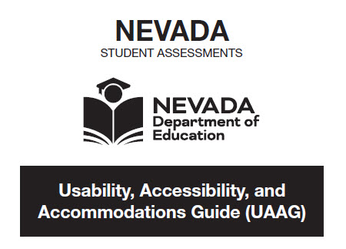
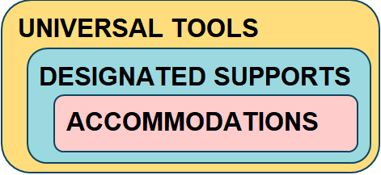
Usability, Accessibility, and Accommodations Guide (UAAG)
Assessments
Nevada Science
Smarter Balanced Summative ELA
Smarter Balanced Summative Math
When used in a manner consistent with the UAAG (guidelines), universal tools, designated supports, and accommodations all yield valid scores that count as participation in assessments that meet the requirements of ESSA.
Notes:
Testing Staff
SAY:
The Usability, Accessibility, and Accommodations Guide describes test tools, features, supports, and accommodations allowed on the Nevada general assessments.
When used in a manner consistent with the UAAG, universal tools, designated supports, and accommodations all yield valid scores that count as participation in assessments that meet the requirements of ESSA.

Slide 22
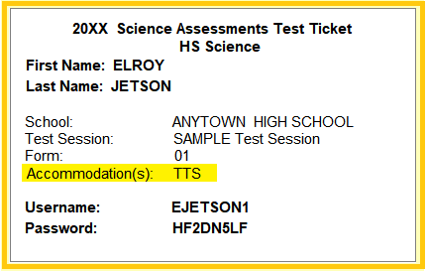
Pre-Selected Accommodations/Designated Supports
Selected in DRC portal (Student Management) BEFORE student is added to test session(s)
DRC selected online and presentation accommodations and designated supports indicated on the test ticket and session roster
IMPORTANT!
Do not allow a test to be started if the DRC selected online or presentation accommodation/designated support is incorrect or missing from the ticket
Notes:
Testing Staff
SAY:
Online and presentation accommodations and designated supports must be selected in DRC INSIGHT before printing test tickets. Students must not begin a test if their online or presentation accommodations or designated supports are not indicated on their test ticket.
Test administrators should verify the accommodation or designated support on a student’s login ticket. If the ticket is not correct, do not allow the student to log in/start and notify the school test coordinator. The test coordinator will contact Assessment Support and request a new test login ticket for the student.

Slide 23
Accommodations:
Individualized Education Program (IEP) and Section 504
UNIVERSAL TOOLS (Step 1)
DESIGNATED SUPPORTS (Step 2)
ACCOMMODATIONS (Step 3)
Adaptations or adjustments to testing conditions for students with a documented disability.
Allowed accommodations used during testing
  must align with the accommodations section of the IEP or 504 Plan, and
  should be used regularly by the student to access classroom instruction and assessments.
New accommodations or changes to a student’s accommodations must be documented and implemented at least 30 days prior to the start of testing.
Notes:
Testing Staff
SAY:
Students should ONLY use testing accommodations and other accessibility supports that they have experience with and that align with those used regularly to access classroom instruction and assessments.
Failure to provide the testing accommodations required by the student’s IEP/504 plan may result in the invalidation of the student’s test score.

Slide 24
Designated Supports
Including supports for English Learners
UNIVERSAL TOOLS (Step 1)
DESIGNATED SUPPORTS (Step 2)
ACCOMMODATIONS (Step 3)
Accessibility features permissible for use by a student for whom the need has been identified by a team of educators, including the student and their guardian.
Designated supports should align with classroom supports used regularly by a student to access instruction and assessments.
Follow a consistent process for determining designated supports.
Professionals familiar with the student and the types of supports available should advise during the decision process.
Notes:
Testing Staff
SAY:
Designated supports are tools and features permissible for use by a student for whom the need has been identified. Educators should follow a consistent process in determining designated supports for individual students.
Students should ONLY use designated supports that they have experience with and that align with classroom supports used regularly to access instruction and assessments.

Slide 25
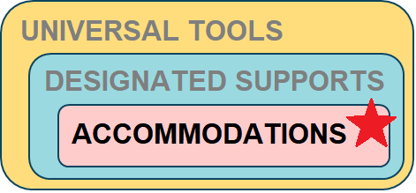
Accommodations: Preselected in DRC INSIGHT
Must be documented in student’s IEP/504 plan and on the NDE testing accommodations form for IEP and 504.
Online and Presentation accommodations selected in DRC INSIGHT portal—
Text-to-Speech (TTS) for ELA, Math, and Science directions, questions, and answer options; Math and Science stimuli and items
Text-to-Speech with ELA reading passages (fewer than 2% in grades 6, 7, 8)
Speech-to-Text (specify integrated or non-embedded; use own AT)
Word Completion, non-embedded; use own AT
Video Sign Language (VSL) for Math and Science
Closed Captioning (CC) & Video Sign Language (VSL) for ELA listening passages
Paper: Braille, Large-Print (18-pt), Paper/Print on Demand (standard font-size)
Review UAAG guidelines on other non-embedded accommodations (e.g., 100s Number Table, Multiplication Table 1x12)
Notes:
Testing Staff
SAY:
Accommodations must be documented in a student’s IEP or 504 plan and on the current year NDE testing accommodations form.

Slide 26

Accommodations: Speech-to-Text/STT
Must be documented in student’s IEP/504 plan and on the NDE testing accommodations form for IEP and 504.
Speech-to-Text (STT), 1:1
Selected in portal before printing test ticket(s); integrated or non-embedded.
Integrated (1-device): Student will use their own assistive technology with specially installed* DRC INSIGHT “permissive mode” version; allows responses to be recorded directly into the test engine. (*IT support)
Non-embedded (2-devices): Student will use their own assistive technology (AT) device; student responses must be transcribed into the DRC INSIGHT test engine by the test administrator or school test coordinator.
Notes:
Testing Staff
SAY:
Integrated or non-embedded speech to text is available for students using this accommodation.

Slide 27
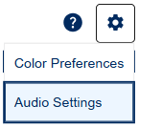


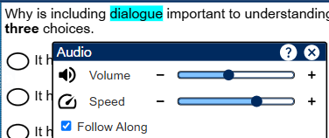
Designated Support/Accommodation: Text-to-Speech (TTS)
Text-to-Speech/TTS
Student controls for TTS
  select Options and Audio Settings
  increase or decrease voice volume and speed
  disable or enable “Follow Along” highlighting of text
Notes:
Testing Staff
SAY:
Text to speech or “TTS” is an embedded feature where text on the screen is read by human voice audio in English. This embedded feature is available for all content areas. TTS is available as a designated support for ELA, Math and Science directions, questions, and answer options but not ELA reading passages. A limited number of students may qualify for TTS accommodation on the ELA assessment in grades 6-8 which includes passages.
Students using text to speech should practice with this feature through the OTT training tests.

Slide 28
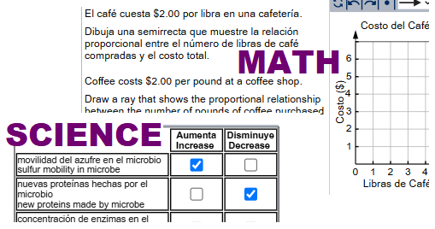

Designated Supports: Translation (fixed form sessions lock overnight)
Dual Language Spanish/English for Math and Science; Spanish translations of directions, test questions, and answer options followed by English text
Human Voice Audio reads the Spanish text; no text follow along
Glossing in Cantonese, Spanish, or Tagalog for Math and Science; selected construct-irrelevant terms presented in a pop-up window in the pre-selected language
Notes:
Testing Staff
SAY:
Language translation supports are available for Math and Science assessments only. Students respond in English.
Dual language Spanish translation is a designated support where text appears in Spanish and English. This may be appropriate for students proficient in reading Spanish.
Human voice audio in Spanish is available with the dual language Spanish designated support. Audio is enabled for the Spanish text only.
Glossing is available in Cantonese, Spanish, or Tagalog languages only.

Slide 29
Student Equipment Required for Testing
*Monitor and track use of scratch paper. Collect and separate used scratch paper. All used scratch paper must be shredded after testing (securely destroyed).
Content Area | Required Equipment & Materials
ELA | Headphones are required for ALL students during the ELA CAT session. | Scratch paper* (and pen/pencil) required for all grades; scratch paper may be plain unlined, lined, or grid-only (unlabeled) graphing paper. *See UAAG for accommodations. Headphones required for students using embedded TTS/text-to-speech or Spanish dual language with audio.
Mathematics | Graph (or grid-only) paper* is required for the mathematics sessions in grades 6, 7, & 8.
Science
Notes:
Testing Staff
SAY:
Some materials will be required for all students. The test administrator’s manual (TAM) describes materials and supplies allowed or not allowed during a test session.
1)_Tests with Audio: Make sure audio is functional and headphones are working before a student starts their test.
--All students will need headphones for the ELA CAT session.
--Students using text-to-speech or the Spanish dual language with audio will require headphones for those assessments.
2)_Scratch Paper: All students should be provided clean scratch paper at the start of each scheduled testing period. Test administrators and room proctors must closely monitor use of scratch paper. Used scratch paper must be kept secured and is collected and returned to the school test coordinator for shredding.
--Graph paper or grid only paper is required for the math test sessions in grades 6, 7, and 8.
--Return used scratch paper to the school test coordinator for secure disposal.

Slide 30
Types of Test Questions
Multiple-choice response: four response options with only one correct answer.
Multiple-select response: multiple-response options with one or more correct answers. The test question does not always tell how many options should be chosen.
Technology enhanced: questions that may include drag-and-drop, graphing, drop-down menus, and matching.
Written-response questions: questions that will require the student to answer by typing their response in the space given.
(none on HS Science)
Notes:
Testing Staff
SAY:
Practice opportunities help expose students to the different types of test questions. Students may see multiple choice, multiple select, technology enhanced, and written response questions.
Science includes sets of items tied to a scenario. ELA includes items tied to a set of reading passages.
High school science does not include written-response questions.

Slide 31
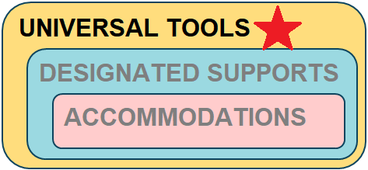
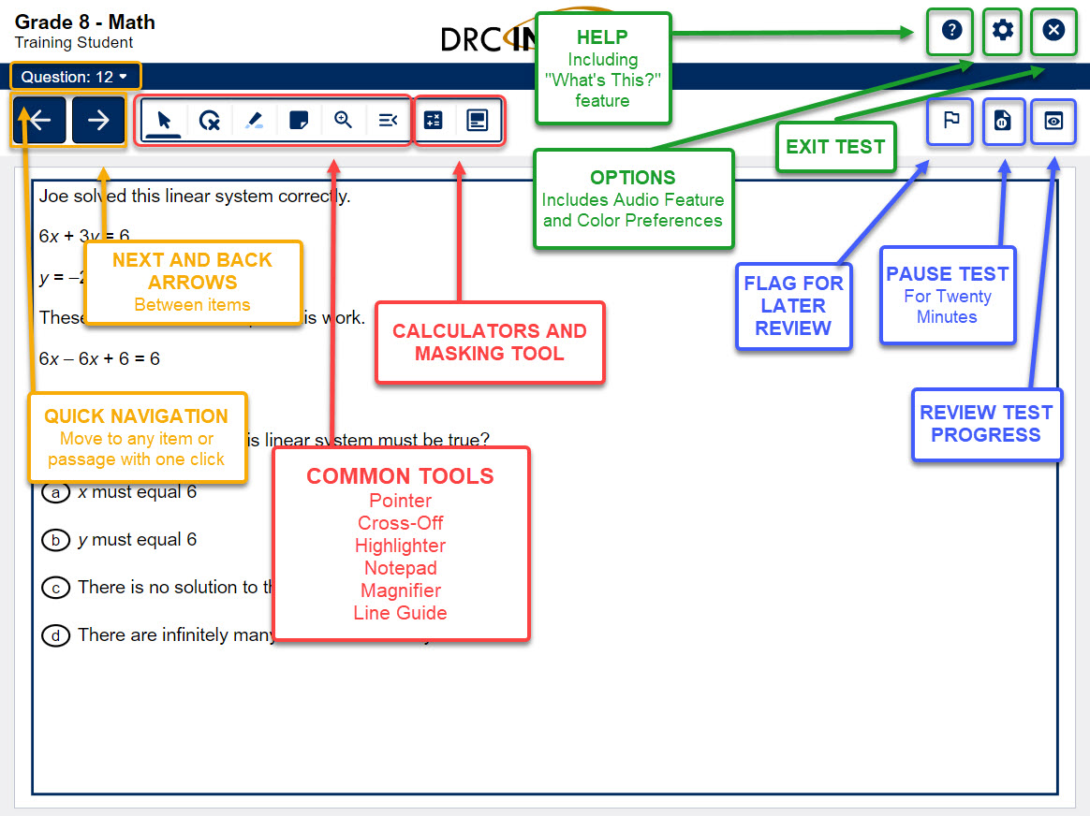
Universal Tools in DRC INSIGHT
Universal tools are available to all students taking the assessment.
The test administration manual (TAM) describes non-embedded materials allowed or not allowed during testing.
Notes:
Testing Staff
SAY:
Universal tools are available to all students taking the assessments. Students can try out these tools when they go through the training tests.

Slide 32
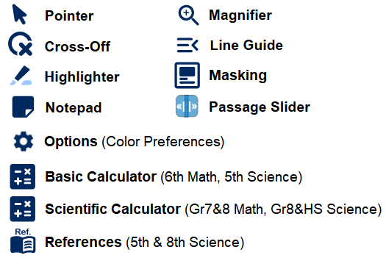

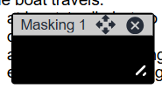
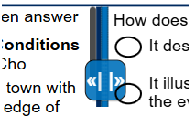
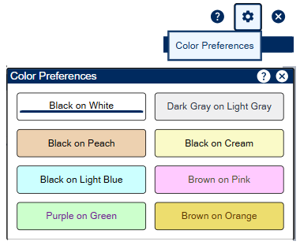
Online Tools for All Students
Notes:
Testing Staff
SAY:
All students taking the same assessment will have use of these tools: Pointer, Cross-Off, Highlighter, Notepad, Magnifier, Line Guide, Masking, Passage Slider, Options (Color Preferences), Basic Calculator, Scientific Calculator, References

Slide 33
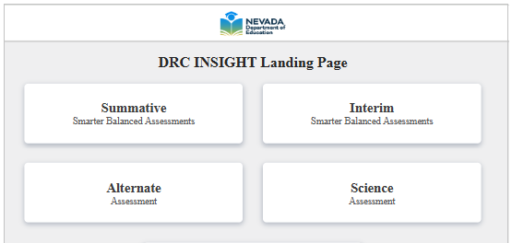
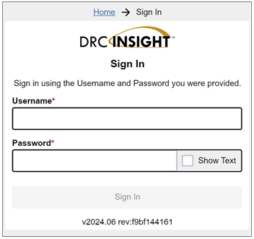
DRC INSIGHT Landing Page, Log In Screen and Test Ticket
Notes:
Testing Staff
SAY:
Students log in to live assessments with a unique username and password indicated on their secure test ticket. Verify the test ticket lists correct online or presentation accommodations for the student before distributing tickets.
If a test ticket login is not working, check that the correct administration is selected. A student’s test login for Science will not work in the Summative administration and vice versa.

Slide 34
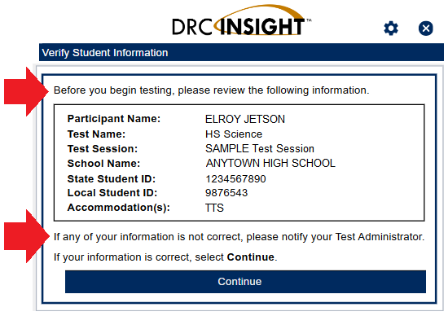

DRC INSIGHT: Welcome Screen
Read-Aloud Instructions to Students
Look at the information on the Welcome screen and make sure that the following facts
about you are correct:
• Your first name, middle initial (if available), and last name
• Your test name
• Your test session
• Your school name
• Your State Student ID
• Your Local Student ID (if available)
• Accommodation(s) (if available)
…If the information is not correct, raise your hand.
Verify students are logged in under the correct name.
When exited at this point the test will not be started.
Notes:
Testing Staff
SAY:
The training and practice tests are set up just like the live assessments. When practicing with students, teachers can read aloud the directions just as if they were going through it in a secure testing scenario.

Slide 35
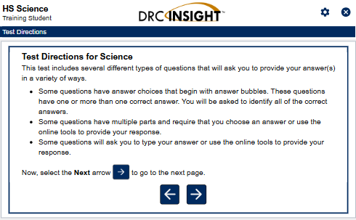
DRC INSIGHT: Test Security and Test Directions
Review with Students!
Test Security screen:
In order for the results to be valid, you must not
• give or receive help.
• view another student’s testing device for answers or allow another student to
view yours.
• use your cell phone or other electronic devices or take pictures or screenshots.
• cause a disturbance of any kind.
• remove test tickets and scratch paper from the room.
• discuss the test with anyone.
Before seeing any test questions, students will go through screens containing information and instructions.
The Test Administrator will read the instructions aloud from the Test Administrator’s Manual (TAM).
Notes:
Testing Staff
SAY:
During training and practice tests the information on each screen may be discussed with students. Teachers will read these directions from the test administrator’s manual (TAM) while students follow along on their computers.

Slide 36
Navigation: Science, ELA PT and Math PT (Fixed Form)
Within a test part, students may navigate forward through questions and go back to review questions/answers.
Students may skip to the next question without answering the current question.
A Review Screen shows which questions have not been answered and students may go back those items.
When finished, the student clicks on “End Test.”
A pop-up box will ask the student to confirm they have completed their test and click on the “Submit” button.
After submitting, the test or test part will be locked.
Notes:
Testing Staff
SAY: (read slide)
The OTT (training tests) model fixed form navigation. Tests that are fixed form include Science and the performance tasks in ELA and Math.
--Within a test part, students may navigate forward through questions and go back to review questions/answers.
--Students may skip to the next question without answering the current question.
--A Review Screen shows which questions have not been answered and students may go back those items.
--When finished, the student clicks on “End Test.”
--A pop-up box will ask the student to confirm they have completed the test and click on the “Submit” button.
--After submitting, the test or test part will be locked.

Slide 37
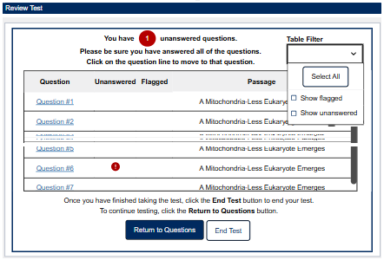
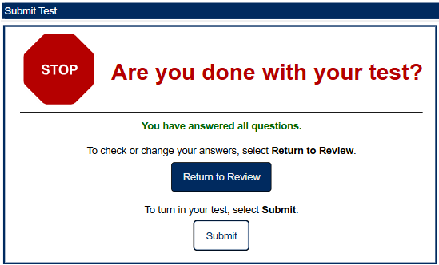
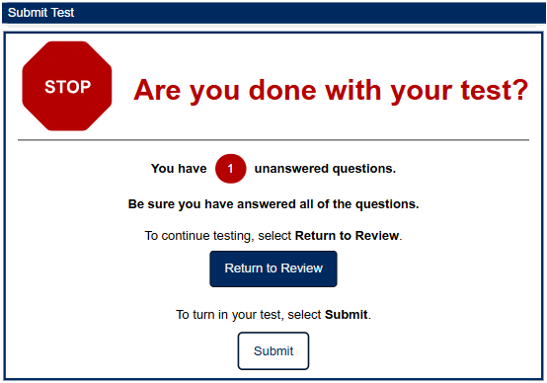

Review, End Test, and Submit: “Fixed Form”
Performance Task, Science, ASL/VSL & CC, Dual Language Spanish, Glossing
“You have answered all questions.”
“Are you done…? You have [#] unanswered questions.”
Notes:
Testing Staff
SAY:
Here’s an example of the review/end test screen and submit process for fixed form non-adaptive assessments.

Slide 38

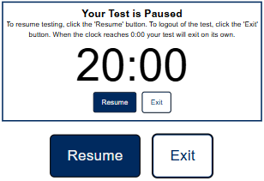
Pausing the Test
*Students should request permission to use the pause feature and be directed when to do so.
A student can pause an active test for up to 20 minutes by clicking on the Pause button.
If they return within 20 minutes, the student should click on Resume to continue testing.
Students (and paused devices) must be monitored.
If a break exceeds the set 20-minute mark AND the student was supervised, the test administrator may allow the student to log back in by providing the student with their test ticket/login details.
Notes:
Testing Staff
SAY:
Use the training tests to try out pause and resume actions…

Slide 39
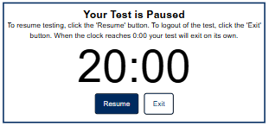
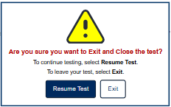

Exiting the Test (before completing)
*Monitor for students exiting and logging back in to their test.
A test may need to be exited for the following reasons:
  Taking the CAT (ELA, Math) over multiple days
  Moving a student; changing computers
  Testing irregularity (e.g., emergency evacuation, student illness, interruption)
To exit a test:
click “Pause”
on the timer screen click “Exit”
next screen click, “Exit”
Notes:
Testing Staff
SAY:
…and how to exit before completing a test.

Slide 40
Two Categories of Test Questions
  Operational Questions
  Included in test results
  Majority of test questions
  Proven performance on past tests
  Field Test Questions
  Not included in test results
  Newly written test questions being tried for future test administrations
  Only a few questions per student interspersed throughout
ELA & Math (Summative Smarter Balanced) – all operational questions
Science – mix of operational and field test questions
Notes:
Testing Staff
SAY:
Student scores and reported results are based on “operational” test items only. These are test questions that have been through rigorous performance and bias review. On the science assessment students will not know whether an item is an operational or field test question.

Slide 41

Grades 5, 8, HS
Science
SCIENCE
Test content developed by DRC and reviewed by Nevada educators
Aligned with the Nevada Academic Content Standards for Science (NVACSS) based on the NGSS
Assessed Topics
  Integrated relevant science practices and concepts and…
  Grades 5 and 8: Life, Physical, and Earth Sciences
  High School: Life Science/Biology
Students participate in the HS Science assessment during grade 9 or 10 only
NGSS = Next Generation Science Standards
Notes:
Testing Staff
SAY:
Developed specifically for Nevada, the Science assessments emphasize applying understanding to scenarios and related questions.
Additional notes:
1._Developed by DRC, test questions are reviewed by Nevada Educators to ensure test content is aligned with the standards, accurate and appropriate for the grade level, and free of bias.
2._The test is aligned with the Nevada Academic Content Standards and Next Generation Science Standards
https://doe.nv.gov/offices/office-of-teaching-and-learning/science (accessed JAN 2025)

Slide 42

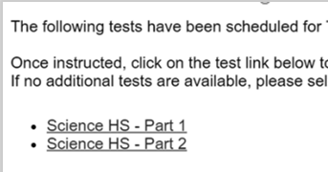
Science:
Test Parts and Estimated Testing Time
Science Assessment – Estimated Testing Times
(for planning purposes)
Session/ Parts | Details | Time | Rules
Science Part 1 | 21-26 questions | 1 hour | Must be completed on a single day; no unsupervised breaks
Science Part 2 | 20-24 questions | 1 hour | Must be completed on a single day; no unsupervised breaks
The Science test is a fixed form test, not adaptive (not “CAT”).
Test parts can be administered on the same day or on separate days.
Students cannot resume a test part on a subsequent day or after an unsupervised break.
Confirm students have selected the correct part for the scheduled testing period. (however, order doesn’t matter)
Notes:
Testing Staff
SAY:
Science assessments are two parts. The parts may be completed on separate days, with a full break between, or back-to-back within the same supervised testing period. Once a part is started it must be completed in a single supervised testing period. Here again, students working productively should be given time to complete the test part or session.
TIP: If a student starts part 2 before starting part 1, let them finish the started part. The order doesn’t matter, only that the student finishes one part before starting the other part.

Slide 43

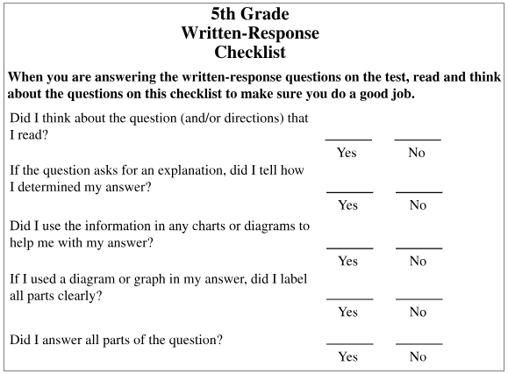
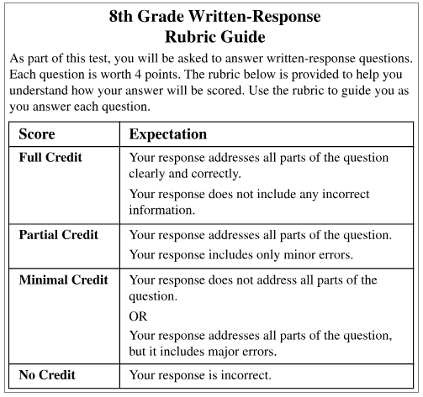
SCIENCE 5 & 8
Test Specific Tools for All Students
References: Written-Response Checklist & Rubric Guide
Grade 5 Science
Written-Response Checklist
Grade 8 Science
Written-Responses Rubric Guide
Notes:
Testing Staff
SAY:
The grade 5 and grade 8 science assessments include written response items. An online reference page is an available tool for these tests. Paper copies are not permitted for online administrations. High school Science does not include written-response items.

Slide 44

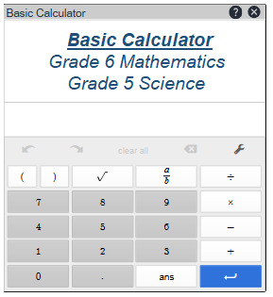
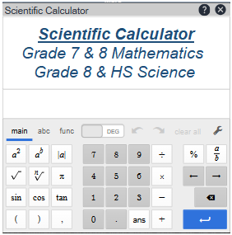
DESMOS Calculator
MATH 6-8, SCIENCE
Test Specific Tools for All Students
22
Grade 6 Math and Grade 5 Science
Basic Calculator: perform calculations involving addition, subtraction, multiplication, and division
Grade 7 & 8 Math and Grade 8 & HS Science
Scientific Calculator: perform calculations involving square root, exponential, logarithmic, trigonometric, and factorial functions, and basic calculations involving addition, subtraction, multiplication, and division
DESMOS Calculator (practice): https://calculator.smarterbalanced.org
Notes:
Testing Staff
SAY:
Embedded Desmos calculators are a universal tool when allowed for the test or test question. The calculator tool may not be available on all test items.
A basic calculator is available on the grade 5 Science test and for some items on the grade 6 Math test.
A scientific calculator is available on the grade 8 and high school Science tests and for some items on the grades 7 and 8 Math tests.
Students can practice using the embedded Desmos calculators within the training tests or by accessing the link shown.

Slide 45

Grades 3-8
Smarter Balanced Summative for
ELA & Math
Smarter Balanced Assessment Consortium
Members: CA, CT, DE, HI, ID, IN, MI, MT, NV, OR, SD, WA, VI, BIE
English Language Arts/Literacy (ELA), Mathematics
Test content provided by Smarter Balanced
Aligned with the Nevada Academic Content Standards (NVACS) based on the CCSS
Smarter Balanced TRANSPARENCY | Content Specifications | Item Specifications
Test Blueprints | Content Specifications | Item Specifications
Number of items Score points (weighting) Depth of Knowledge/DOK | List of assessment targets Identify which standard each target assesses | By grade level, claim, and target Task Models; stems for items
contentexplorer.smarterbalanced.org
CCSS = Common Core State Standards
Notes:
Testing Staff
SAY:
Nevada is one of several member states utilizing the Smarter Balanced assessments to measure academic achievement of students in grades 3 through 8.
**Content Explorer… https://contentexplorer.smarterbalanced.org/ (accessed JAN 2025)
Smarter Balanced is committed to an unprecedented level of transparency, so that anyone who is interested can see exactly how the test is made.
Content Explorer features:
--Tool for educators; available to public
--Filter by grade, subject, claim, target, and standard
--See how test items connect to academic standards
Additional notes:
1._The test is aligned with the Nevada Academic Content Standards based on CCSS
https://doe.nv.gov/offices/office-of-teaching-and-learning (accessed JAN 2025)
2._Test questions are provided by the Smarter Balanced Assessment Consortium
Smarter Balanced Members: California, Connecticut, Delaware, Hawaii, Idaho, Indiana, Michigan, Montana, Nevada, Oregon, South Dakota, Washington, US Virgin Islands, Bureau of Indian Education
3._Visit Smarter Balanced Content Explorer for test blueprints
https://contentexplorer.smarterbalanced.org/test-development#blueprints (accessed JAN 2025)

Slide 46
ELA and Mathematics Adjusted Form
Test Sessions and Estimated Testing Time
Smarter Balanced Summative – Estimated Testing Times
(for planning purposes)
Session/ Part | Details | Time | Rules
ELA CAT* | 20-22 questions | 45 min | Can be completed across multiple testing days
ELA PT (fixed form) | Two parts; same pieces of source material (passages) presented in both parts > Part 1 – 1 question > Part 2 – 1 extended written response item | 2 hours | Each part (reading, writing) must be completed on a single day; no unsupervised breaks
Math CAT* | 16-17 questions | 45-60 min | Can be completed across multiple testing days
Math PT (fixed form) | One part with 4-6 items | 1 hour | Must be completed on a single day; no unsupervised breaks
ELA PT Part 1 is intended to be completed before starting ELA PT Part 2.
The Summative Assessments in ELA and Mathematics have both CAT* and fixed form test sessions.
*Fixed form only versions: VSL, Dual Language Spanish, Glossing, paper
CAT=Computer Adaptive Test
PT=Performance Task
Notes:
Testing Staff
SAY:
The ELA and Math content assessments are each split in two sessions, an adaptive (CAT) session and a performance task (PT) session. Within the ELA performance task there are two parts.
During the performance tasks students must be supervised from start to finish. The CAT sessions may be given over multiple days.
Test sessions are not timed and students who are working productively should be given time to complete the session. Estimated testing times are based on past administrations.
Schools may decide the order for the test sessions; however, on the ELA performance task, part one “reading” should be completed before starting part 2 “writing”. Remember, each part of the ELA performance task must be completed during a single supervised testing period.
Note, online assessments with video sign language or closed captioning, dual language Spanish, or glossing, and paper administrations are fixed form. Each “session” must be completed in one supervised testing period.

Slide 47
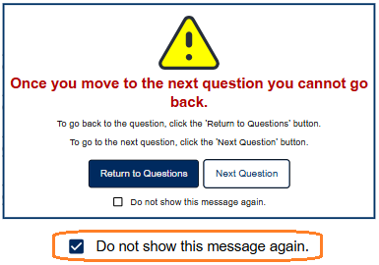
Navigation: ELA and Mathematics CAT Sessions (Adaptive)
Students cannot skip test questions. A question must be answered before advancing to the next item.
After advancing, students cannot return to a previous test question or passage set.
Moving to the next question – CAT/Adaptive
Student responds to question and clicks “Next”
Pop-up message warns, “you cannot go back”
Pop-up will appear after every question or question set.
TIP: Check box “Do not show…” to disable pop-up on subsequent questions.
Notes:
*
SAY:
The ELA and Math CAT sessions are adaptive. This type of testing experience is modeled in the Summative Practice Tests.
In the CAT, students cannot skip test questions and must answer each question or all questions in tied to a passage set before advancing to the next item. Students will see a pop-up message warning them they cannot go back to the previous test question once they move to the next question. This pop-up can be disabled by the student during the test.

Slide 48
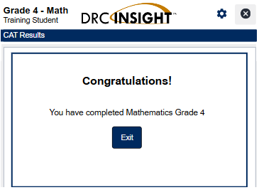
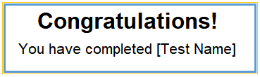
Finishing the CAT (Computer Adaptive Test – ELA, Math)
After completing the last question, the CAT will automatically end, and the student cannot re-enter the test.
TIP: A student may exit from the “congratulations” screen without realizing the test ended. If a student cannot log back into the CAT, the test is completed. Check with the STC who can verify test status in the DRC INSIGHT portal.
Notes:
Testing Staff
SAY:
After the final question on the CAT, the test automatically ends, and the student cannot re-enter the test. Note, a student may close their test without realizing they finished. If the test ticket doesn’t allow a student to log back in, their test has been submitted.

Slide 49

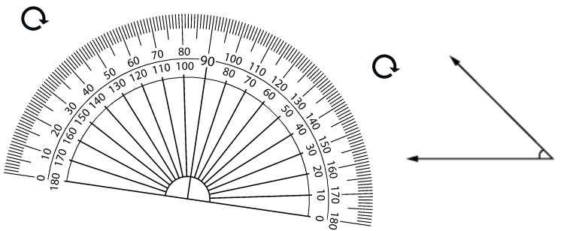
MATH Grade 4
Test Specific Tools for All Students
Measurement Tools: Protractor
Grade 4 Math
Protractor tool for measuring angles.
Available only with the specific items for which the Smarter Balanced Item Specifications indicate that the digital math tool would be appropriate.
TIP: Access items that use a protractor tool in the Summative “Practice Tests” for Grade 4 Mathematics.
Notes:
Testing Staff
SAY:
A protractor tool is available for specific items on the grade 4 Math assessment. This tool is available in the Grades 3 to 5 Math OTT (Online Tools Training).

Slide 50
Types of Test Questions – Summative ELA
ELA CAT
Listening: Students will listen to a passage and then respond to questions about the passage.
Extended written-response: Students will produce an on-demand writing sample related to a reading passage.
ELA PT
Writing, part 2
Notes:
Testing Staff
SAY:
For ELA only, there will be listening items during the CAT session and one on-demand extended writing item in the PT (performance task) session.

Slide 51
ELA Listening Questions
All students will require wired headphones for the ELA CAT.
ELA CAT: Student will confirm sound is working before starting test.
Notes:
Testing Staff
SAY:
Students will confirm their headphones and computer audio are working as part of the directions on the ELA CAT session.
Test administrators and room proctors may not assist students with test questions, online navigation, or audio controls during the actual test. The Summative ELA training tests include one or more listening items for students to practice.
**No Bluetooth or wireless headphones.

Slide 52
Scratch Paper – Special Instructions for ELA PT
ELA Performance Task
*Monitor and track use of scratch paper. Collect and separate used scratch paper. All used scratch paper must be shredded after testing (securely destroyed).
Scratch paper* (and pen/pencil) required for all grades; scratch paper may be plain unlined, lined, or grid-only (unlabeled) graphing paper. (*See UAAG for allowed accommodations.)
ELA Performance Task only…
Scratch paper from the ELA PT Reading session may be collected, securely stored, and made available to a student for the ELA PT Writing session.
The student’s name and other identifying information must be clearly indicated on the used scratch paper from the ELA PT Reading session.
Be careful to distribute used scratch paper to the correct student before beginning the ELA PT Writing session.
Notes:
Testing Staff
SAY:
Test administrators and room proctors must closely monitor use of scratch paper. Used scratch paper must be kept secured and is collected and returned to the school test coordinator for shredding.

Slide 53

Writing Prompt Tools
ELA PT part 2
Test Specific Tools for All Students
22
Summative ELA Performance Task
Extended written response (ELA PT part 2)
Online formatting tools: Undo, Redo, Cut, Copy, Paste, Bold, Italic, Underline, Indent, Outdent
ELA Writing Task Tips
Limited to 10,000 characters including spaces; approximately 1600 words or 3.5 pages single-spaced
PRACTICE using online tools for the Extended Written Response
Start from the DRC INSIGHT Landing Page
Select: Summative > Practice Tests
Choose: English Language Arts > select grade level > Continue
Select test link: Grade X – ELA Performance Task
Click next [→] repeatedly, then [Begin The Test] and go to Question 4
Notes:
Testing Staff
SAY:
During the ELA performance task students will produce an on-demand writing sample. Students will have access to standard formatting tools. Refer to the steps to locate writing tools for practice.

Slide 54


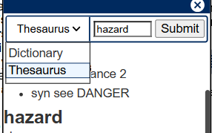
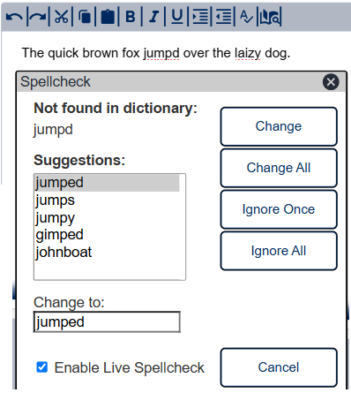

Spellcheck, Dictionary and Thesaurus
ELA PT part 2
Test Specific Tools for All Students
22
Summative ELA Performance Task (PT)
Dictionary/Thesaurus
Spellcheck
Notes:
Testing Staff
SAY:
In addition to formatting tools, students can access an online dictionary and thesaurus and spellcheck for the ELA on-demand writing item.

Slide 55
Nevada Alternate Assessment (NAA)
Grades 3-8 & 11
Notes:
Testing Staff

Slide 56
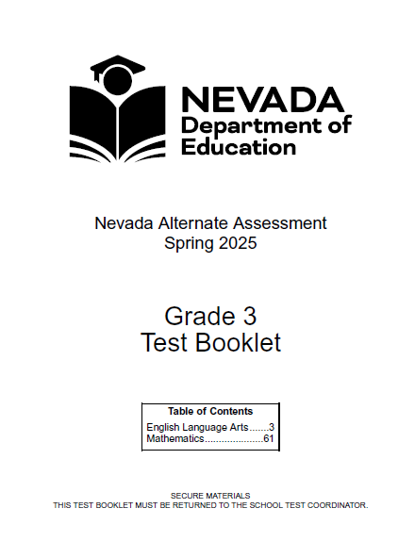
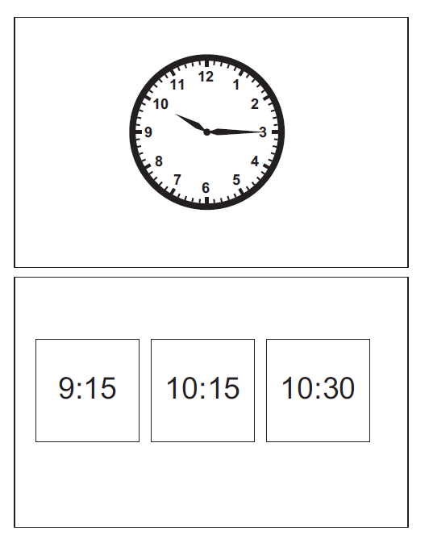
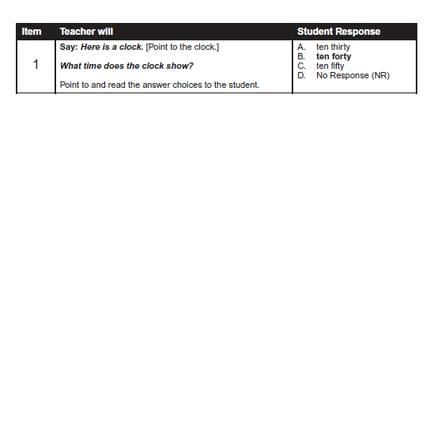
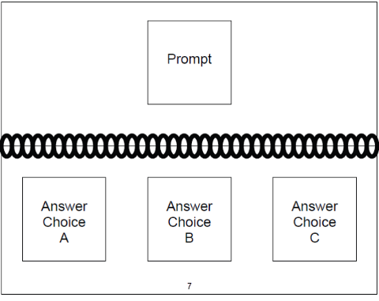
NAA: Test Material Kits
Schools receive 1 grade-specific test kit for every 3 students.
Each grade-specific test kit contains the following items:
  Test Booklet (this is the teacher’s book)
  ELA Student Response Booklet
  Mathematics Student Response Booklet
  Science Student Response Booklet (Grades 5, 8, and 11 only)
Special Request Accommodated Materials – STC contact WCSD Assessment Support
  Single-Sided Student Response Booklets are printed on card stock and packaged unbound so pages can be cut apart to align with the student’s response mode (e.g., eye gaze or picture exchange).
  Braille Translations of Independently Read ELA Passages are available for students who are visually impaired and can read contracted braille.
IMPORTANT: Accommodations must align with what the student uses during daily classroom instruction and must be documented in the IEP. Allowable accommodations are outlined on pages 34–38 of the TAM.
Notes:
Testing Staff
SAY:
Immediately following delivery, check to ensure receipt of test kits for all grade levels needed.​ Ensure students are provided accommodations as documented in their IEP and allowed for the assessment.
>>>
Reference Information
--Universal Tools may already be embedded in the assessment or can be provided to all students regardless of disability or ELL status.
--Presentation Accommodations are for students who require special accommodations to access the assessment. These accommodations must be documented in the student’s IEP and used during daily classroom instruction.
--Response Accommodations are for students who require special accommodations to respond to items during the assessment. These accommodations must be documented in the student’s IEP and used during daily classroom instruction.

Slide 57
NAA: Test Security
The NAA is a secure, standardized assessment that must be administered as consistently as possible.
The following steps must be taken to track and safeguard the security of test materials:
  Locked, secure storage must be provided for all secure testing materials.
  Locked storage must be accessible to only the Principal, School Test Coordinator, and assigned Test Administrator(s).
  Never copy, reproduce, photograph, or take notes on test items. Disclosure of test content is strictly prohibited by state law.
  All transfers of secure test materials must be documented.
  Aat the end of the test administration ALL materials received from DRC and student videos must be accounted for and returned to DRC (by May 23).
  Students should not be left unattended with test materials.
Notes:
Testing Staff
SAY:
The Test Administrator will require access to the test kits AFTER they complete mandatory training in test administration and test security.
The TA should preview each grade level test to familiarize themselves with the test items and ready materials needed to support student access to the assessment.​ Preview of the test helps in planning the number and length of testing sessions that may be required to complete the assessment.
>>>
TA Training Notes:
Schools will receive a ratio of 1 grade-level test kit for every 3 students.
Materials must be kept secured. Supervise access to test materials.​ Do not leave test materials unattended.

Slide 58
NAA: Academic Standards, Item Types and Test Administration
The NAA assesses student academic performance on the Nevada Academic Content Standards (NVACS) Connectors.
The NVACS Connectors align to the general education standards.
NVACS Connectors
Test details:
Content areas may be administered in any order. HOWEVER, test items within each content area MUST be presented in numerical order (1-28) AND a content area MUST be completed before moving to the next content area.
Subject | ELA | Mathematics | Science
Number of Items | 28 | 28 | 28
Item Types | 27 Multiple-Choice and 1 Open-Response | ALL Multiple-Choice | ALL Multiple-Choice
Notes:
Testing Staff
SAY:
Verify the correct grade level of the test books before starting the test. ​Take as many breaks as needed to create space for student success.​
There are 28 items in each content area. Content areas can be administered in any order. Test items within each content MUST be presented in numerical order.​​ Complete all 28 items within a content area before moving on to the next content area.​ ​Once an item has been administered, the teacher and student cannot go back to that item.
All students should have a way to respond (“response mode”). ​Students should respond to NAA items in their typical response mode used in daily communication and classroom instruction. If the teacher is unsure about a student's response mode, please reach out to the SEF & SEA for assistance.
>>>
Resources:
--NVACS Connector Standards​
https://doe.nv.gov/offices/inclusive-education/technical-assistance-and-professional-development/nevada-academic-content-standard-connectors

Slide 59
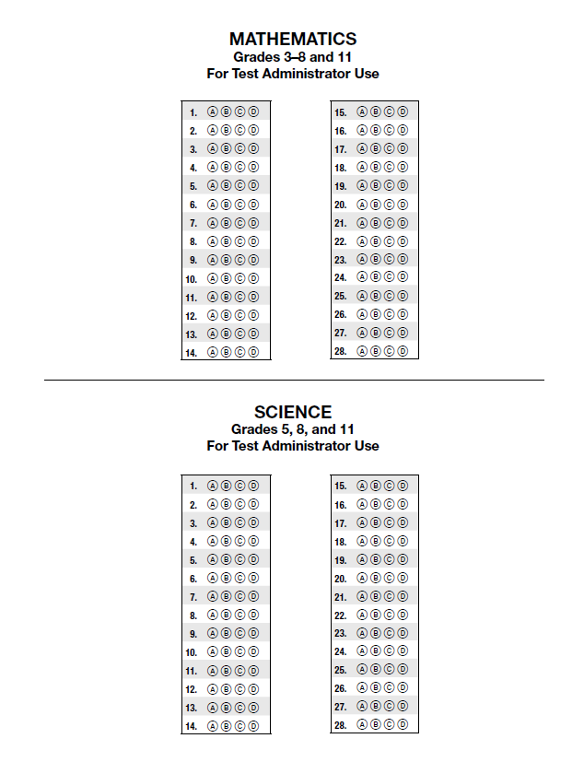
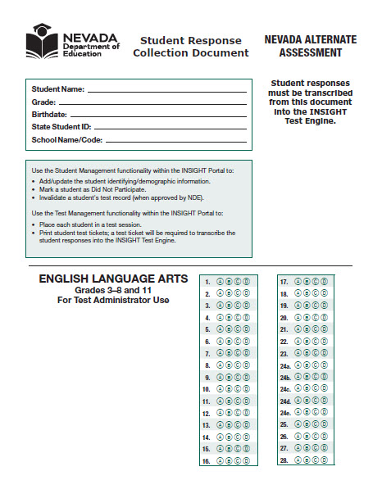
NAA: Transcribing Responses into INSIGHT and Transferring Videos
1._Student Responses Must be Transcribed into DRC INSIGHT
Issue the test ticket to the test administrator AFTER they complete each content area test or all tests for a student.
2._Video Recording Transfer and Storage
Copy video files onto USB flash drive*. Ensure that the actual video files are transferred and not shortcuts to the files.
Label the media storage device with the student’s first and last name and State Student ID.
Verify that EVERY video file opens and plays both audio and video by connecting the media storage device to a different computer than the one used for transferring the files.
Keep saved video recordings until September 30.
*NAA WCSD:
Schools receive one flash drive for each student (send to DRC) and one larger “school” flash drive to reuse each year.
Keep student videos on school flash drive through 9/30 then purge.
Notes:
Testing Staff
SAY:
Test Administrators will require one Test Ticket per student for transcribing all content areas of the assessment for that student. Test Tickets are secure materials and must be locked in secure storage when not in use.
STC and TA work together to ensure videos save correctly and playback successfully on a different computer.​

Slide 60

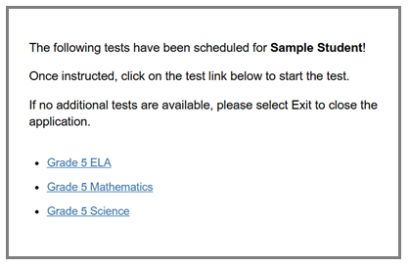
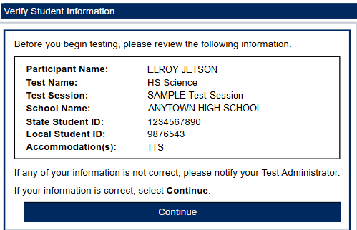
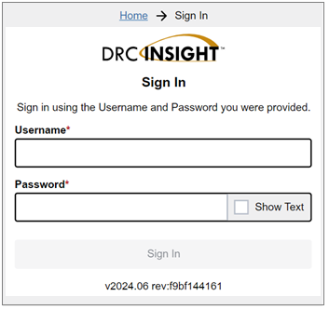
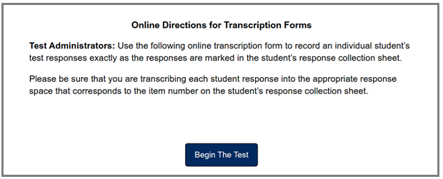
NAA: Transcribe Responses into DRC INSIGHT
Verify student name and grade level are correct and match the assessment completed by the student.
Make sure the answer sheet you are transcribing is for that student!
AFTER testing is completed for a student, and no later than May 6, 2025.
1
3
4
2
Online Directions
Select the correct content area.
Once a content area is submitted you will no longer be able to select that test.
Notes:
Testing Staff
SAY:
The School Test Coordinator (STC) will instruct Test Administrators on transcribing responses into the DRC INSIGHT test engine and submitting student responses for scoring.
When ready the Test Administrator will…
1. Show STC completed answer sheet(s) for student(s) and request test ticket(s).
2. Choose a quiet location free from students and distractions; requires access to a student computer with DRC INSIGHT test application installed.
3. Log in with student’s test ticket and transcribe responses. ACCURATELY transcribe each student response into the appropriate response space that corresponds to the item number on the student’s response collection sheet.
4. Submit completed test(s).

Slide 61
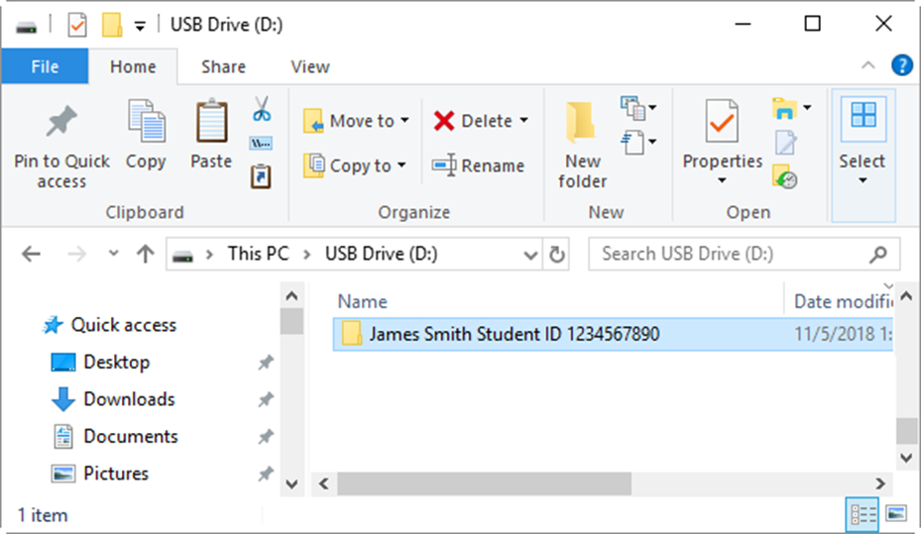


NAA
Naming & Organization of Video Files
Test Administrator’s Manual
Main Folder:
Student’s Full Name & State Student ID (i.e. John Smith SSID 123456789)
  Sub Folders (Within main student folder)
    ELA
    Math
    Science (5, 8, 11)
      Content Folders (Within sub folders, labeled by range of items shown in video)
        John Smith ELA Items 1-12, John Smith ELA Items 13-28
        John Smith Math Items 1-28
        John Smith Science Items 1-28
Notes:
Testing Staff
SAY:
Instructions for video recording and transferring files are available from the SEF/SEA. Remember that each student’s videos must be saved to their own flash drive, AND the school must retain a copy of all recordings for each student. The school’s copy may include multiple students and must be stored securely until September 30 of the same calendar year.

Slide 62


NAA: Returning Test Materials to DRC
STC
Collect ALL used and unused materials received from DRC. Compare barcode numbers against materials packing list.
Prepare student videos:
  Ensure all student video files open and play both video and audio.
  Ensure all media storage devices are clearly marked with student’s name and State Student ID in permanent ink.
  Place media storage devices for each student into their respective pre-assigned Student Video Envelope.
  If no Student Video Envelope was received for a student who participated in the NAA, clearly write the student’s information on an Overage Student Video Envelope, and place video media inside.
DO NOT PLACE MORE THAN ONE STUDENT’S VIDEO MEDIA IN A SINGLE ENVELOPE.
Notes:
Testing Staff
SAY:
This is a responsibility of the STC. Student Video Envelopes and nonscorable test materials can be packed in the same box. Affix a pink DRC Return Label which indicates scorable materials are enclosed. Affix a UPS Return Shipping label.
Keep boxes in a secure location until handed off to UPS.
>>>
Reference > NAA TCM
Standard packaging process:
Place the Student Video Envelopes into a box and seal it using heavy-duty packing tape.
Affix a pink DRC Return Label to the box, indicating scorable materials (student videos) are enclosed.
Affix a UPS Return Shipping label.
Keep boxes in a secure location until handed off to UPS.
Place all other test materials into a box and seal it using heavy-duty packing tape.
Affix a white DRC Return Label to the box, indicating nonscorable materials are enclosed.
Affix a UPS Return Shipping label.
Keep boxes in a secure location until handed off to UPS.

Slide 63
WCSD Support
Department of Assessment
  Dr. Sandra Aird, Director
  Rebecca Curtright
  Anna Kanarowski
  Laney Porter
Office of Accountability
Kyle Kemp
Notes:
*wcsd
The Department of Assessment provides guidance and support to schools administering Nevada accountability assessments.

Slide 64
Who to call, Assessment Support or DRC Help Desk?
DRC Nevada Help Desk
WCSD Assessment Support (district)
Suspected Issue with Test Item During Testing
1.866.588.4978
Be prepared to provide:
Everything else…
Policy Questions
Student Participation
Testing Staff
Manuals, Training, Procedures
Accommodations, Designated Supports
Permissible Materials
Testing Irregularities
Test, Part, Test Session | Student Name
Grade | Student State ID
Question Number | Issue
Notes:
*wcsd
Test item concerns are reported directly to DRC Nevada Help Desk.
Call: 1-866-588-4978
Suspected Issue with Test Item During Testing
Be prepared to provide:
--Student Name, Student State ID, Grade Level
--Test (name, part, test session), Question Number, Issue/Concern

Slide 65

Support
WCSD Assessment Support
AssessmentSupport@washoeschools.net
1.775.348.0248
DRC Nevada Help Desk
7:30 am to 4:30 pm (Pacific)
NVHelpDesk@datarecognitioncorp.com
1.866.588.4978
Notes:
*wcsd

