Slide 1

Critique
How to give constructive feedback. How to receive constructive feedback.
How to grow from giving and getting constructive feedback.

Slide 2
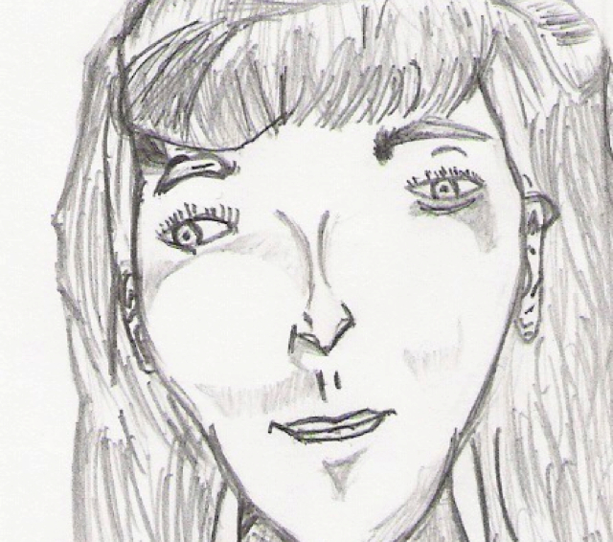
Observe and Reflect on this Art
1. What would you say about it if your crush drew it and gave it to you as a gift?
2. What would you tweet about it if you saw it for sale on Ebay for $1000?
3. What would you say if you saw it in a book of famous pieces of art?

Slide 3
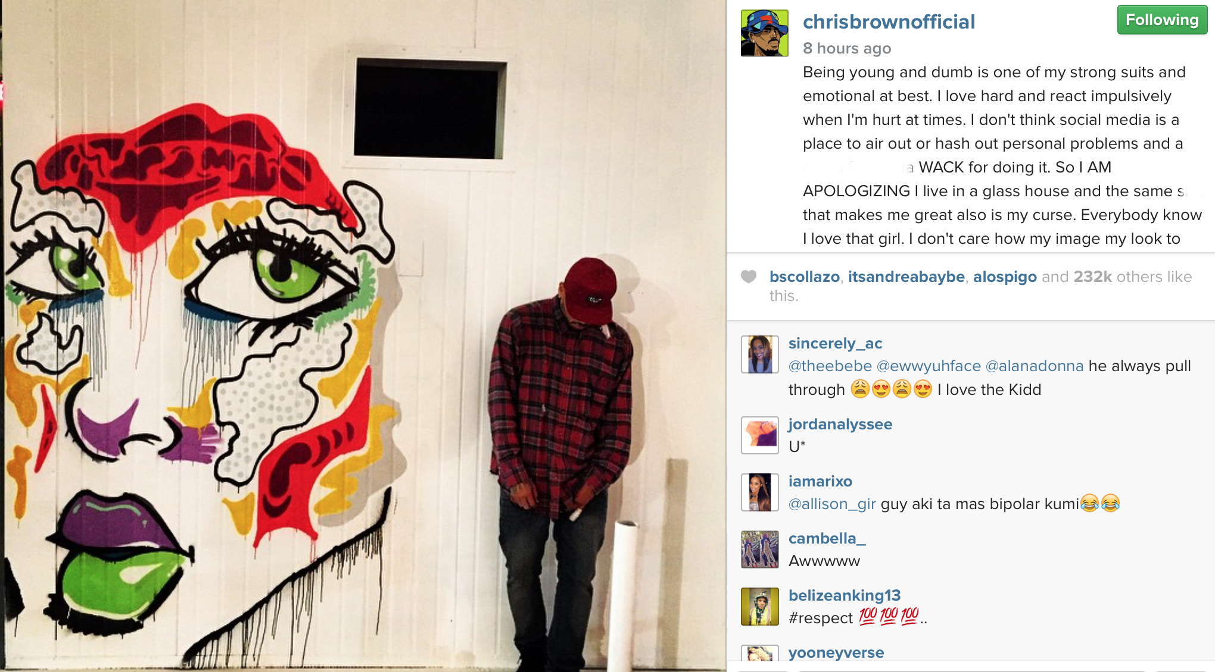
Social Norms vs. Critique
Tell what you think, with EVIDENCE.
You don’t have street cred in the design world.
Everything you say needs a POV, and to be specific.
Use what you see to determine what you say.
Likes, while awesome on IG, Twitter and Facebook, mean nothing in critique, because they don’t help us think, only confirm what we think.

Slide 4


What is Constructive Feedback?

Slide 5

What did we see?
How was the feedback for Austin different than we might be used to?

Slide 6

Examples of Specific Feedback:
Examples show us what you think and why:
I think………because I see…
You did……. well…. because…..
I observe…. that shows………..
You might think about….because
It’s NOT about LIKES.
Likes are for facebook.
Instagram.
Twittter.
Your grandma’s cookies.
Receiving Feedback:
Clarify, rephrase, thank them, do not defend, or get snippy.

Slide 7


Let’s Practice

Slide 8
What Feedback would give your group for orientation?
How could you say what your group did a good job at?
How could you say what your group could do better at?
How could you connect what your group did back to what Frank Gehry does?

