Slide 1
How to animate words and pictures
By Xavier Angus and Jake Rich

Slide 2
Why animate?
Animating makes your PowerPoint more captivating and keeps your audience engaged.
For instance, if you make a slideshow with no animations do you think the audience would pay attention as much as if your slideshow was animated?

Slide 3
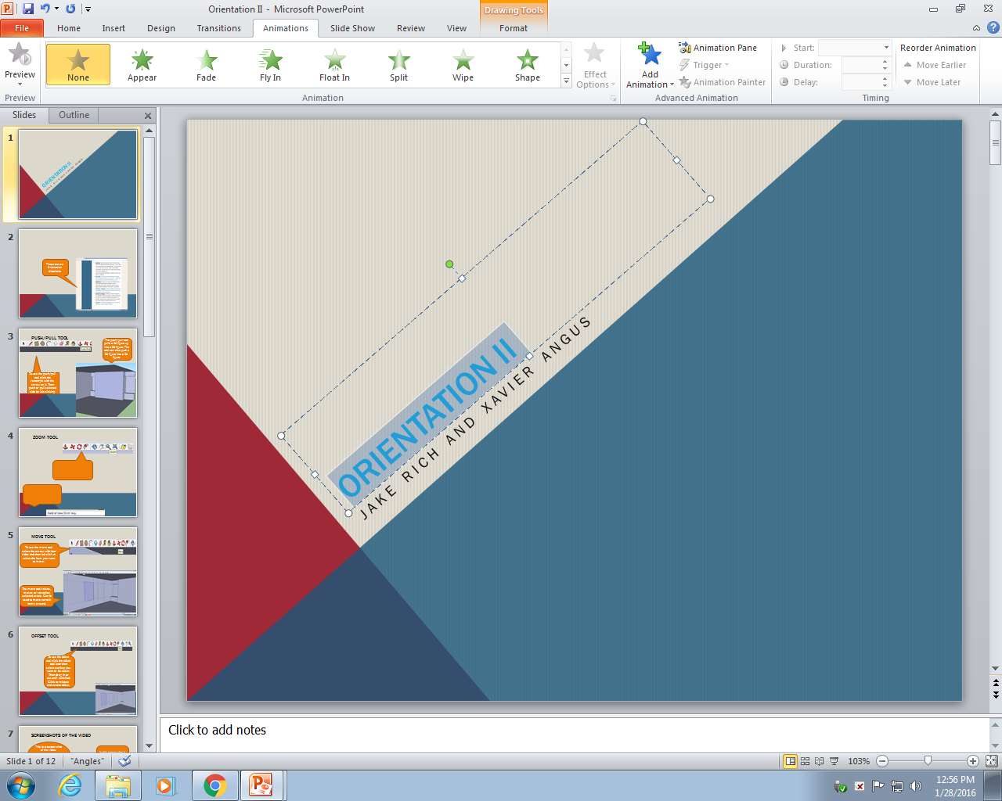
Getting Started
Next click the animations tab. A menu should come up
To start highlight the word you want animated.
When Animating a word or picture use the same instructions used in this PowerPoint.

Slide 4
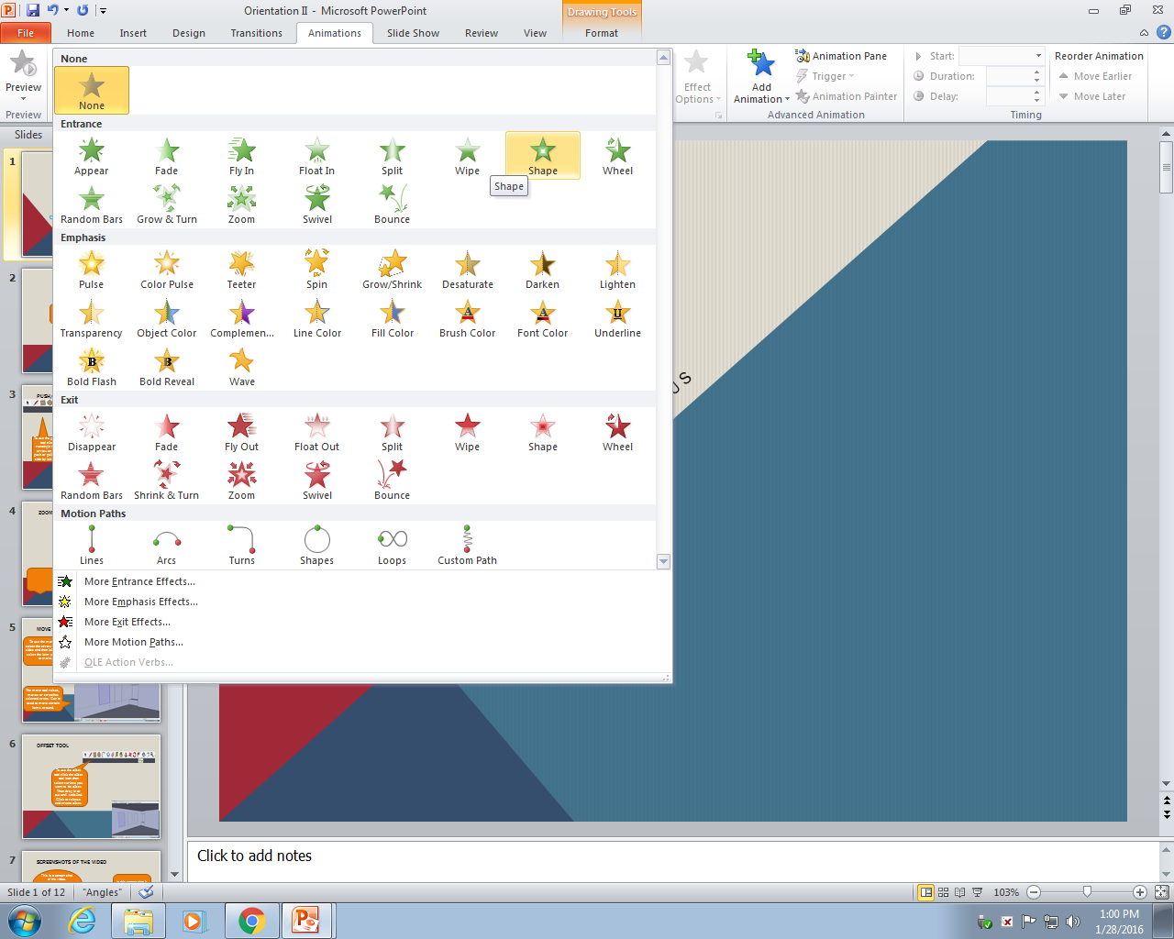
Using Animations
Click on the animation you want that word to model.
Click on the arrow next to the last animation and another menu should open up.

Slide 5
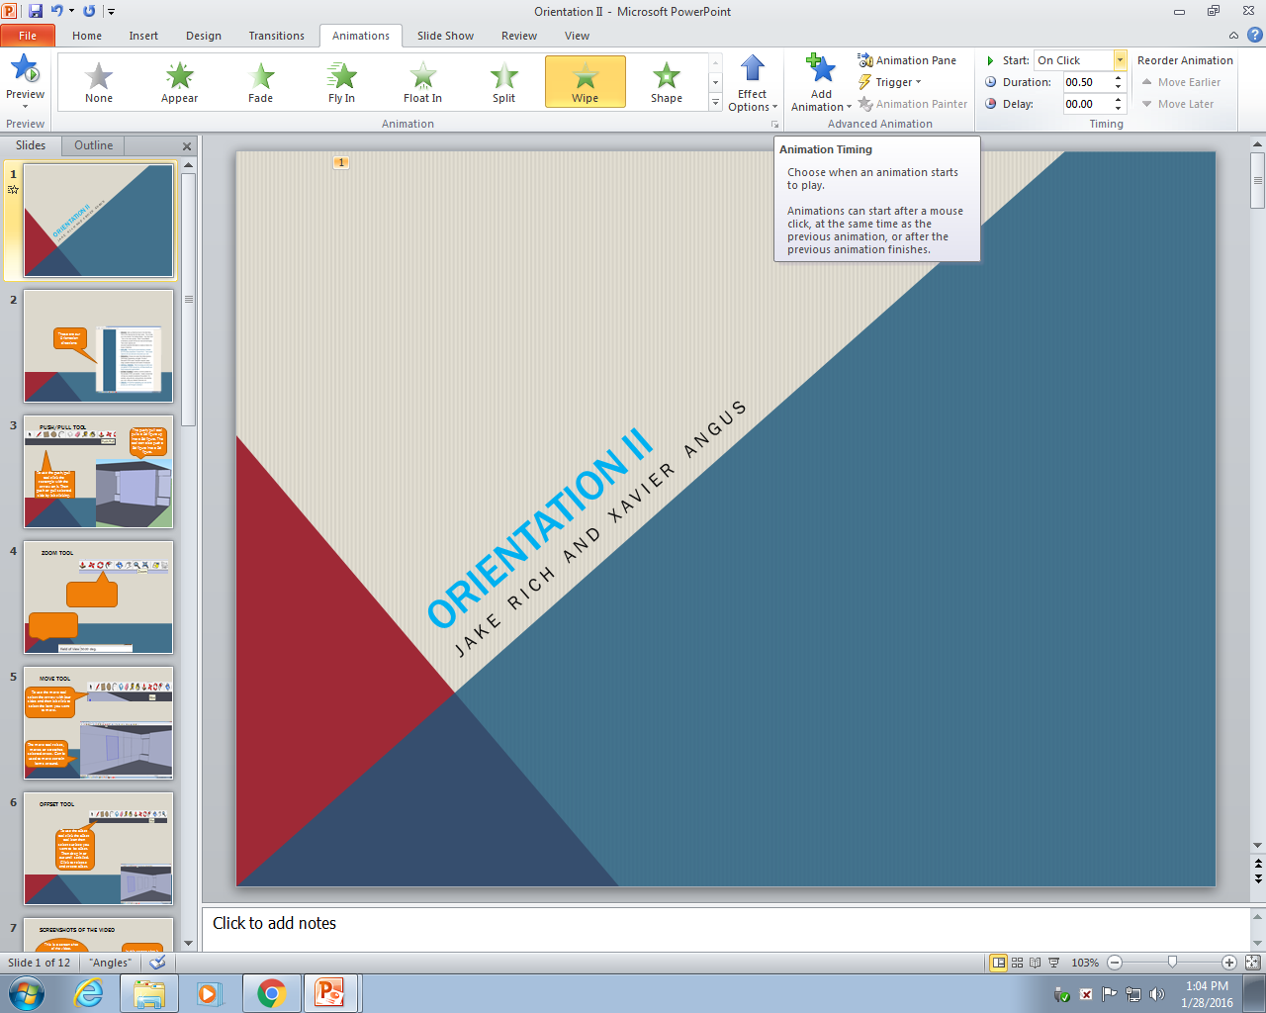
Timing Your Animations
By doing this you can schedule multiple animations on the same slide at different times without clicking.
After you found the animation that suits your word, if you would like to time your animation, click the On Click arrow

Slide 6
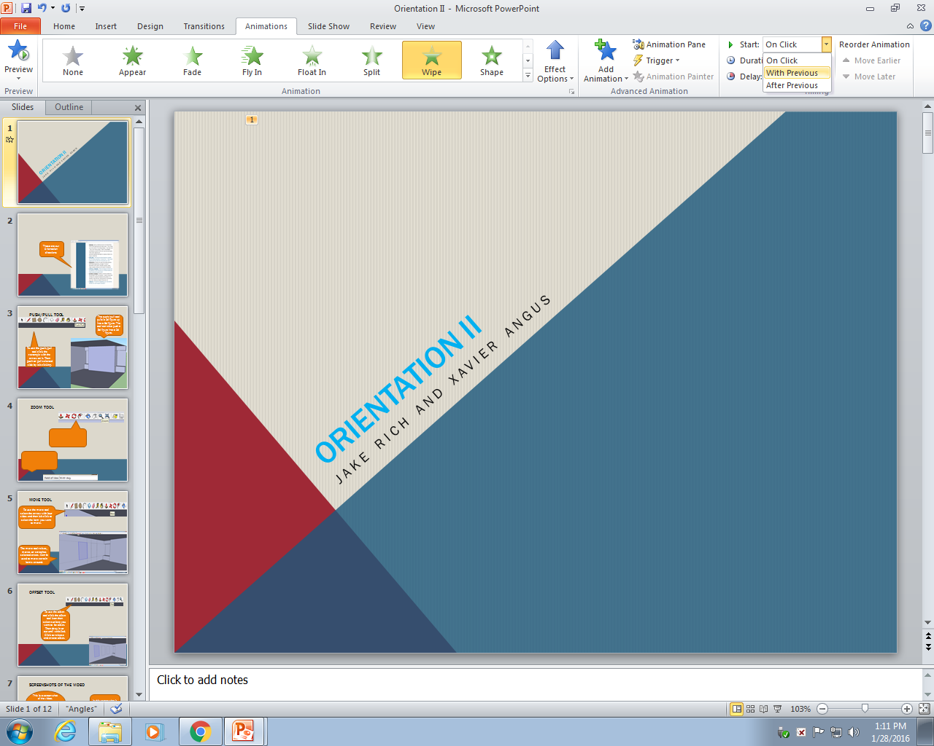
Timing Your Animations(cont.)
If this is your first animation on the slide click the with previous button. If this isn't your first click the after previous button
By doing this you will make your words come in at different times.

Slide 7
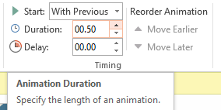
Timing Your Animations
If you would like to lengthen or shorten the time of your animation click on the arrows of the Duration Box.
If you would like for your animation to come in later click on the top arrow of the Delay Box.

Slide 8

Order of Animations
The zeros on the PowerPoint are a guide. They show you which animation will go first. In this case, unless you delay one of the animations both will go at the same time.
The zeros on the PowerPoint also shows you that both titles have an animation.

Slide 9
Thank you for watching!
Why are you still here? Go animate!

