Slide 1
How to Save to Your Learners Drive

Slide 2
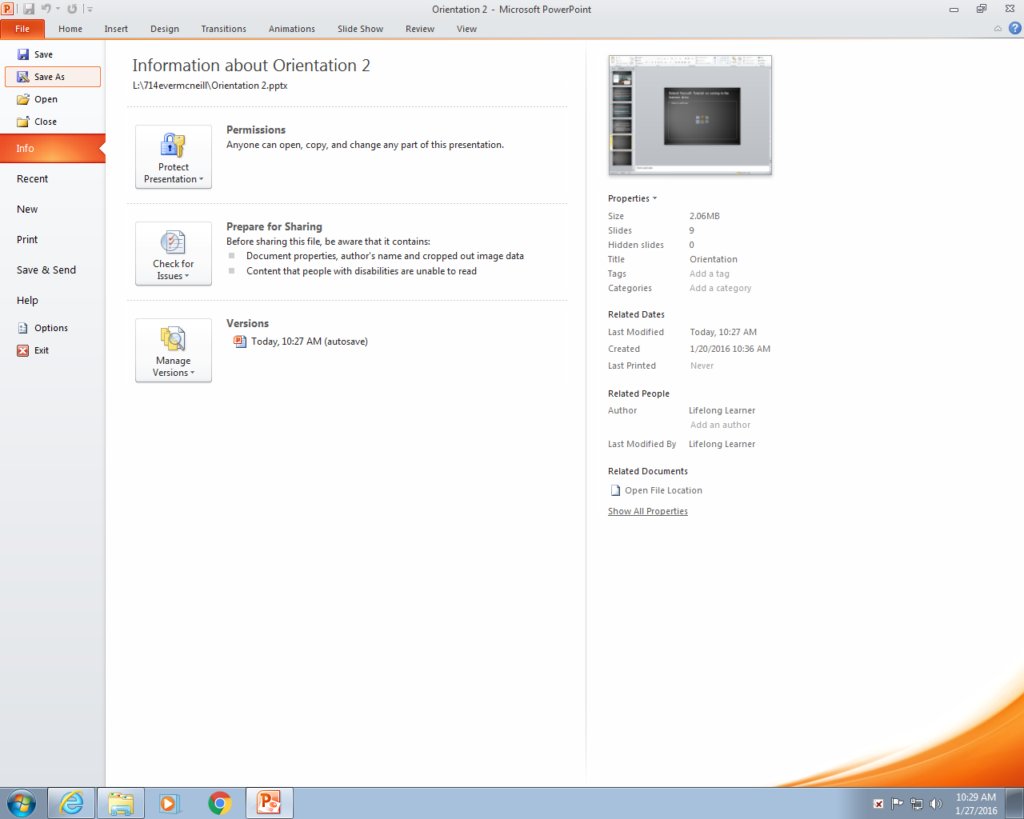
Extend Yourself: Tutorial on saving to the learners drive
To start off with, go to file and click save as.

Slide 3
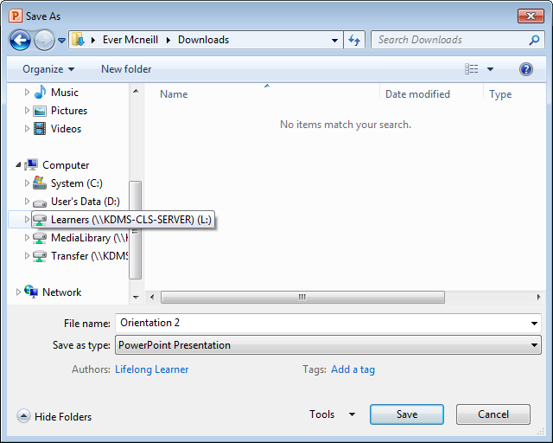
Extend Yourself: Tutorial on saving to the learners drive
Scroll down on the side bar, till you see the KDMS learners drive.

Slide 4
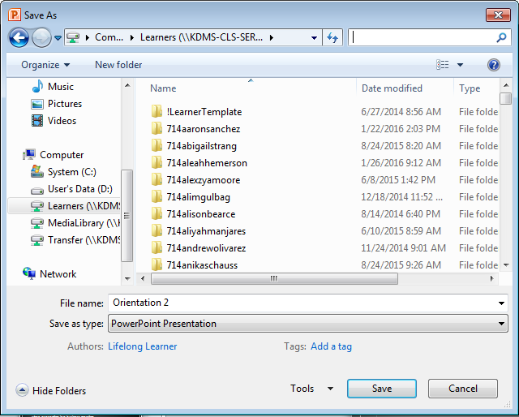
Extend Yourself: Tutorial on saving to the learners drive
When you open it, it will look like this. Click the search bar on the top right corner, and type in your username.
This is optional - you can scroll through the list and find your username. Though searching for your name is faster.

Slide 5
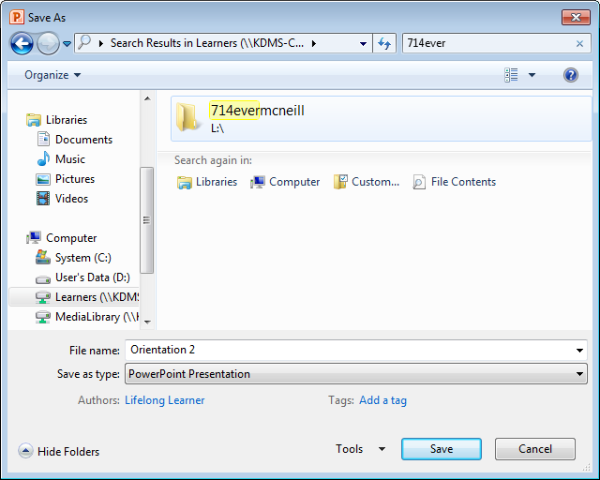
Extend Yourself: Tutorial on saving to the learners drive
After typing in your username, your folder will show up and you can open it from there.

Slide 6
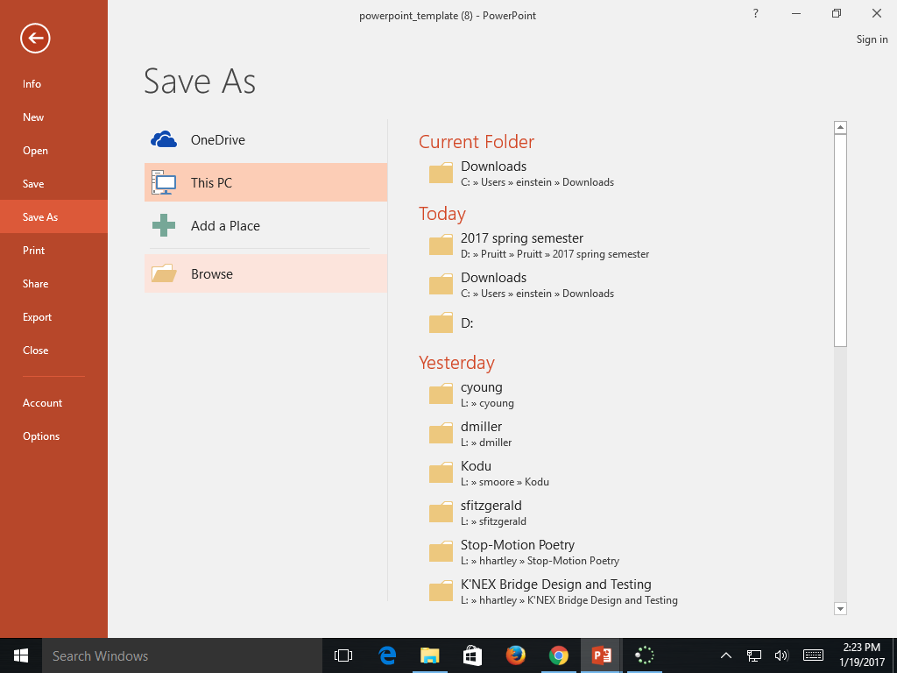
Option 2 for saving
Press Save as and then click on browse

Slide 7
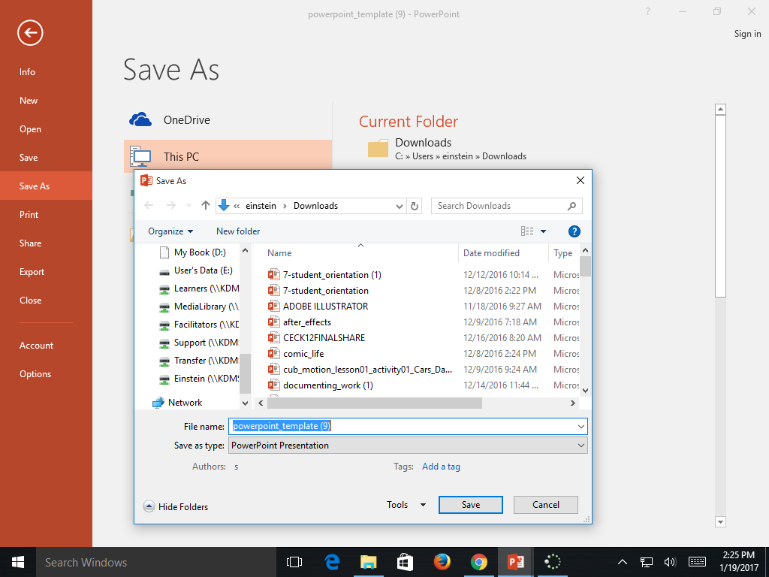
Scroll down the left side of the menu until you see your name under the Learners Drive directory. Click on your
name and then name your file and press save.

