Slide 1
WCSD Student Climate Survey:
What do YOU have to say about your school?

Slide 2
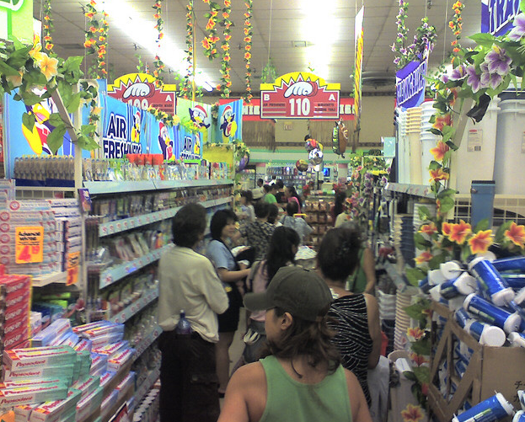
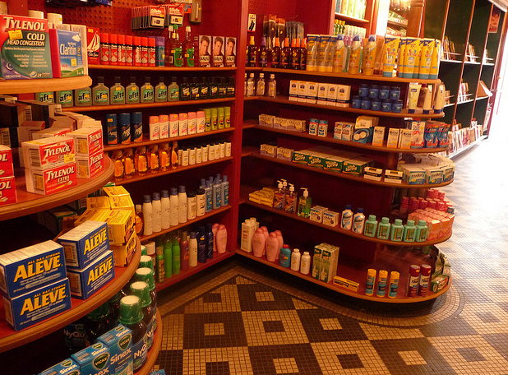
Envisioning School Climate
Notes:
Opening SEL activity:
“To begin, we’ll take a look at how a positive climate that is safe, respectful, participatory, engaging, and well–managed is established and what its impact is on students’ social and emotional development.
To create a here-and-now feeling of climate, think of a store you really don’t like to shop in. Describe it. How is the lighting, display, directions for finding merchandise, assistance, noise, smell? [Gather several responses.]
Now think of a store you love to shop in. What are its characteristics? “
Talking points:
Schools should have that same feel – orderly, safe, predictable, friendly, full of new things, great treatment by the staff, etc.
We as adults get to choose those environments to go to. Kids don’t have options, they are required to go to school. We should work to make that school as safe and positive a school environment as possible. No one wants to go to that uncomfortable store over and over – we wouldn’t engage, we’d shop quickly and get out of there, etc. The same thing happens to kids in a school – they don’t engage, they want out of there, etc. There are resources to help with building these school environments, but it starts with the staff at the school all treating each other and the students respectfully. For example, you can’t yell at a student to stop yelling.

Slide 3
Learning Intentions
1
2
Decompose the data to find trends
3
Discuss how we can support the students and school to enhance school climate
Build our understanding of the purpose and intention of the Climate Survey

Slide 4
What is the Student Climate Survey?

Slide 5
WCSD Climate Surveys
All students in grades 5 – 9 and 11
  Climate Survey (N = 11,822)
  Safety Survey (N = 12,119)
  Online only
All parents in district
  Paper or online
  N = 12,091
All school staff in district
  Online
  N = 3,651
Did you know?
We have 5 years of data from the three surveys!
Notes:
The Student Climate Survey is something that more than 20,000 students in our school district participate in every year since 2011. That means that almost 1/3rd of all the students in the district give us their feedback through this survey.
In case you can’t remember taking it, this is the survey that you took in March – June last year. Probably in the computer lab. It asked questions about whether you like school or about your drug and alcohol use or how much you like your classes. We do this survey every year so we can figure out what we are doing well

Slide 6
STUDENT-STAFF RELATIONSHIPS
CULTURE OF RESPECT
SOCIAL AND EMOTIONAL SKILLS
EDUCATION ATTITUDES
Adult Caring
Academic Support
Student Respect
Staff Respect
Student Climate Survey
Utility of Education
Self-Efficacy
Participation
Student Engagement
Self-Awareness
Social Awareness
Self-Management
Relationship Skills
Decision-Making
Notes:
These are the types of things we ask students about on the Student Climate Survey. These are all things that have been found to strongly relate to whether students come to school and engage and their academic achievement (how well they do on tests and in their classes).

Slide 7
FEELINGS OF SAFETY
RISK-TAKING BEHAVIORS
VIOLENCE ON SCHOOL PROPERTY
DRUG/ ALCOHOL ATTITUDES
Safety In/Out of School
Safety Procedure Knowledge
Drugs
Alcohol
Skipping Class
Bringing Weapon
Student Safety Survey
Parent Attitudes
Peer Attitudes
Student Attitudes
Fighting
Teasing/Rumors
Sexting/Electronic
Property Damage
Notes:
These are the types of things we ask about on the Student Safety Survey. Before we can ever expect students to focus and do well in school, we have to ensure that they are safe, comfortable, and welcomed at our schools.

Slide 8
You guys say that people take [the Climate Survey] every year, but it doesn’t really make a difference. Like, when you ask questions about bullying, you think, ‘Okay, then maybe the school’s gonna do something about the bullying.’
But every year you still take the same survey with the same questions, and nothing ever happens. I feel like just, after a while, people get tired of it, and it’s like, ‘Maybe I saw bullying, maybe I didn't—yeah, I did, it’s not a big deal.’
-Damonte Ranch HS Student
Notes:
We did 16 focus group with more than 100 students in our district about the Student Climate Survey. Although lots of students said it was kind of cool that they got to provide their feedback about the school, LOTS of students said they’d never seen the reports that come out of it! Some students thought that We think it’s important to see what you and your peers have to say about this school.

Slide 9
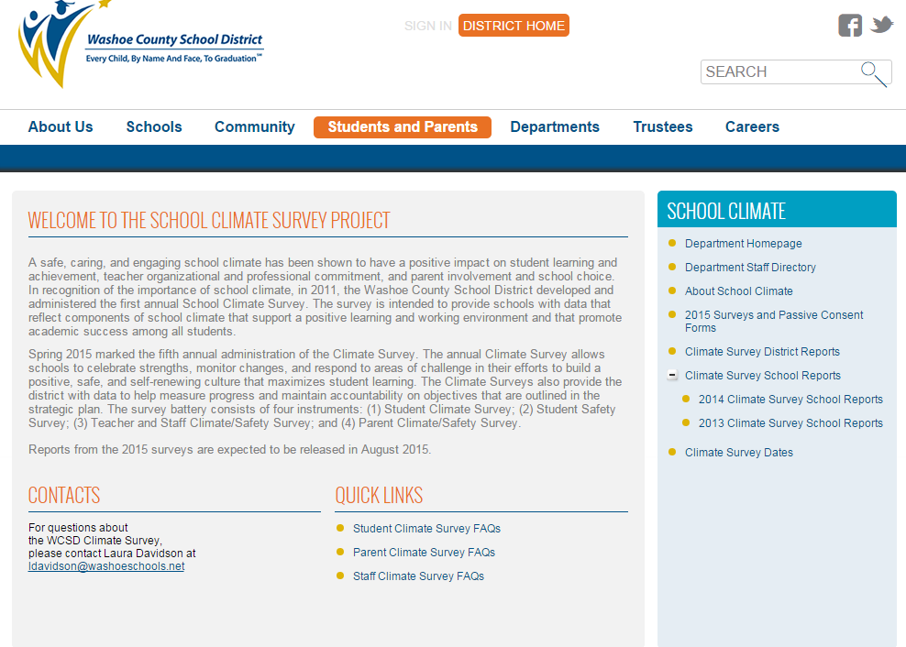
http://www.washoeschools.net/Page/866
Notes:
Here is where YOU can find your school’s survey reports. The link is at the top.

Slide 10
Understanding the Data Using the Y Activity
Notes:
This section will teach you about a great way to debrief data with students in a way that will lead to data-based action-planning with your students.

Slide 11
Notes:
[You can replace these with your own school’s data. But, it’s nice to show snapshots from your data or print out the reports so everyone can see the same data. Ideally, you want to look at the graphs on the front page of the report, and then dig into the scale more deeply by looking at the corresponding table. The scale is more reliable because the number is based on all the questions, but it’s also nice to look at the actual questions in the scale and what is high or low. Using the snapshot tool in Adobe Acrobat, you can take pictures just like this from the reports that you can then copy and paste into this sample powerpoint]

Slide 12
Understanding Data: Writing Narrative Statements
Overall, XX% think that adults at this school care about them.
XX% of students believe _______________.
XX% of students do not agree that ___________________________.
Students were most likely to agree that _____________________.
Students were most likely to disagree that _________________________________.
Notes:
[Before you start action-planning, it’s important to make sure all students understand what the data is saying. One way to do this is to have students fill out narrative statements in groups or as a team. For younger students, you might want to give students the sentence roots above and have them fill them in with numbers from the report. For older students, they can write their own narrative statements to summarize the data. You can either pick one or two scales from the report, or give students the whole report to look through. Whatever you have time for.]

Slide 13
Why? Worksheet
Narrative Statement:___% of students at this school disagree that adults at this school care about them. Why do you think that __% of students feel this way?
Because staff…
Because students…
Because schools…
Notes:
[Here, students will pick one statement that they came up with that they want to address. For Adult Caring, you might want students to think of reasons why 20% of students do not believe that adults care about them. Why might students feel uncared for? ]
[You want students to spend time thinking about reasons from multiple perspectives, including how students might contribute to this issue, how staff might contribute to this issue, and how schools might contribute to this issue. Some examples that students might come up with could be:
1. Staff: Because in middle school, staff only have students for one hour a day. They have 150 students and it’s hard to get to know everybody.
2. Students: Because students might not feel cared for because they get in trouble in class all the time, so they think teachers don’t like them.
3. Schools: Because middle schools are so much bigger than elementary schools, it’s easy for students to fall through the cracks. Some students’ friends might go to different middle schools than they do after 6th grade.

Slide 14
Action Planning with Students

Slide 15
What issue do we want to address?
[fill in issue students want to tackle]
Notes:
[Using the Y activity, have students pick one thing that they think they can address at their school. This will be the basis for their action planning]

Slide 16
More or Less Activity
Schools/Staff/Students should do MORE of this… | Timeline | Who will make sure this happens
Schools/Staff/Students should do LESS of this… | Timeline | Who will make sure this happens

Slide 17
3, 2, 1 Activity
3 things you found interesting about the data
2 things you want to know more about after looking at the data
1 thing you want to do right now as a result of the data
Notes:
These questions can either be used as a closing activity discussed verbally with a partner or as a reflection sheet to be turned in to the Climate survey team and site administrator. It is incredibly important that you follow up with your students about their action plan. Student voice only works if students’ feel like their ideas are valued and will lead to change! Make a commitment with your students that you will follow up on their ideas and give a specific timeline.

Slide 18
For more information about student voice…
Student voice toolkit with other strategies:
(https://relwest.wested.org/resources/31)
Contact Laura Davidson at ldavidson@washoeschools.net

