Slide 1
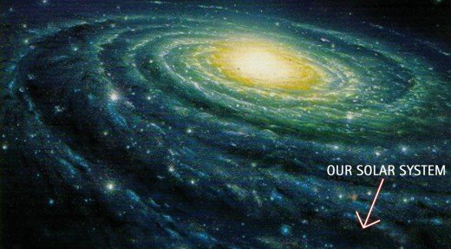
Milky Way Galaxy

Slide 2
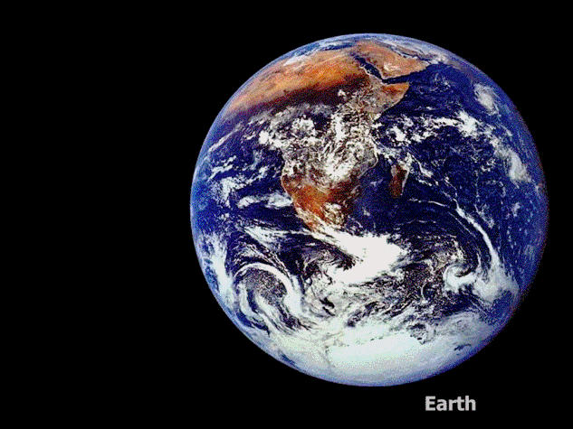
Pearson Prentice Hall
Physical Science: Concepts in Action
Chapter 26
Exploring the Universe

