Slide 1

Welcome to
Round table
03/25/2025
9am-12pm
Notes:
This guide will replace the one’s that have been handed out during the past month as the schools have been trained. This is far more detailed in the step by step.

Slide 2
IC Fees and
Entering in School Books
How to guide
Notes:
This guide will replace the one’s that have been handed out during the past month as the schools have been trained. This is far more detailed in the step by step.

Slide 3
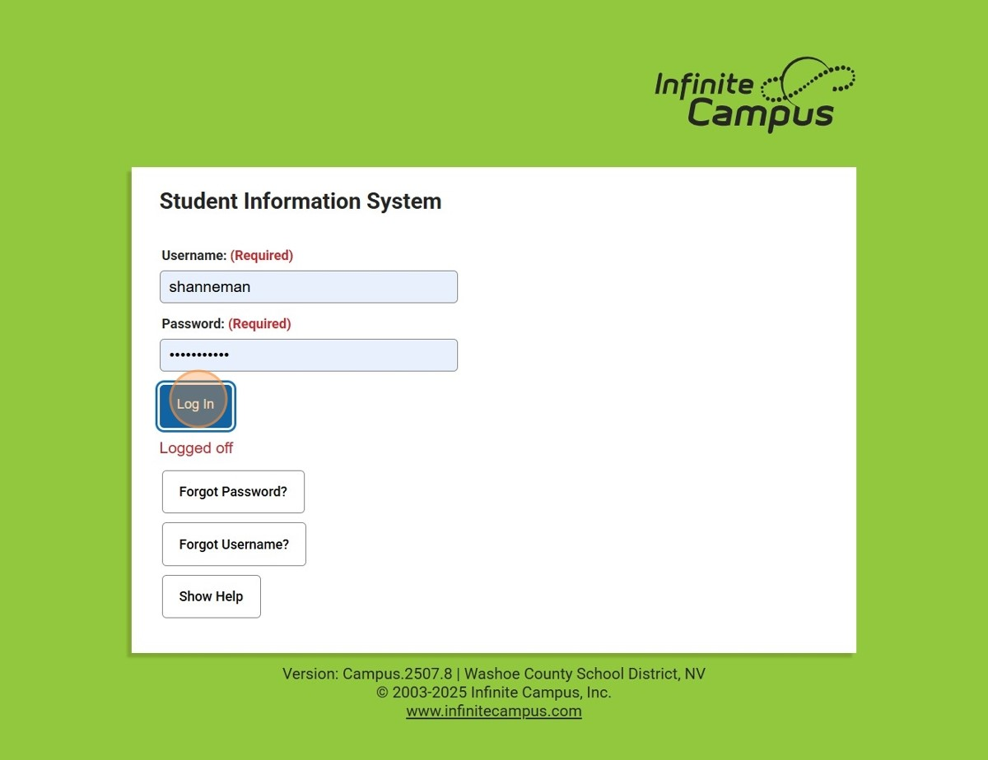
Getting started in Infinite Campus
(IC)
Notes:
Log in as you would normally, you will need to be in the new view after 7/1/2025 the old view will be going away!

Slide 4
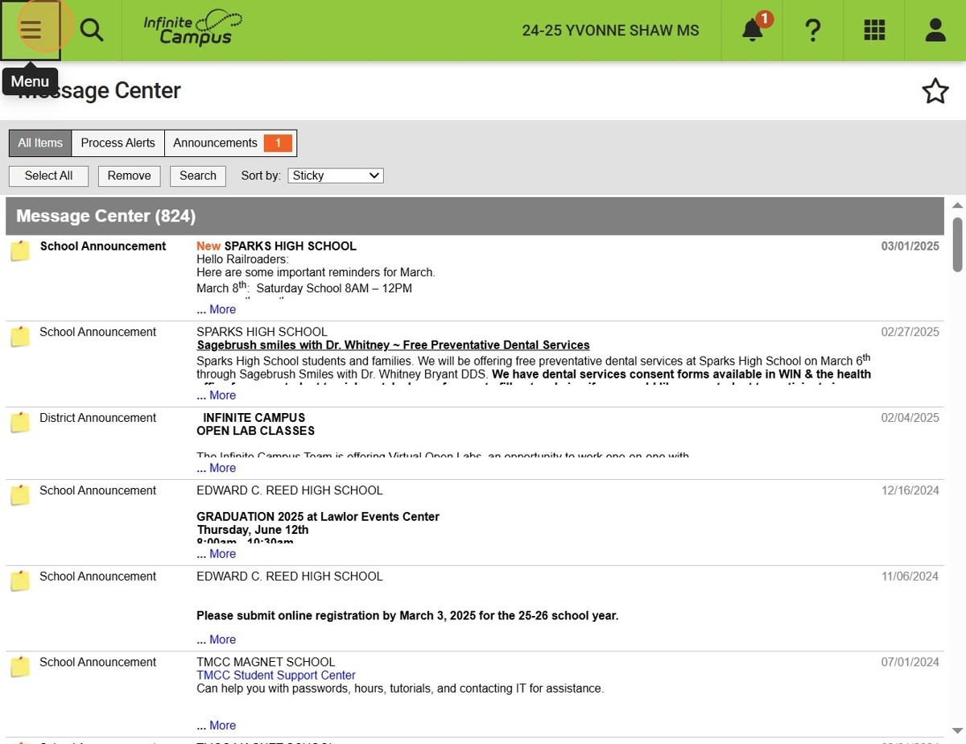
Go to the three-line menu
This menu is in the upper left-hand corner. This will open the main menu.
OR
Use the breadcrumbs

Slide 5

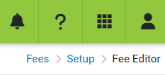
Breadcrumbs
IC will call the blue tabs at the top of your screen breadcrumbs. This is another way to navigate back to a previous menu instead of going all the way back to the main menu.
Top-Left side of the screen
Top-Right side of the screen

Slide 6
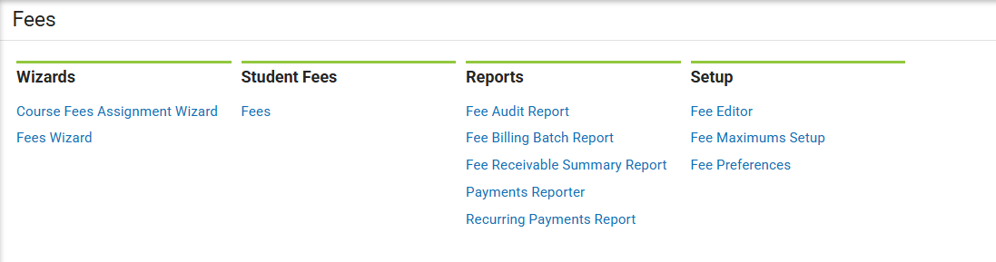
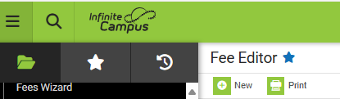

Breadcrumbs
Once you’ve been on a page you can add it to your favorites by clicking the
little star to the right of the title. This will add it to your favorite's menu you can
click this star to find your favorites.

Slide 7
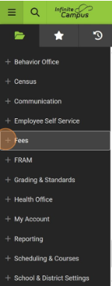
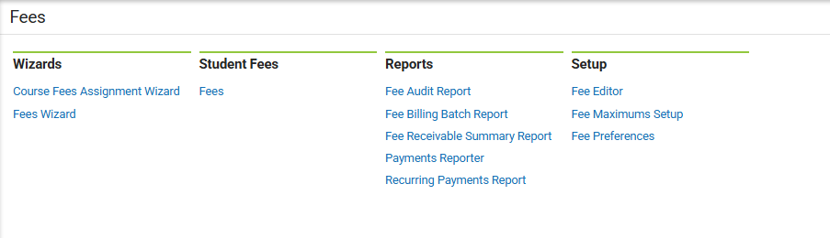
Find the Fees selection in the main menu select
Click on +Fees
Go to Setup then Fee Preferences
This is where you will check Display Fees on Portal and Active Years/Future Years
You can find it here if you’ve used the breadcrumbs

Slide 8
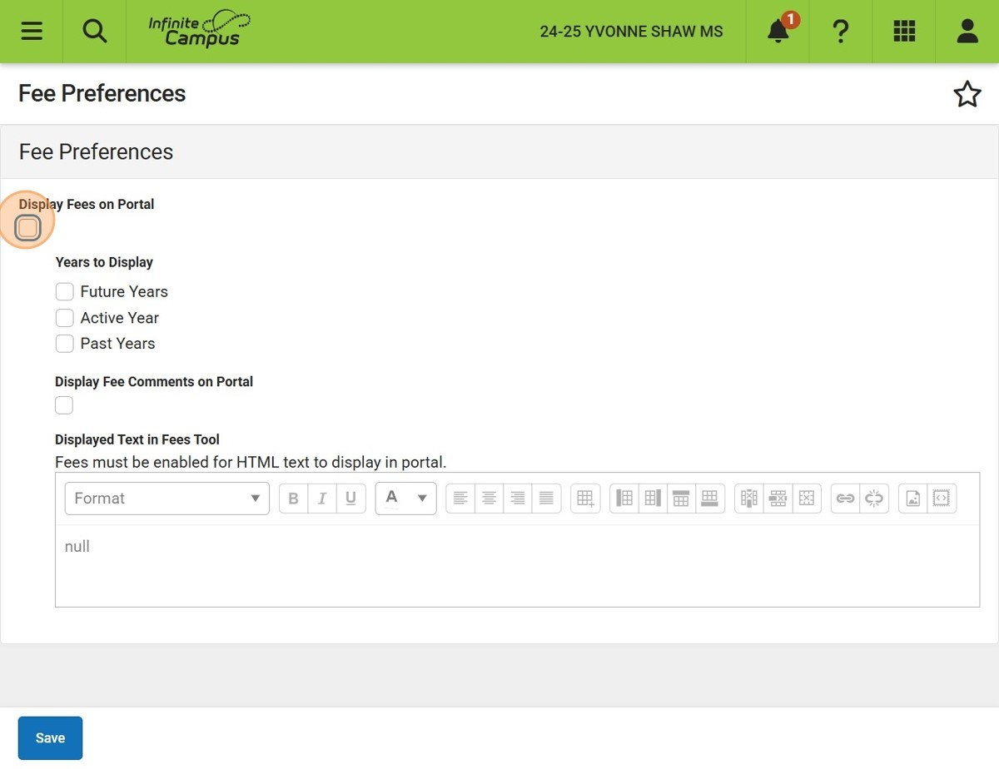
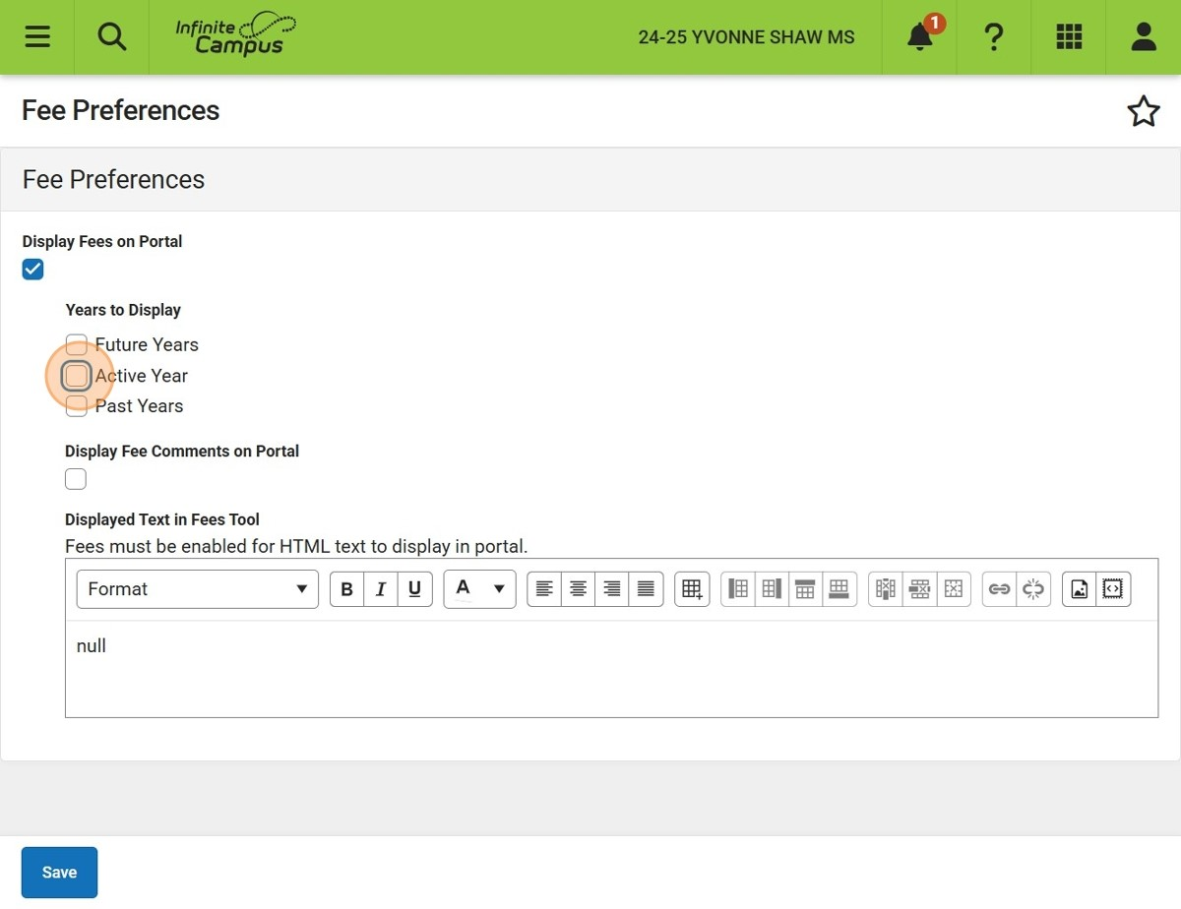
Fee Preferences
Display fees on portal
Display active year
Click this box if you want comments
You can Display Fee Comments on Portal, if you would like to put something here for your parents and students to see, but this is not necessary.
Remember to SAVE
Notes:
Active year is the current year you're in. Your can activate the future years so you can put fees on the student panels before the school year starts.

Slide 9
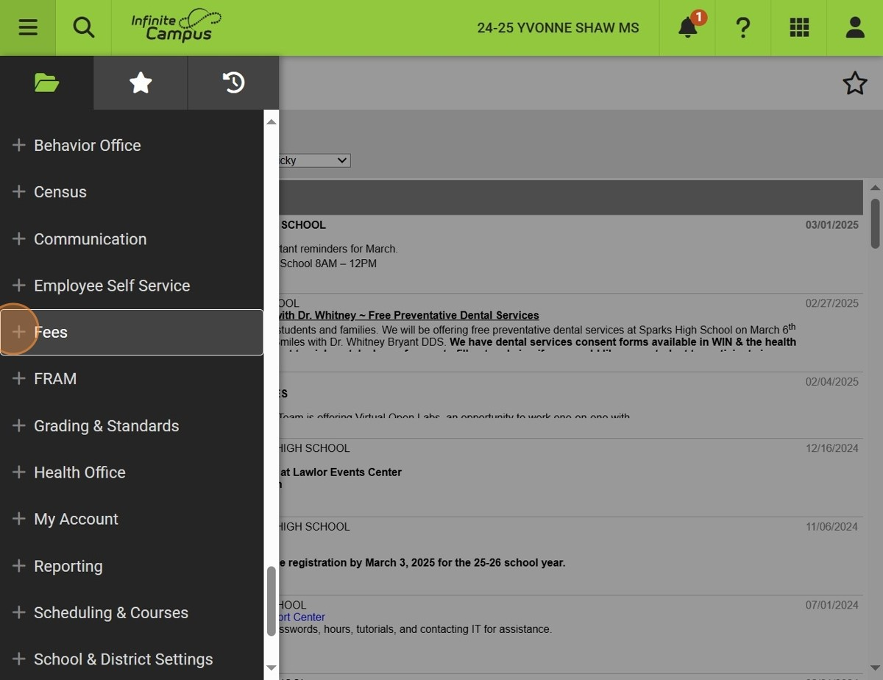
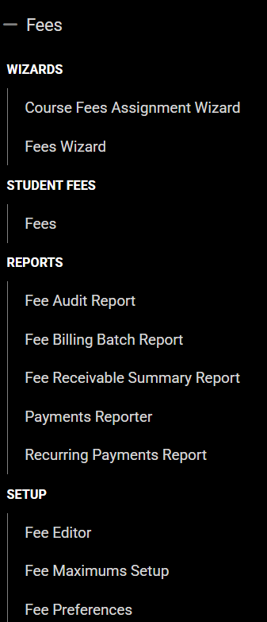
Find the Fees selection in the menu
Click on +Fees
Go to Setup then Fee Editor
This is where you will add (new), edit, activate, or inactivate your fees. Double click on any of the course this will open a new window. *Note that fees have been entered as only the last 4 digits of the account number dropping the 40-10 unless the account has a 20 or 30 then these have been left example 20-1001 Science Projects/Race….
If using breadcrumbs
go back to fees

Slide 10
Find the Fees selection in the menu
Your menu will like this if you use the “breadcrumbs….

Slide 11
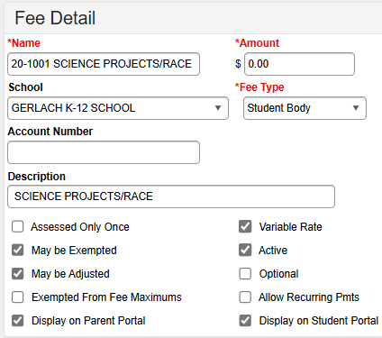



Fee Editor
In the fee editor you will select the new icon which will open the fee detail window.
You will need to fill out the name, amount and fee type. Copy and paste to the description box from the name above.
We have kept everything in CAPITAL letters just because IC has entered information that way. If you have more fees to add, just click
again.
You will contact the SAF office for an account # as you have in the past.
Notes:
This screen can make you life easier just by checking or unchecking the boxes. If you inactivate an account, then it will turn red and drop to the bottom of the list.

Slide 12
Fee Editor continued…
You will need to select if you want the fee to be a Variable Rate. This is best so you can change the rate on the student panel later. If this is an unchanging fee, then uncheck the Variable Rate. You will not be able to adjust on the student panel if unchecked.
Notes:
This screen can make you life easier just by checking or unchecking the boxes. If you inactivate an account, then it will turn red and drop to the bottom of the list.

Slide 13
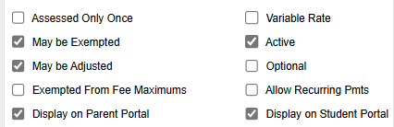
Fee Editor continued…
The boxes to the left are the ones that IC automatically has checked. Display on parent and student portal should be checked.
Make sure to save
✔
Other boxes you might need to check will be Assessed Only Once if this fee is to be a one-time fee, Optional
an example of this would be putting Yearbook on all students panel but it’s optional if they buy one, and Allow
Recurring Pmts this would be for a Senior trip or Cheerleading this allows the parent/student to set up payments. May be exempted we suggest to leave checked you can exempt a fee from the student panel.
Notes:
This screen can make you life easier just by checking or unchecking the boxes. If you inactivate an account, then it will turn red and drop to the bottom of the list.

Slide 14
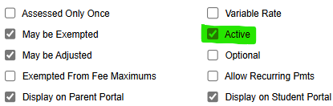
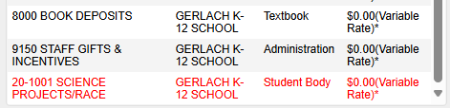
Fee Editor continued…
If you uncheck the Active box, you will inactivate an account, then it will turn red and drop to the bottom of the list.
Remember to SAVE!
If you leave this here at the bottom you can reactive it later if you find you need it after all. If you find you don’t need it email the SAF office, and we can delete it for you.
Notes:
This screen can make you life easier just by checking or unchecking the boxes. If you inactivate an account, then it will turn red and drop to the bottom of the list.

Slide 15
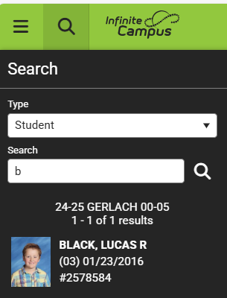
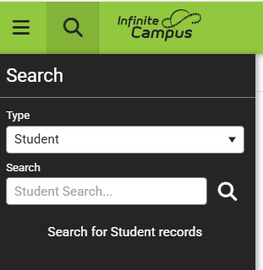
Creating Fees for Individual Students
Click here to search student name
or student number.

Slide 16
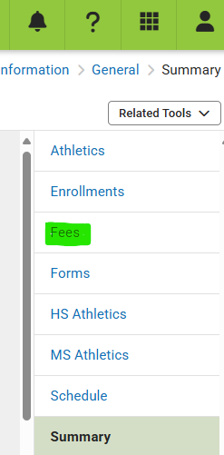
Creating Fees for Individual Students continued
Go to the left side panel and select Fees.
This will open a new window.

Slide 17
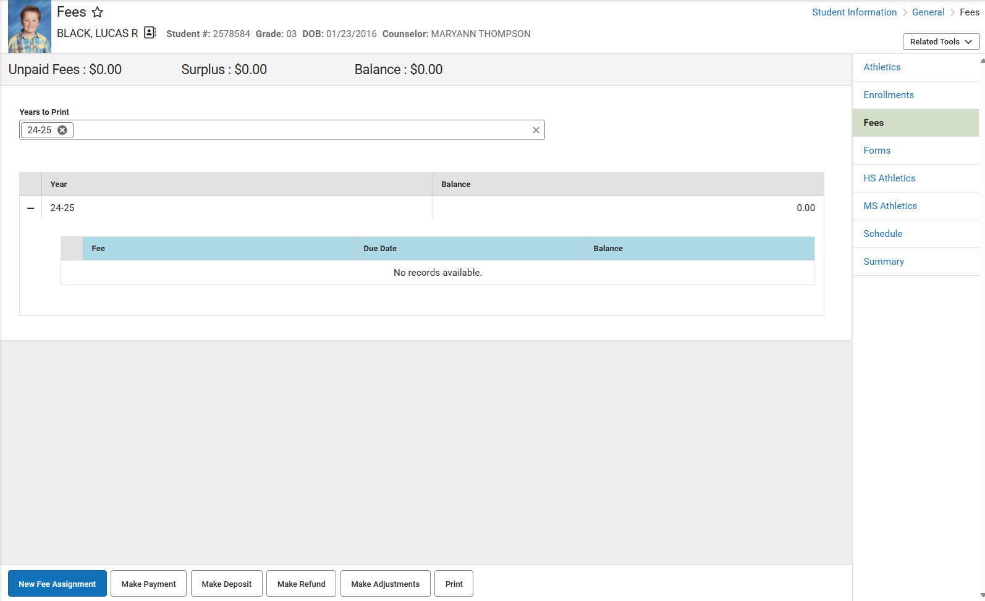
Creating Fees for Individual Students continued

Slide 18
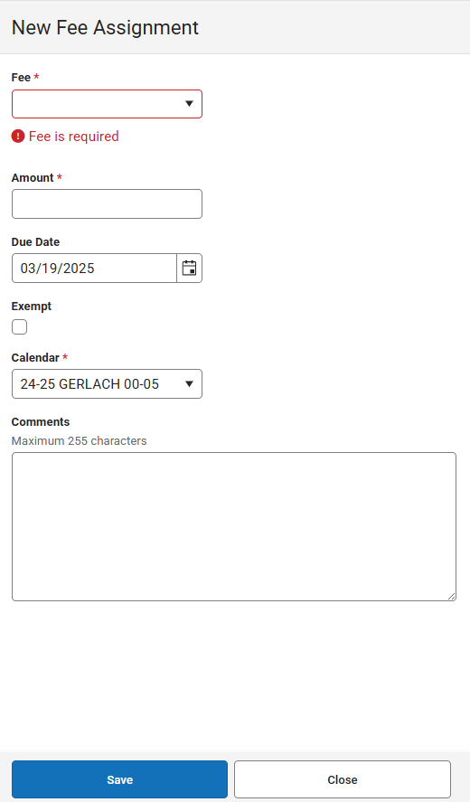
Creating Fees for Individual Students continued
You will click on the New Fee
Assignment at the bottom of the
Page. A new window will open.

Slide 19
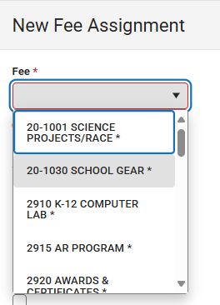
Creating Fees for Individual Students continued
This will open the drop-down menu for the fees you will need to assign here.

Slide 20
Creating Fees for Individual Students continued
This will allow you to put in the fee amount. If you have already put a fee in when doing the fee editor
this will auto populate for you. If you’ve left the variable box checked, you can edit the amount here. If the variable box is unchecked the amount will be greyed out and will not be able to be audited.

Slide 21
Creating Fees for Individual Students continued
This will allow you to put in a date that the fee is due by. If there is no actual due date you can just leave the auto populated date in the field.

Slide 22
Creating Fees for Individual Students continued
This will allow you to exempt a student from the fees. This can be used for CIT students. It will show the fees on their portal but will show them as exempt.

Slide 23

Creating Fees for Individual Students continued
Make sure you are in the current school year for current fees. You can also add fees to a future year but would probably only due this at the beginning of
a school year when you’re setting up your new fee schedule.
Add any comments you need/want to this space and
SAVE!!
Continue with the New Fee Assignment until all fees
are entered.

Slide 24
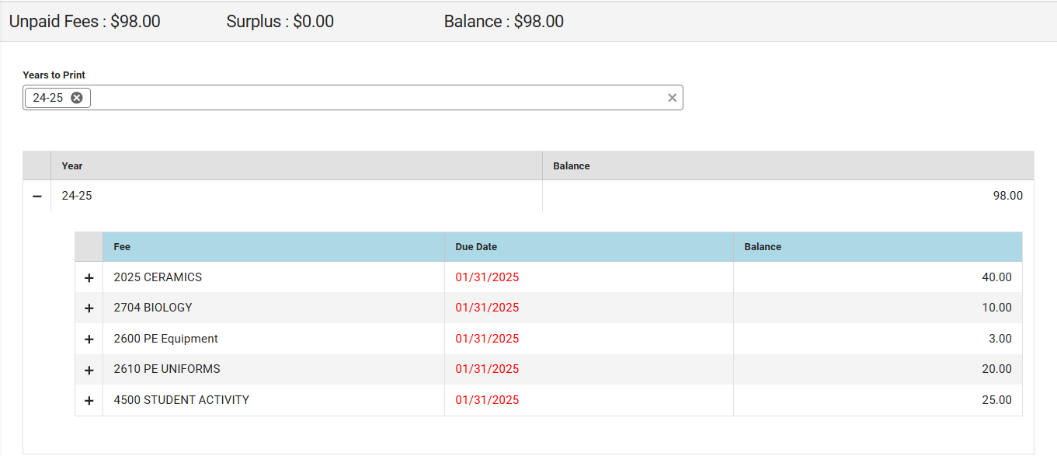
Creating Fees for Individual Students continued
This is what the student panel will look like once your done with fee. At the top it will show the
unpaid fees and the balance

Slide 25
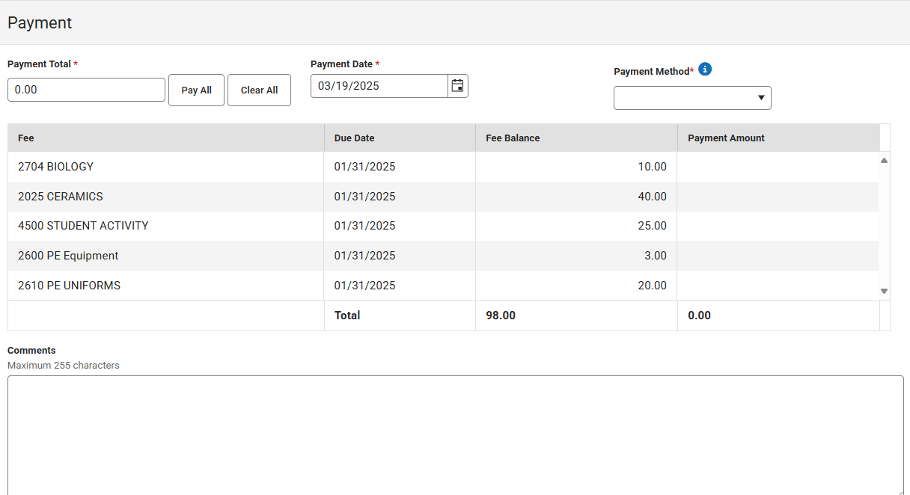
Making Payments in IC
This will now be on the Parent/Student panel. This can now be paid at your desk with cash, check or
credit card by selecting the Make Payment button.
It can also be paid on the portal by the parent/student by credit card or e-check. Currently
The service fee is 4.0% and is automatically charged to the parent/student or a flat fee of .35¢.
This you will select a single fee by double clicking the fee, the pay all button if all fees are to be paid or selecting a single fee and paying a partial payment. You can print a receipt from the print button, but you don’t have to as it will show paid on their portal. Add any comments you need.

Slide 26
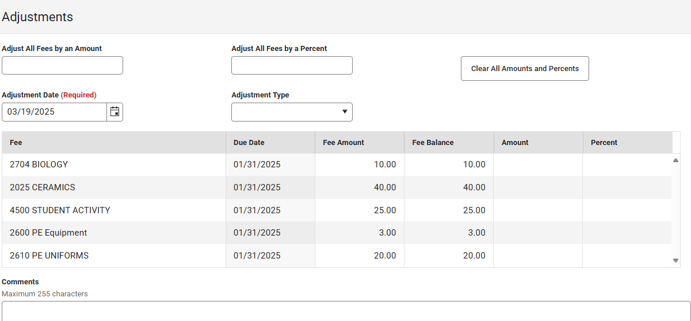
Making Adjustments in IC
Make Deposit icon is NOT for making a deposit. What this will do is let you put surplus money on a students
Account.
Once the student has paid and you need to refund a fee start with, Make Adjustments button.
This you can adjust by an amount, a percent. These two types will probably not be used much.
Go to the fee, select the amount column and put in the amount to be adjusted. Make any comments you need. Once your done with this step select the Make Adjustment button at the bottom. This will give you surplus dollars at the top of the student panel.

Slide 27
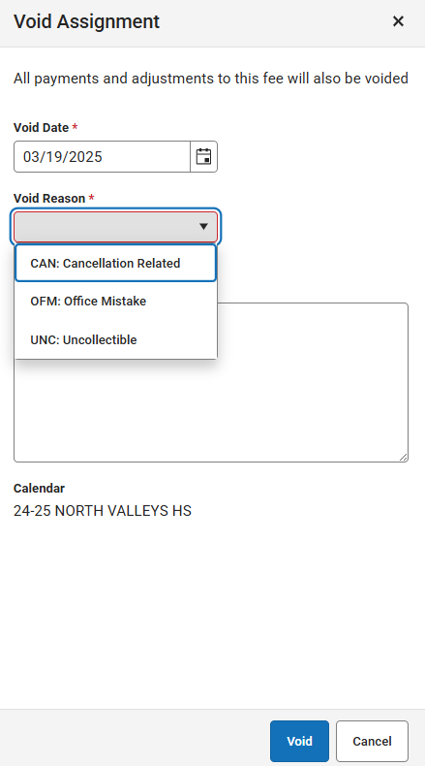
Making Adjustments in IC
Make Adjustments button. If the student has paid for a fee and needs a refund, go to the Make Adjustment
button at the bottom.
Once your done with Make Adjustment this will give you surplus dollars at the top of the student panel.
Make Adjustment is also when you need to void a fee charged to a portal incorrectly example to a wrong student. You will go to the Make Adjustment button; choose the void button at the bottom a new window will open you will then need to choose a reason. The most often used reason is OFM: Office Mistake then select the Void button at the bottom.

Slide 28
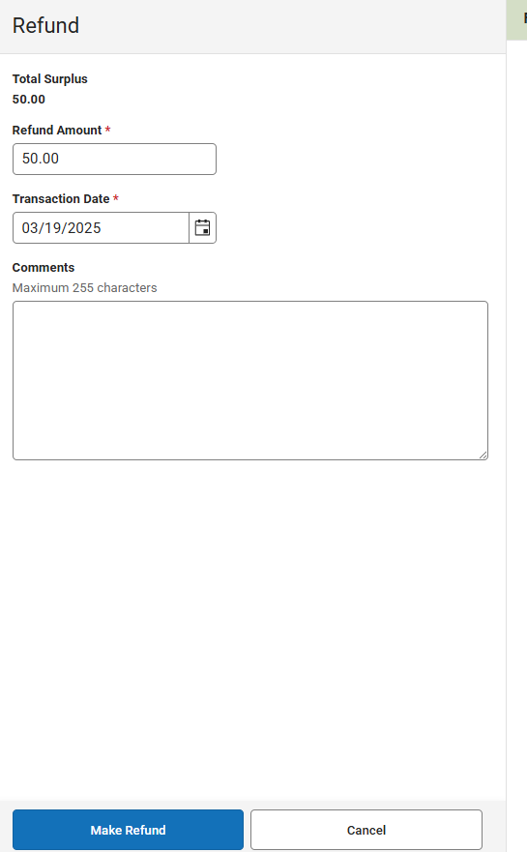
Making Refunds in IC
Make Refunds button. After you’ve made the adjustment, you now can do one of two things: leave the money on the student panel for future payment of fees or Make Refund.
Once your done with Make Adjustment this will give you surplus dollars at the top of the student panel. Now you need to do the Make Refund. This will show you the amount you have to refund, date and any comments you’ll make. Now you will have to print the receipt that show the refund and go to Schoolbooks and process the check from there.

Slide 29
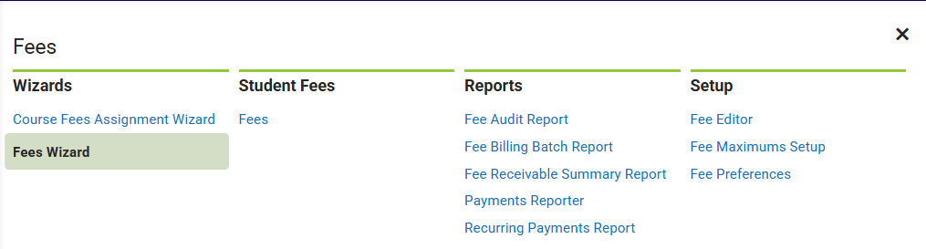
Using: Fees Wizard for Fees
Go to the main menu the three lines in the upper left-hand corner. Select Fees then Fees Wizard.
This will open a new window.

Slide 30
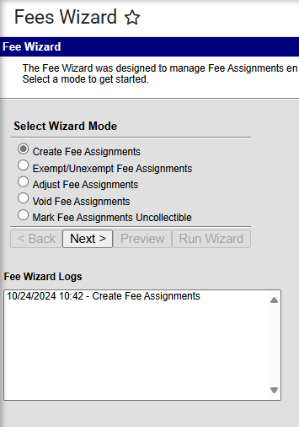
Fees Wizard for Fees continued
Once the Fees Wizard opens select Create Fee Assignments.
This will once again open a new window.

Slide 31
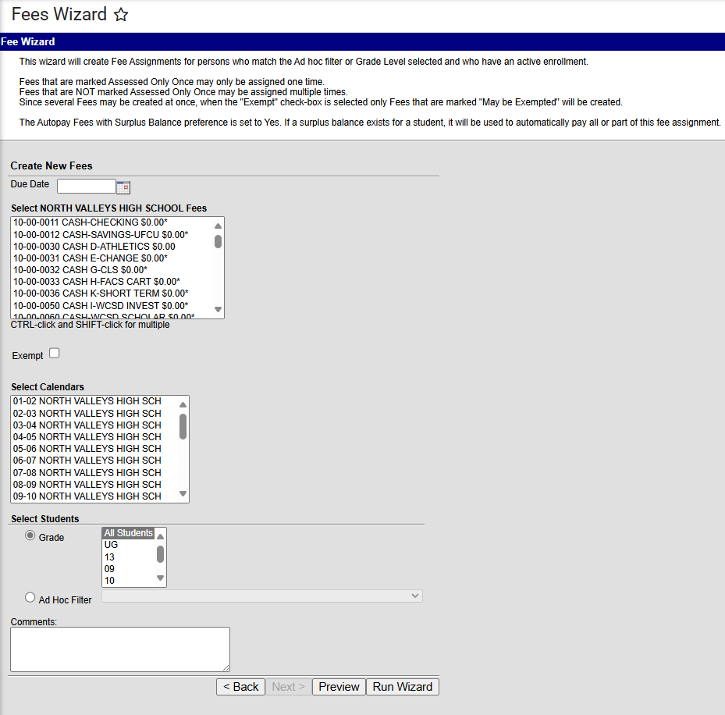
Fees Wizard for Fees continued
If you have a due date for a course enter it in the due date field.
Next, select the course you need to apply fees to. If you have multiple accounts, click on the accounts being charged by using ctrl and select the account. (Lift off the ctrl key when moving through the list or it will resize your screen for you).The courses you select will be grayed out, so you know they’ve been selected. Select the calendar year the fee will be charged in, select all student, individual grades, or add an ad hoc report that is being charged. (more information to come for ad hoc).
Select Run Wizard button when you are ready to apply fees to the student panels.
To check that the Run Wizard went to the correct panels find a student to review. Using the magnifying glass find a student.

Slide 32
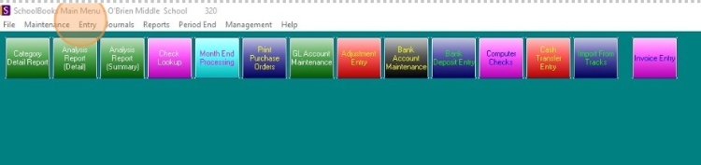
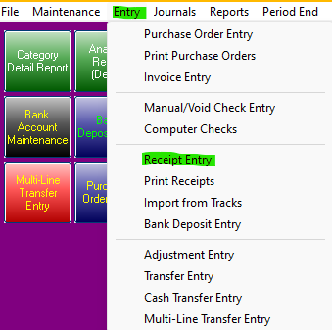
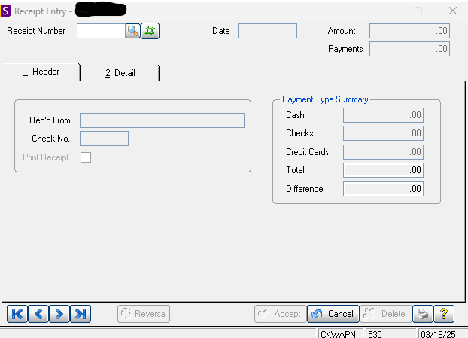
Taking a fee that is not a student in IC: Z-customers
Open Schoolbooks
Select Entry on the top ribbon, scroll down to Receipt Entry, this will
open a new window

Slide 33
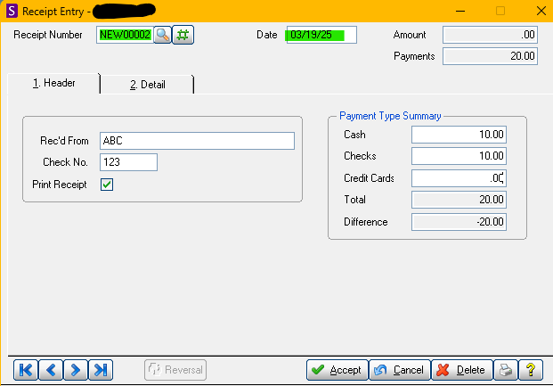
Taking a fee that is not a student in IC: Z-customers continued…
On this screen 1. Header
You will enter your receipt number manually if you have one or auto generate a receipt number buy selecting the # sign.
Then TAB over to the date.

Slide 34
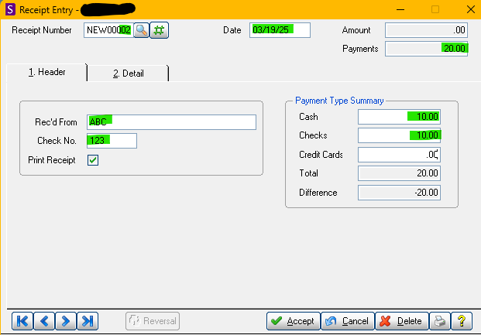
Taking a fee that is not a student in IC: Z-customers continued…
Still on screen 1. Header
Type in Rec'd From (the person who giving you the money or receipt name).
Tab to the “Check No.” field. If the money consists of:
• A single check -- enter the check number.
• Cash only -- enter “Cash”.
• Multiple checks (no cash) – enter “Multiple”.
• Cash and checks – enter “Mix”.
On the Payment Type Summary
Fill in the total amount of cash in the cash, fill in the total amount of checks in the check field.
*Enter the payment types that make up this receipt. The purpose of tracking this data is to make it easier for you to tie the amounts and types of money you receive to individual transactions that are not student based. Click on the “Detail” tab in the window to advance to the Detail screen.

Slide 35
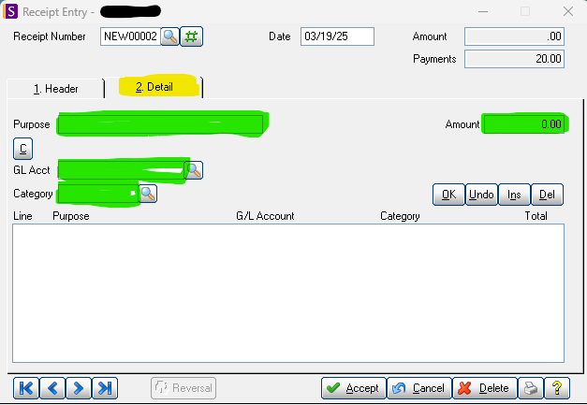
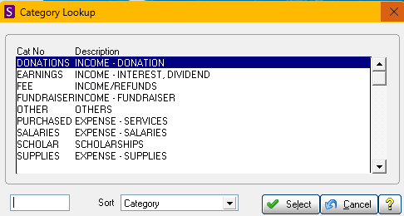
Taking a fee that is not a student in IC: Z-customers continued…
On screen 2. Details
In the “Purpose” field, enter the purpose or description for the receipt, such as “Fundraiser”, "Store Sales" or “Field trip”, etc..
*Example for keying in your multiple checks or single check. Use the purpose lines to enter your check information. Ex. Ck#125 Alex Smith- Band Rental
Tab to the “Amount” field and enter the amount associated with this purpose/description
Tab to the “GL Acct” field and enter the GL Account # associated with this purpose/description. You can also click on the magnifying glass next to the GL Account field to easily find the GL Account number.
Tab to Category and select which income it is tied to and click select.
Click OK

Slide 36
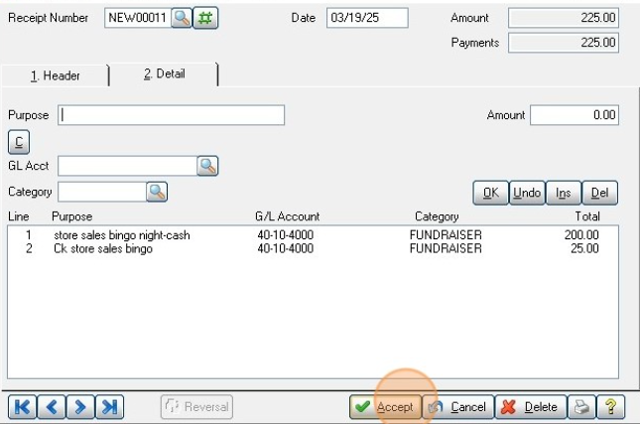
Taking a fee that is not a student in IC: Z-customers continued…
On screen 2. Details
Repeat the steps on the previous slide for each different GL Account which a receipt needs to be entered.
When done, click the “OK” button and confirm that the amount in the “Amount” field at the top right corner of the Receipt Entry window is correct – both the amount and payments are equal.
If it doesn’t go back and double check what you have entered.
If it does, click “Accept” at the bottom of the Receipt Entry window.

Slide 37
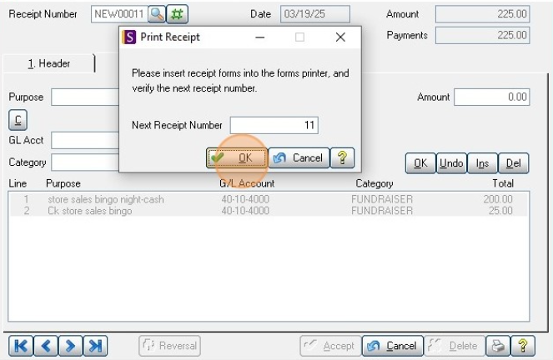

Taking a fee that is not a student in IC: Z-customers continued…
Print Receipt screen make sure that your receipts match if they do select OK.
Click Yes if everything printed correctly.
Once completed, accepted & printed repeat until you are ready to do a deposit.

Slide 38
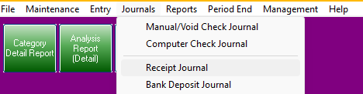
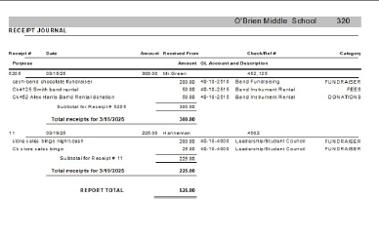
Taking a fee that is not a student in IC: Z-customers continued…
Under Journals- Click "Receipt Journal" once open click print.
This is an example of what will print when you select
print from the above step. You will verify everything
matches your receipts that you inputted for your
non-student customers. (z-customers)

Slide 39
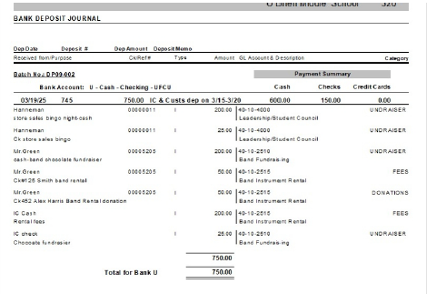
Bank Deposit Entry
The total for your bank deposit, should match what you are sending to the bank. Fill out your bank slip to send to the bank.

Slide 40
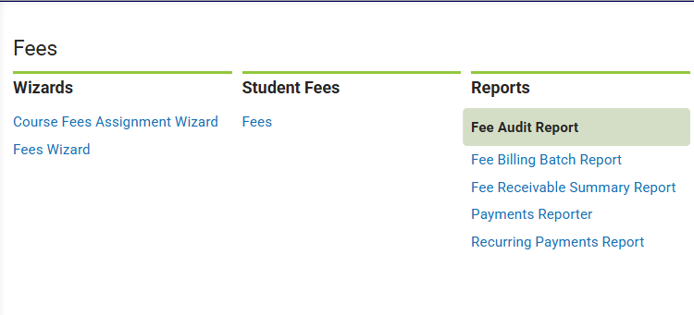
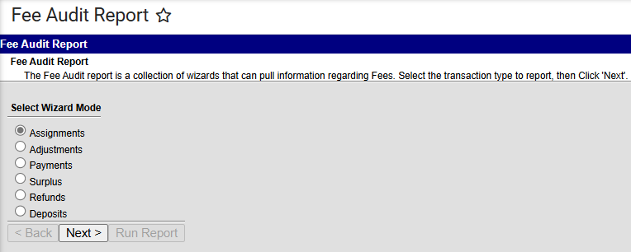
Pulling the Report to Record Fees in SchoolBooks:
In the main menu go to Fees then Reports to Fee
Audit Report.
A new window will open that looks like this
Select payments for this report
A new window will open
Select payments for this report

Slide 41
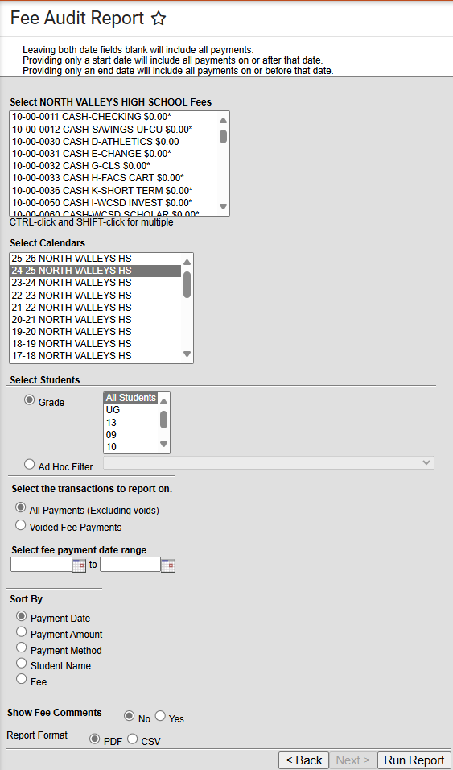
Pulling the Report to Record Fees in SchoolBooks:
Leave the top box as it is don’t select any accounts.
The second box select the current year.
The third box select the grade or all students.
You and use an Ad Hoc Filter at this line if you have one.
Select All Payments (Excluding Voids)
Select your date range-this is important to make it your deposit date range. Example if you do the deposit on Thursday night, then you would do Friday date to the next Thursday date.
Sort by can be any of these but Fee is recommended.
Leave Show Fee Comments as a NO.
Select PDF and Run Report then as a CSV and Run Report

Slide 42
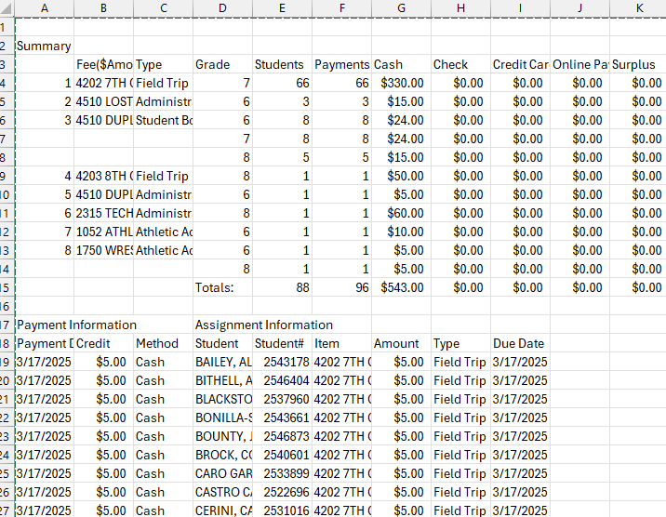

Pulling the Report to Record Fees in SchoolBooks: continued
When you pull the report as a CSV it will look something like this. Now you will need to expand and filter.
Start by going to the This will highlight the whole worksheet. Then go to the line between column A & B
You will get a black + sign then double click this will open the entire workbook so you can see all the information. I would delete rows 1 & 2 and filter row 3.
NEXT…..

Slide 43
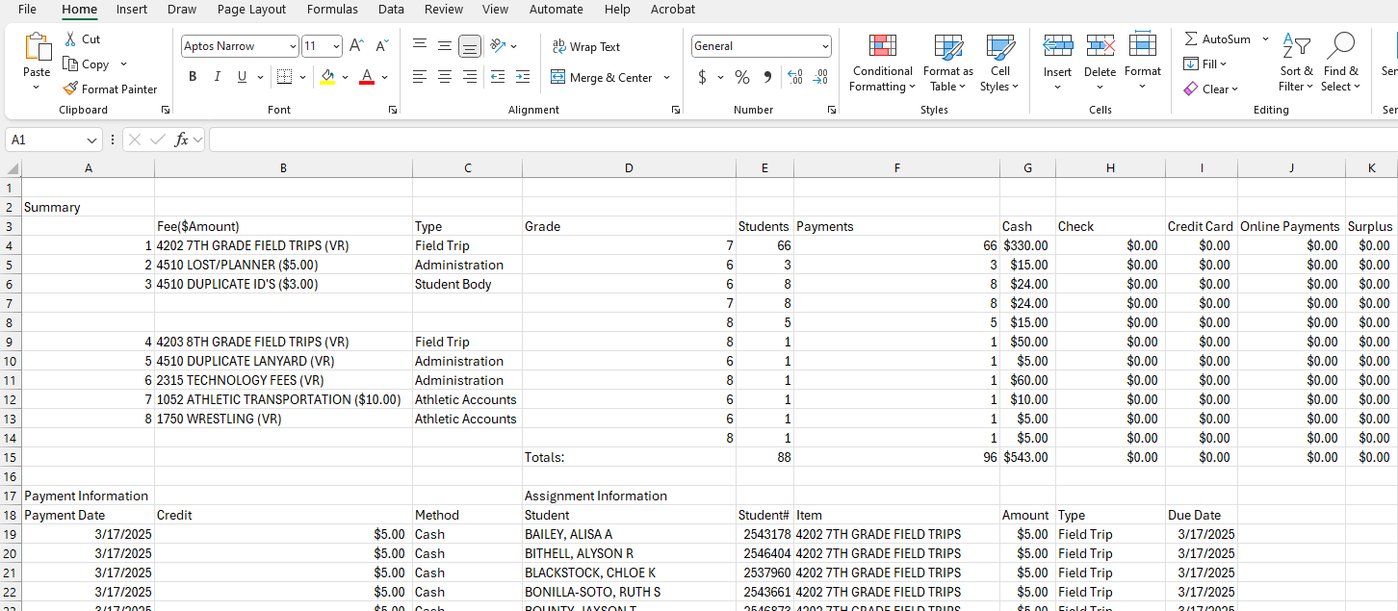
Pulling the Report to Record Fees in SchoolBooks: continued
All your columns will expand. This is what a small report will look like your report could be much larger.
The top is your deposits & the bottom is the payees (receipts). Now delete rows 1& 2.
NEXT…

Slide 44
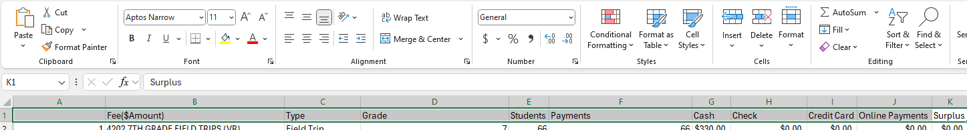
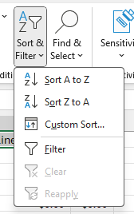
Pulling the Report to Record Fees in SchoolBooks: continued
1. Highlight row 1 and add a filter
2. Go to your ribbon to the Sort & filter
3. Select your filter icon from the ribbon go to the filter
4. Your row will now have little drop down arrows

Slide 45
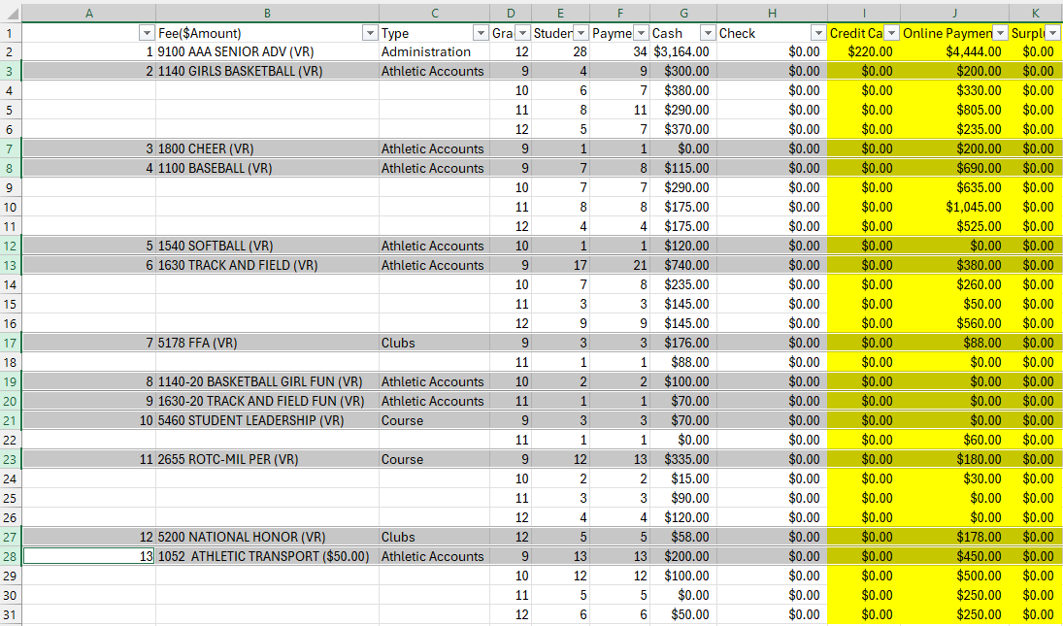

Pulling the Report to Record Fees in SchoolBooks: continued
This is a larger
report so there are more accounts to
separate. You can insert a line between
each account by selecting the account
line going to the ribbon on top/home/
insert. This will add a line after each account.

Slide 46
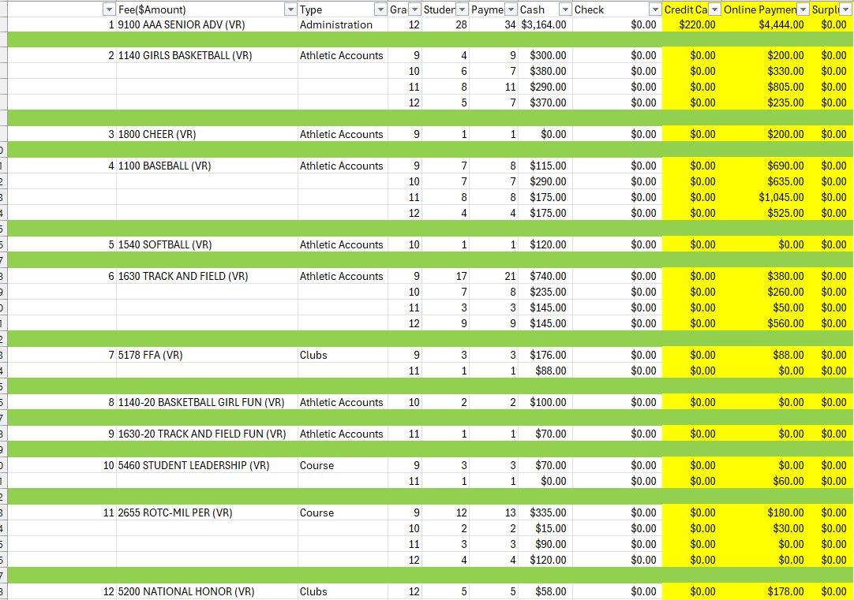
Pulling the Report to Record Fees in SchoolBooks: continued
Now each of your accounts
has a line that you can subtotal the money you’ve take in. The yellow highlighted columns you delete. Credit card and online payments you will do at the end of the month
when you process your bank statements.

Slide 47



Pulling the Report to Record Fees in SchoolBooks: continued
Now select the cell under the account you want to subtotal,
you can do this by selecting the first cells hold down the Ctrl
key and select the next set of cells, continue until you done
with your report. Once your done lift off the Ctrl key. Now you
can auto sum your report. Go to the ribbon on top and select
the auto sum tab. It is the symbol that looks like a
Greek E. Your work- sheet will now have the totals
For your accounts and ready to enter into School-
books.

Slide 48


Pulling the Report to Record Fees in SchoolBooks: continued
Once you’ve added your empty rows, subtotaled and highlighted your totals (this is up to you). You are ready to go to Schoolbooks to do your deposit. The bottom part of this spread sheet is just information on who paid and how they paid. This information is on the CSV and the PDF. The cash column will sum your cash, and the check column will sum your checks. In this case there are no checks. If you want to total your cash & checks, you can subtotal using the auto sum in another column.

Slide 49
Bank Deposit Entry
Now you will take this to go enter in Schoolbooks for your closeout. You will need the IC PDF or the CSV report that you have sorted of the Fee Audit Report with the date range for your deposit, either of these document will show your totals, and if you entered non-customers (Z-customers) in Schoolbooks, you would also need the receipt journal.

Slide 50


Bank Deposit Entry
Under Entry -Click "Bank Deposit Entry" or find your button.
This shows what you entered into the receipt entry and was
uploaded to the bank deposit. Remember this does not
reflect IC cash and check payments. You will be entering IC
amounts that will be sent to the bank.

Slide 51


Bank Deposit Entry
Note: This will
Make your deposit
NOT balance!
Click on the memo and type IC & Cust. dep 3/17-3/20 (this will be the date range or single date of deposit made to the bank)
Click in the Payment Type summary and add the amount of cash and check you have from IC. Don't worry about the credit card payment part (CC are done once a month) we can go over that in another section. Then click 2. Detail tab

Slide 52


Bank Deposit Entry
Enter your fees from IC (IC cash, IC cash & check or IC checks) the purpose from the IC Fee Audit Report (ex. Rental fees), the amount collected to that account, select the account of the GL that it is being deposited to. Select the category for the income.
Before entering these deposits, your balance will be off (see slide #39). You will add your fees from IC and now you should have a zero balance. If you balance - push okay, if it doesn’t balance, select the fee that needs to be fixed by double clicking the line and adjusting the amount if that is what is not entered correctly. Click Accept if everything balances!!

Slide 53


Bank Deposit Entry
Click "Cancel" to print the Bank Deposit Entry.
Click "Yes" and click yes to update if all the information
is correct.

