Slide 1
South, East, and Southeast Asia
300 B.C.E-1980 C.E

Slide 2
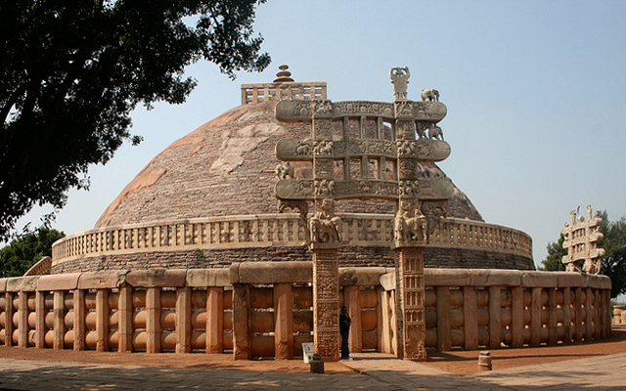
Great Stupa at Sanchi
https://www.khanacademy.org/humanities/ap-art-history/south-east-se-asia/india-art/a/the-stupa
Madhya Pradesh, India
Buddist; Maurya, Late Sungra Dynasty
300 B.C.E.-100 C.E.
Stone masonry, sandstone on dome

Slide 3
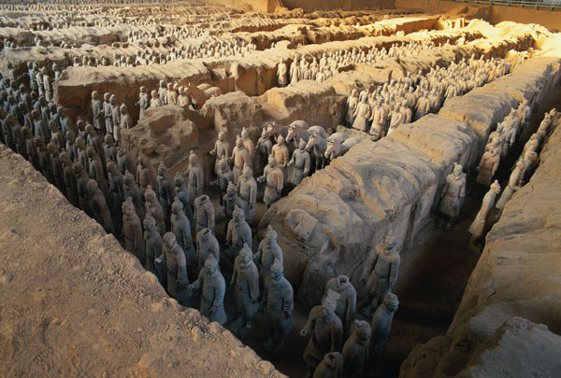
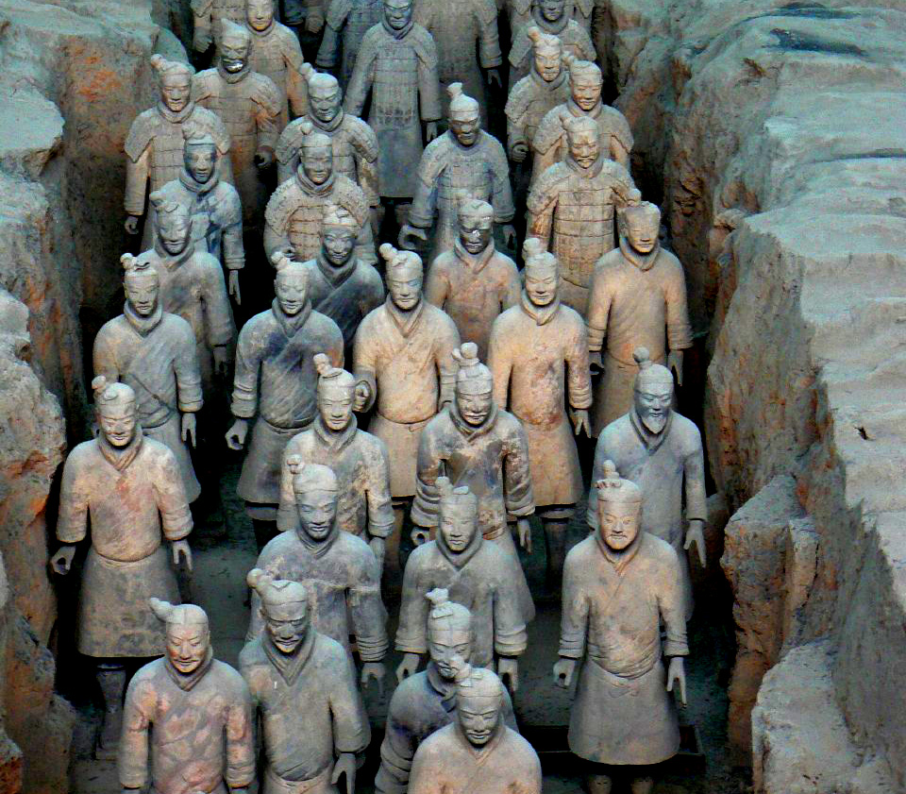
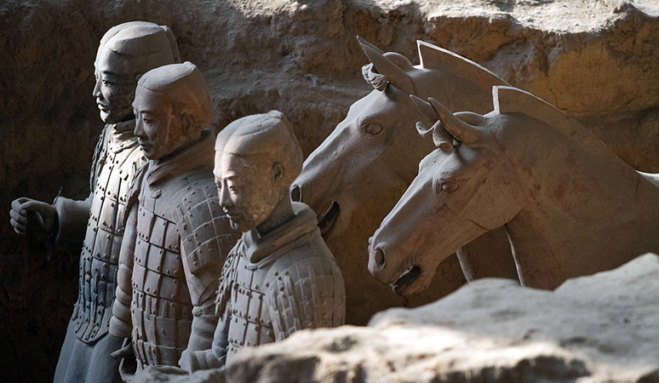
Terra Cotta Warriors from mausoleum of the first Qin Emperor of China
Qin Dynasty
221-209 B.C.E.
Painted terra cotta
https://www.khanacademy.org/humanities/ap-art-history/south-east-se-asia/china-art/a/terracotta-warriors-from-the-mausoleum-of-the-first-qin-emperor-of-china

Slide 4
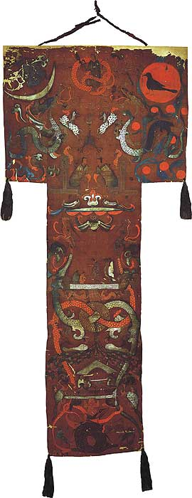
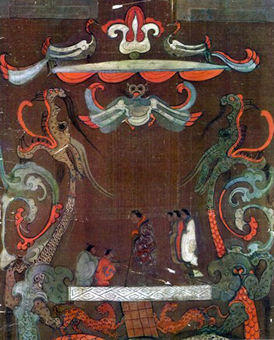
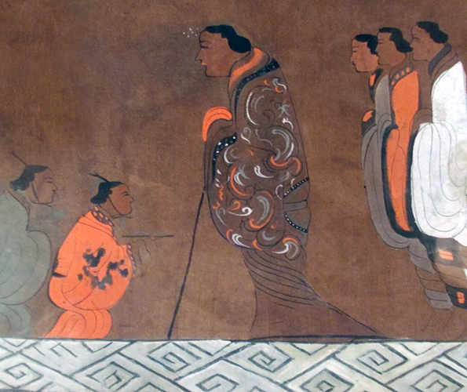
Funeral banner of Lady Dai (Xin Zhui)
Han Dynasty, China
180 B.C.E.
Painted silk
https://www.khanacademy.org/humanities/ap-art-history/south-east-se-asia/china-art/a/funeral-banner-of-lady-dai-xin-zhui

Slide 5
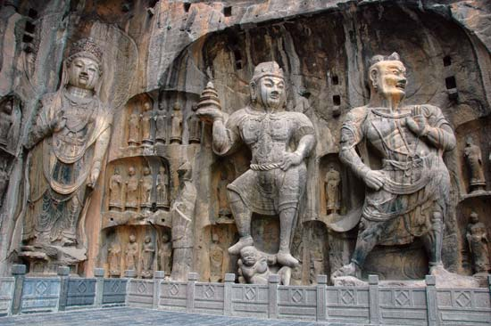
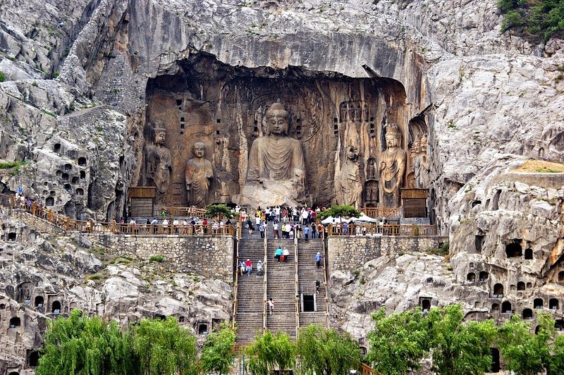
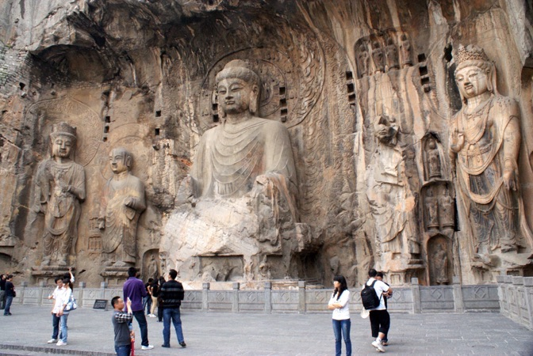
Longmen Caves
Luoyang, China
Tang Dynasty 493-1127 C.E.
Limestone
https://www.khanacademy.org/humanities/ap-art-history/south-east-se-asia/china-art/a/longmen-caves-luoyang

Slide 6
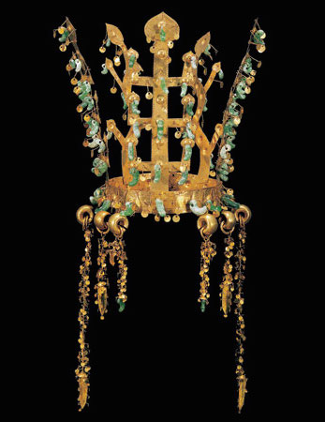
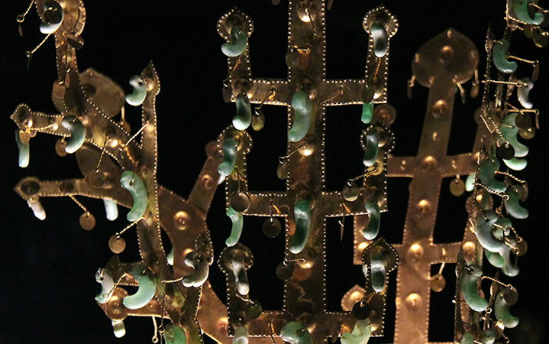
Gold and jade crown
Three Kingdoms Period
Silla Kingdom, Korea
5th to 6th century C.E.
Metalwork
https://www.khanacademy.org/humanities/ap-art-history/south-east-se-asia/korea-art/a/gold-and-jade-crown-silla-kingdom

Slide 7
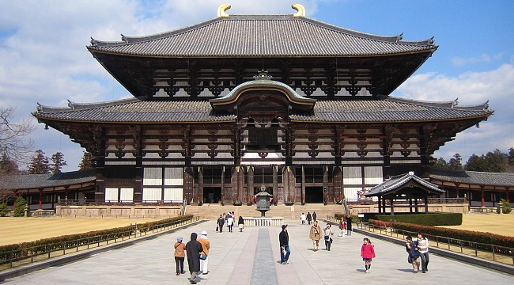
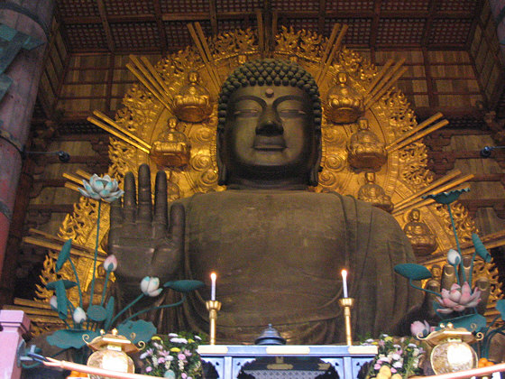
Todai-ji
https://www.khanacademy.org/humanities/ap-art-history/south-east-se-asia/japan-art/a/todai-ji
Nara, Japan
Various artists; sculptors:
Unkei and Keikei
743 C.E. rebuilt in 1700 C.E.
Bronze and wood; wood with ceramic-tile roofing

Slide 8
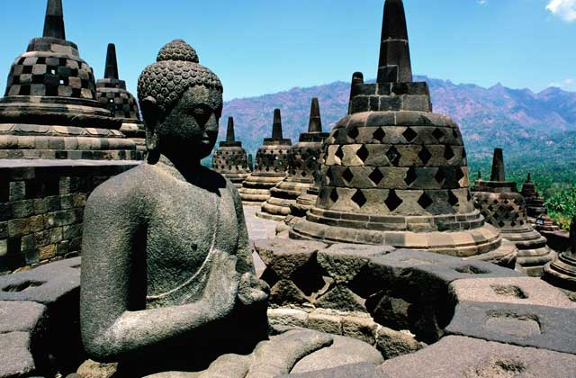
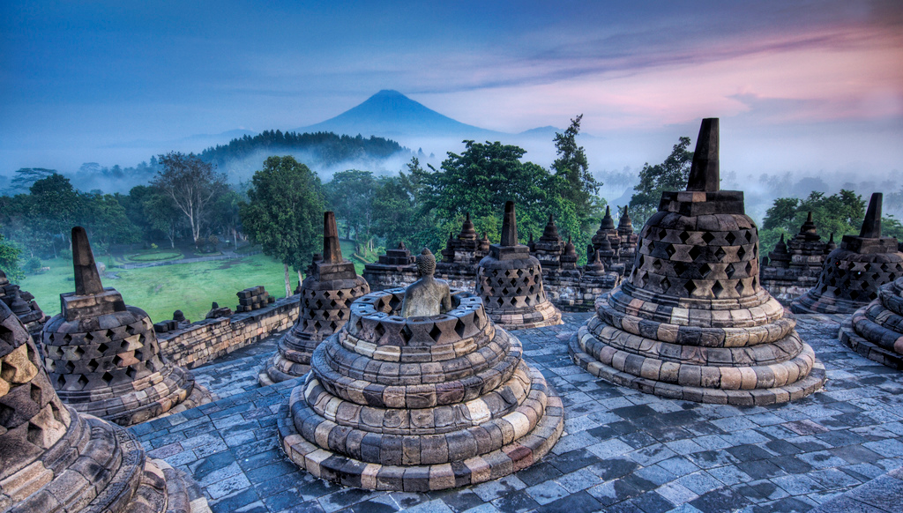
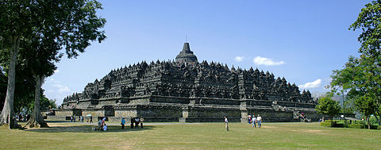
Borobudur
Central Java, Indonesia
Sailendra Dynasty
750-843 C.E.
Volcanic-stone masonry
https://www.khanacademy.org/humanities/ap-art-history/south-east-se-asia/indonesia-art/a/borobudur

Slide 9
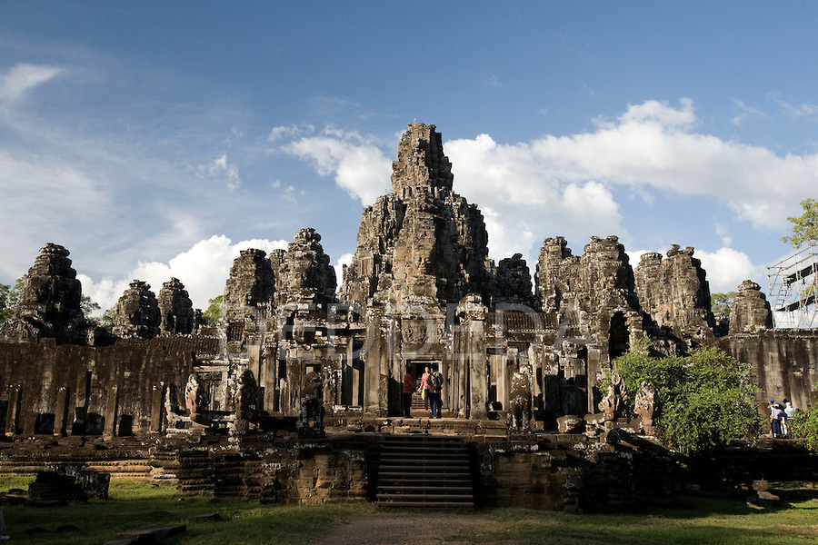
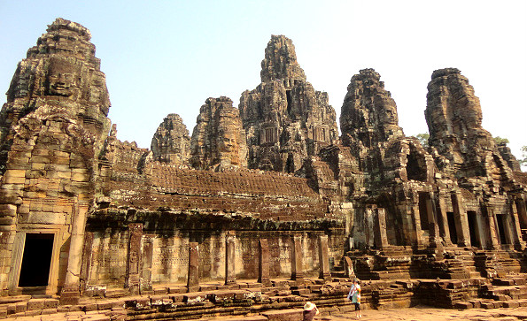
Angkor, the temple of Angkor Wat, the city of Angkor Thom, Cambodia
https://www.khanacademy.org/humanities/ap-art-history/south-east-se-asia/cambodia-art/a/angkor-wat
Hindu, Angkor Dynasty
800-1400 C.E.
Stone masonry, sandstone

Slide 10
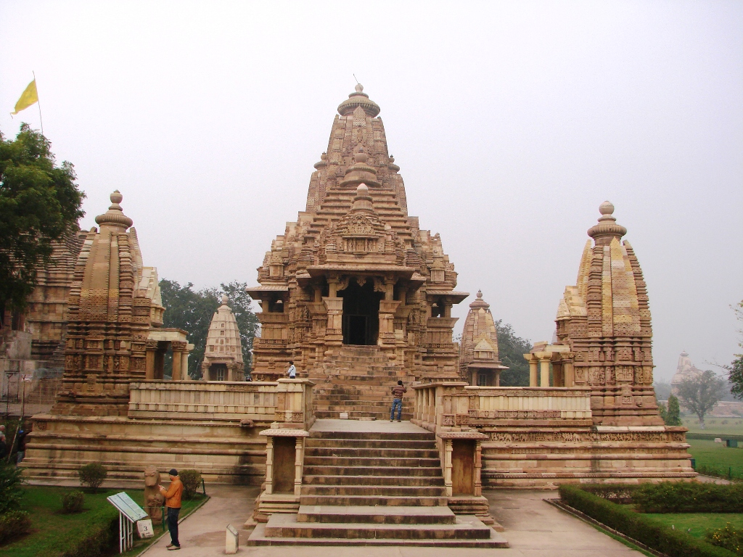
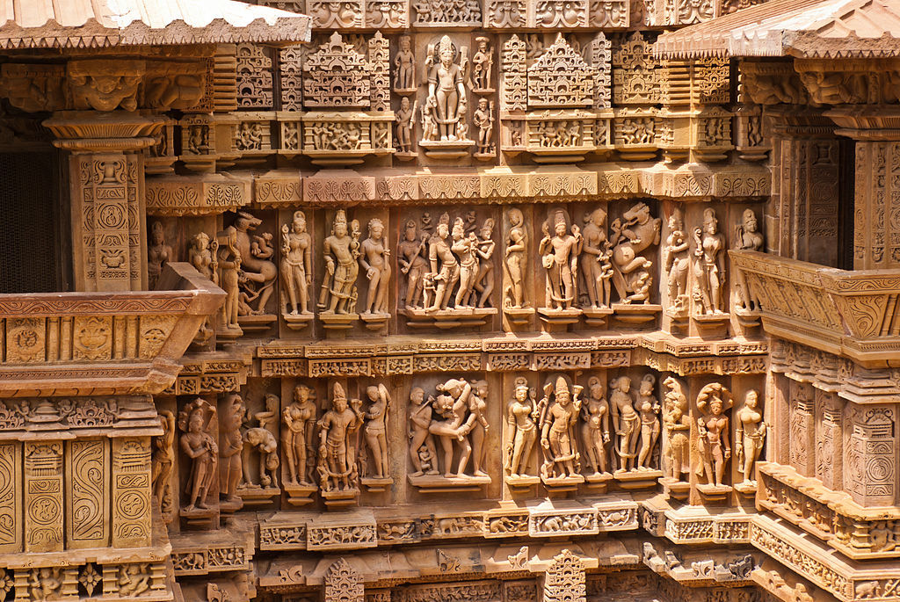
Lakshmana Temple
https://www.khanacademy.org/humanities/ap-art-history/south-east-se-asia/india-art/a/lakshmana-temple-india
Khajuraho, India
Hindu, Chandella Dynasty
930-950 C.E.
Sandstone

Slide 11
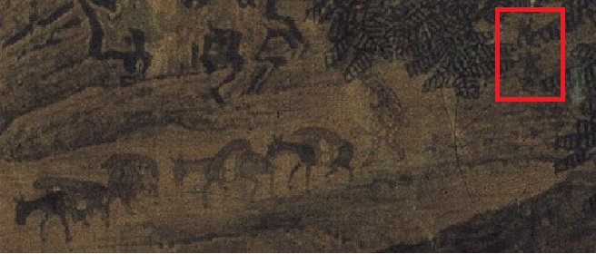
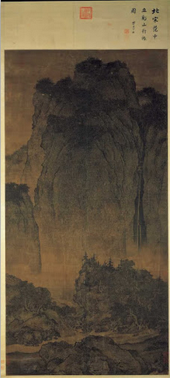
Travelers among Mountains and Streams, Fan Kuan
100 C.E.
Ink and colors on silk
https://www.khanacademy.org/humanities/ap-art-history/south-east-se-asia/china-art/a/neo-confucianism-fan-kuan-travelers-by-streams-and-mountains

Slide 12
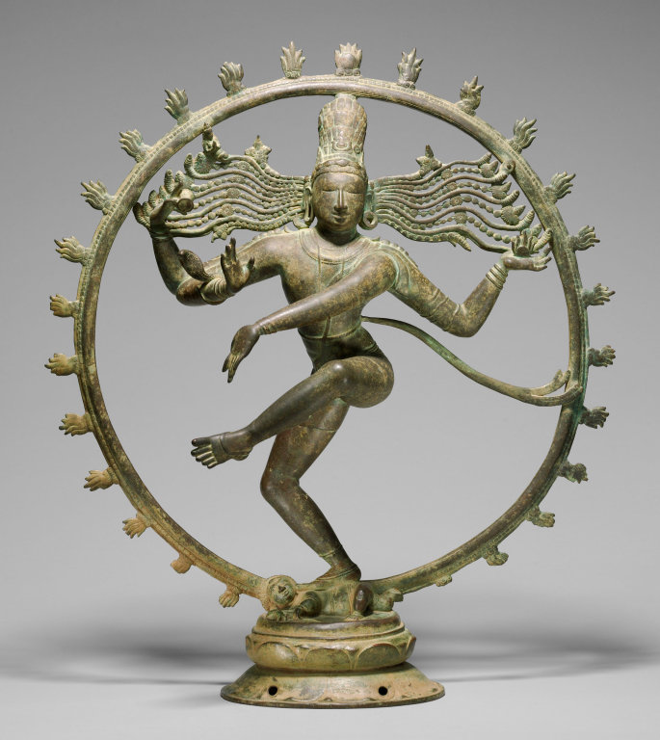
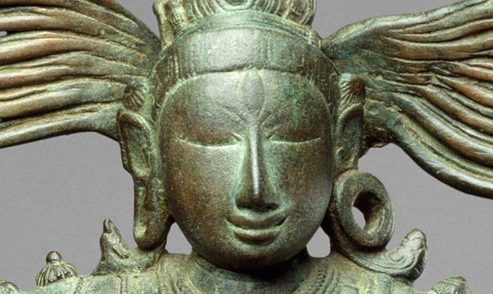
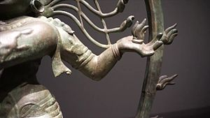
Shiva as Lord of Dance (Nataraja)
Hindu, India (Tamil Nadu)
Chola Dynasty
11th century C.E.
Cast Bronze
https://www.khanacademy.org/humanities/ap-art-history/south-east-se-asia/india-art/a/shiva-as-lord-of-the-dance-nataraja

Slide 13
Night Attack on the Sanjô Palace
Kamakura Period, Japan
1250-1300 C.E.
Hand scroll (ink and color on paper)
https://www.khanacademy.org/humanities/ap-art-history/south-east-se-asia/india-art/a/shiva-as-lord-of-the-dance-nataraja

Slide 14
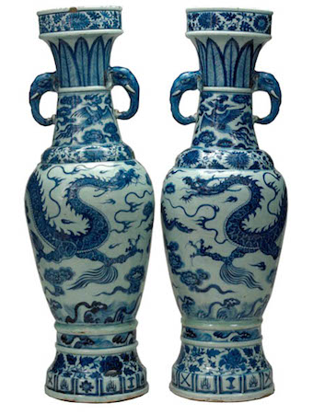
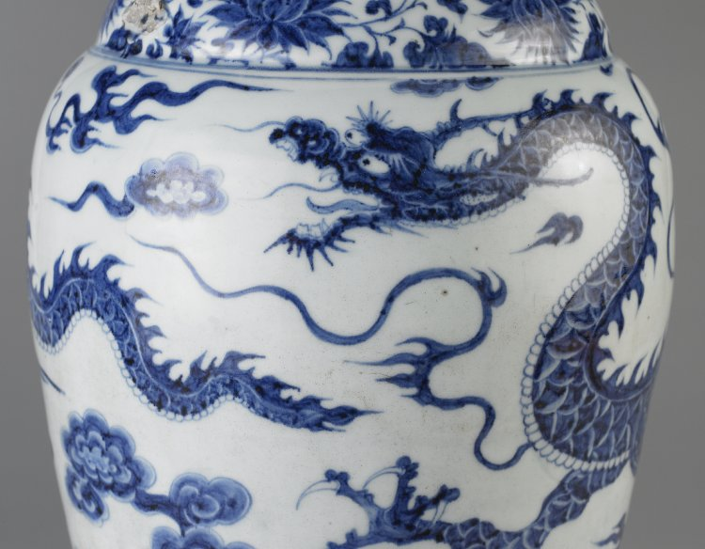
The David Vases
https://www.khanacademy.org/humanities/ap-art-history/south-east-se-asia/china-art/a/the-david-vases-chinese-porcelain
Yuan Dynasty, China
1351 C.E.
Whit porcelain with cobalt blue underglaze

Slide 15
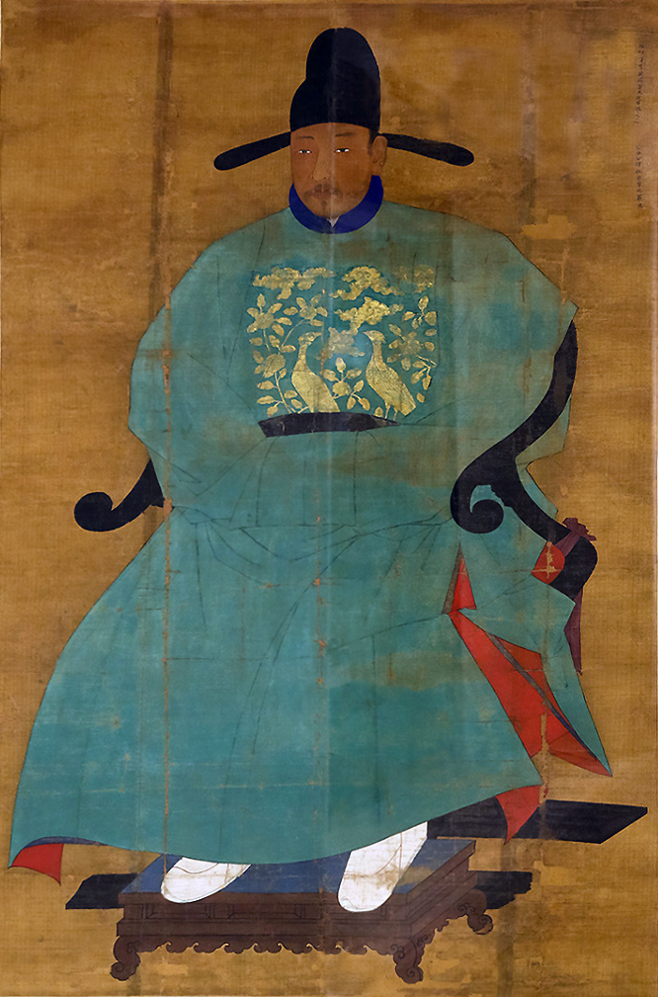
Portrait of Sin Sukju
1417-1475 Imperial Bureau
of Painting
15th Century C.E.
Hanging scroll
https://www.khanacademy.org/humanities/ap-art-history/south-east-se-asia/korea-art/a/sin-sukju

Slide 16
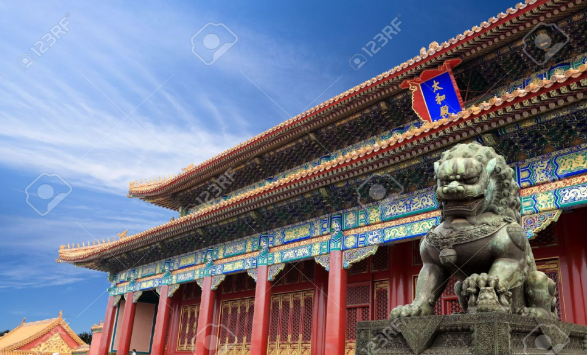
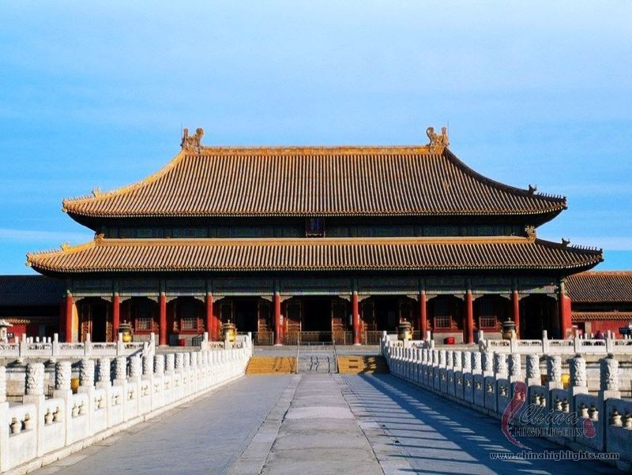
Forbidden City
Beijing, China
Ming Dynasty
15th century C.E.
Stone masonry, marble, brick, wood, and ceramic tile
https://www.khanacademy.org/humanities/ap-art-history/south-east-se-asia/china-art/a/forbidden-city

Slide 17
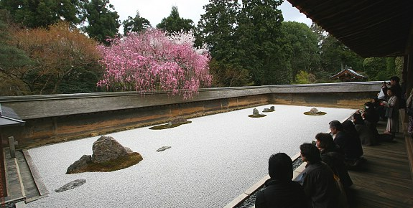
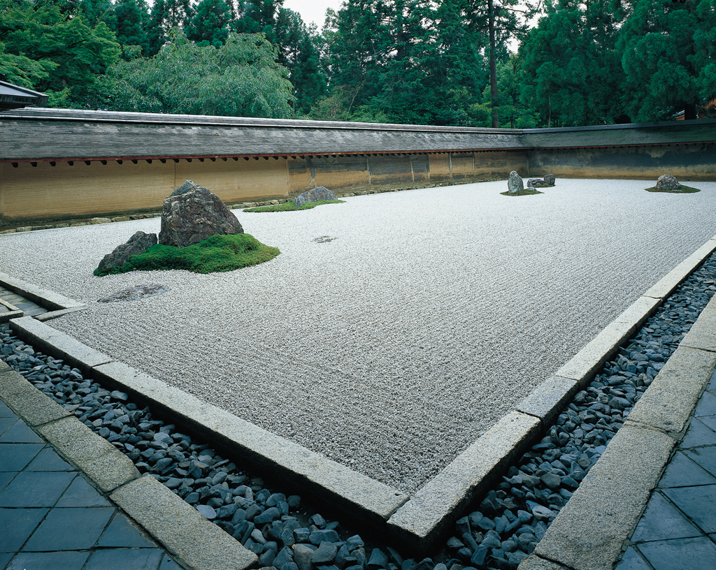
Ryoan-ji
https://www.khanacademy.org/humanities/ap-art-history/south-east-se-asia/japan-art/a/ryoanji
Kyoto, Japan
Muromachi Period 1480 C.E.
Rock Garden

Slide 18
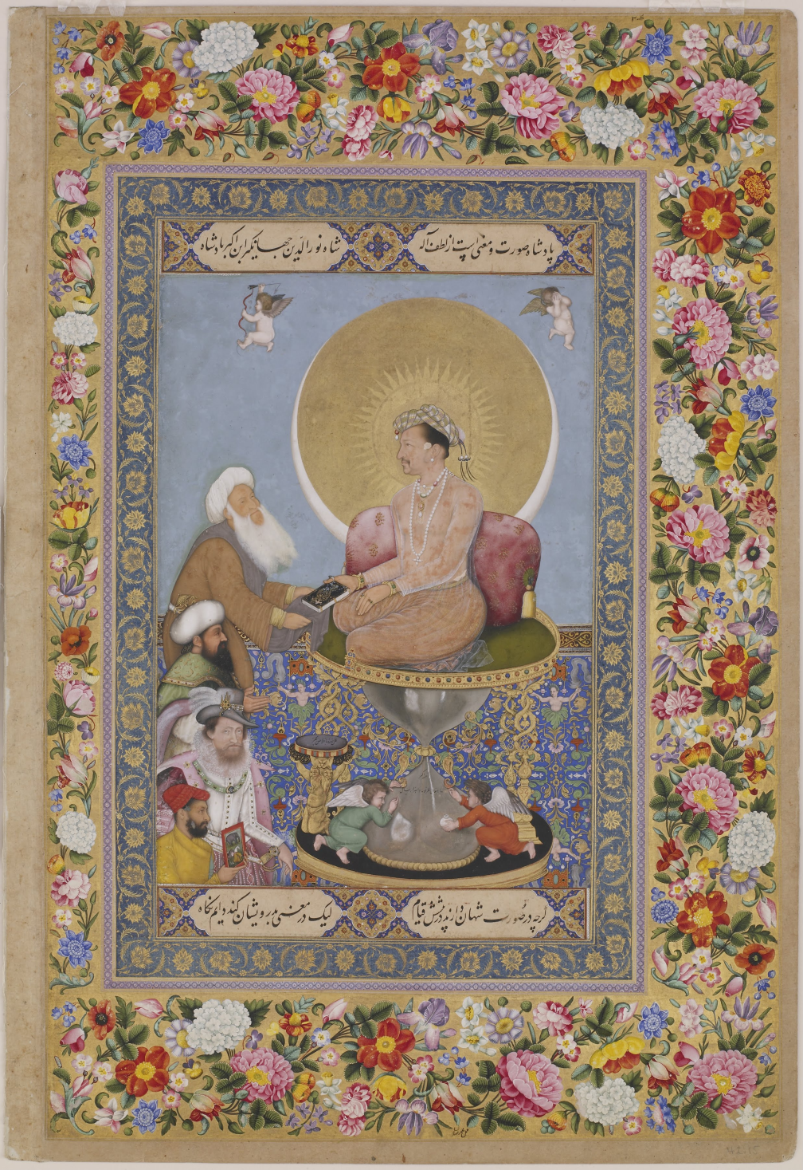
Jahangir Preferring a Sufi Shaikh to Kings, Bichitr
1620 C.E.
Watercolor, gold, and ink on paper
https://www.khanacademy.org/humanities/ap-art-history/south-east-se-asia/india-art/a/bichtir-jahangir-preferring-a-sufi-shaikh-to-kings

Slide 19
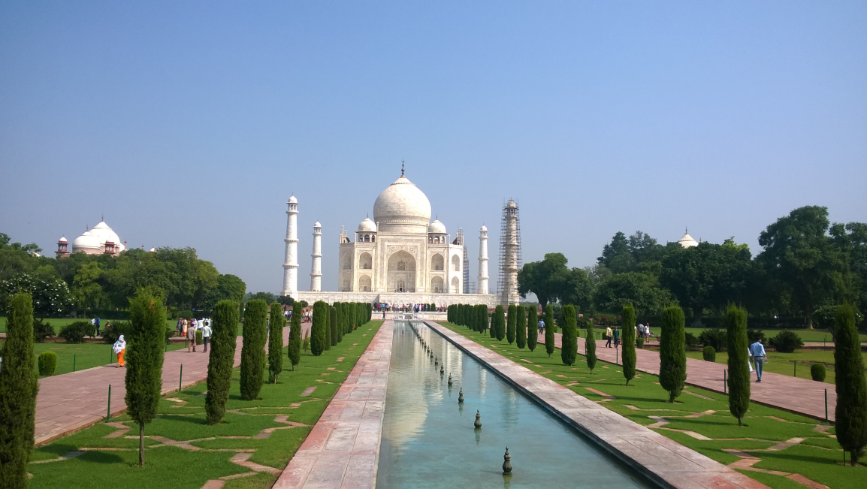
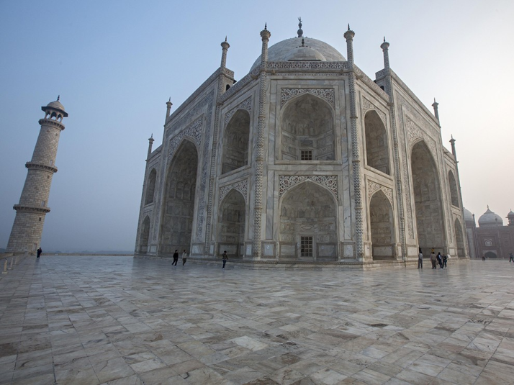
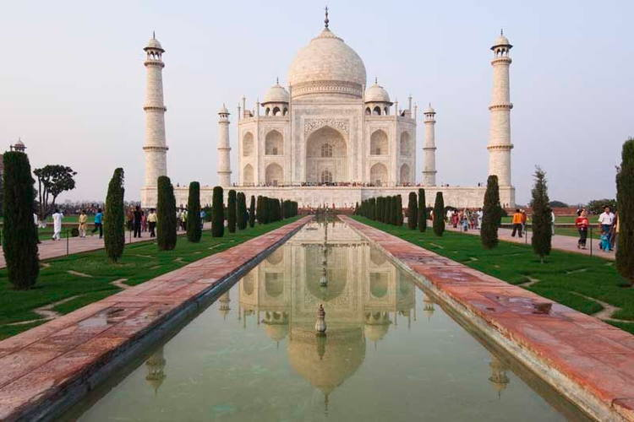
Taj Mahal
Agra, India, 1632-53
Supervision of Ustad Ahmad Lahori
Masons, marble, mosaics, gems
https://www.khanacademy.org/humanities/ap-art-history/south-east-se-asia/india-art/a/the-taj-mahal

Slide 20
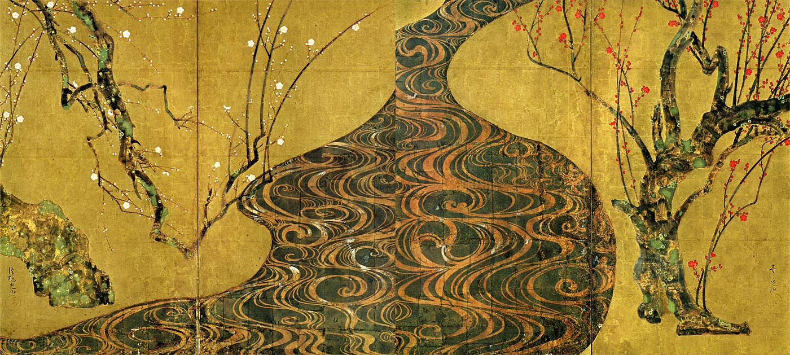
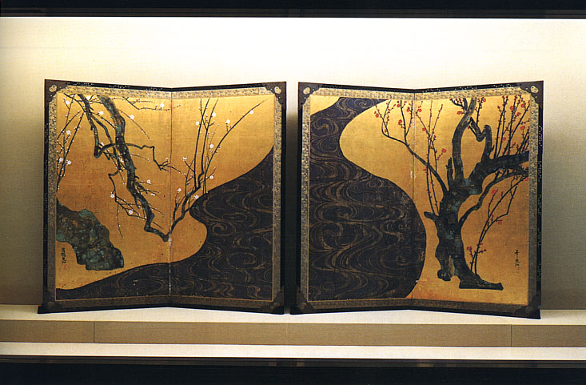
White and Red Plum Blossoms, Ogata Korin
https://www.khanacademy.org/humanities/ap-art-history/south-east-se-asia/japan-art/a/ogata-krin-red-and-white-plum-blossoms
Ogata Korin
1710-1716 C.E.
Ink Watercolor, and golf leaf on paper

Slide 21
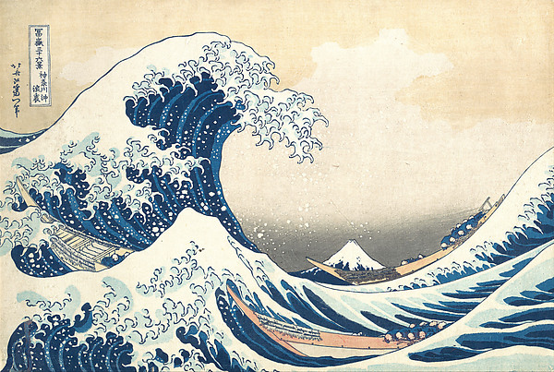
Under the Wave off Kanagawa (Kanagawa oki nami ura), The Great Wave, series Thirty-six Views of Mount Fuji, Katsushika Hokusai
1830-1833 C.E. Polychrome woodclock prink; ink and colored paper
https://www.khanacademy.org/humanities/ap-art-history/south-east-se-asia/japan-art/a/hokusai-under-the-wave-off-kanagawa-the-great-wave

Slide 22
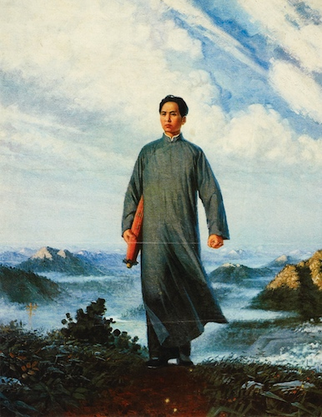
Chairman Mao en Route to Anyuan
Based on an oil painting by Liu Chunhua
1969 C.E. Colored lithograph
https://www.khanacademy.org/humanities/ap-art-history/south-east-se-asia/china-art/a/liu-chunhua-chairman-mao

