Slide 1
Its Senior Year, so…

Slide 2
Post-High School Options
College
2-year community college
4-year college or university
Technical/Trade School
Shorter training times, can be more expensive.
Lots of choices.
Apprenticeship Programs
Earn while you learn
Many construction trades
Must apply.
Military
Army, Navy, Air Force, Marines
Coast Guard, Army and Air Guard.
Work
On-the-Job Training
Stop in the Career Center for college and career assistance!!

Slide 3
Applying for College
Check Deadlines & MEET deadlines
UNR
Admissions open September 1
Early Action deadline: November 15
Fall 2022 Deadline: April 7
UC schools
Admissions open August 1
Fall 2022 Deadline: November 30
Apply early for better service; some colleges offer early consideration, including UNR.
Apply for scholarships and financial aid.
Some schools will have separate application.
You will need to complete the FAFSA form after Oct. 1st.

Slide 4
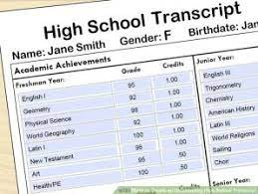
Transcripts
WCSD Student Accounting no longer allows counselors to print/send copies of student transcripts.
All Transcripts must be requested by visiting
www.washoeschools.net/drhs
Click on Quick Links
Click on Transcripts
ScribOrder will send your transcript to your identified college/university
First 4 transcripts are free
$10 per transcript after the 4th transcript
Pro Tip:
Send yourself a copy so that you can send out unofficial transcripts until you’ve narrowed your search
Send official copies later to those schools to which you’ve narrowed your selection

Slide 5
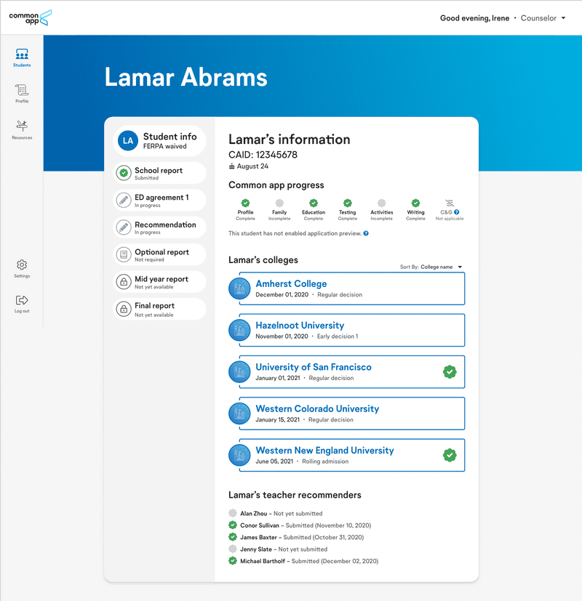
Common App
Navigate your entire college application journey with Common App.
www.commonapp.org
COVID-19 Impact section
Home - Common Data Set

Slide 6
Financial Aid www.fafsa.ed.gov
FAFSA stands for Free Application for Federal Student Aid
Fill it out… the earlier the better!!
Opens Oct. 1st
Please reach out to our College & Career Center for information about upcoming Parent Workshops for assistance

Slide 7
DRHS Scholarship Opportunity
www.washoeschools.net/drhscareercenter

Slide 8
The Millennium Scholarship https://www.nevadatreasurer.gov/GGMS/GGMS_Home/

Slide 9
Nevada Promise Scholarship
How it Works
As a last-dollar scholarship, the Nevada Promise Scholarship covers the cost of the registration and mandatory fees not covered by other gift aid
Tuition is not charged to residents of Nevada.
Gift aid is defined as
a Federal Pell Grant
a Federal Supplemental Educational Opportunity Grant (FSEOG)
a Silver State Opportunity Grant (SSOG)
a Governor Guinn Millennium Scholarship (GGMS).
The Nevada Promise Scholarship can provide funding for a student for up to three years.
Oct 31 Application is Due
https://bit.ly/nshe-nv-promise-app

Slide 10
Nevada Promise Scholarship (continued)
Planning to attend a 2-year college:
College of Southern Nevada (CSN)– Las Vegas
Great Basin College (GBC)- Elko
Truckee Meadows Community College (TMCC)- Reno
Western Nevada College (WNC)- Carson City
Resident of Nevada
High School Diploma
Enroll in 12 semester credits towards Associate’s Degree or Certificate program of study
Meet all deadlines
Application deadline- October 31
Training deadline- December 30
FAFSA deadline- April 1
Mentor Meeting- April 30

Slide 11
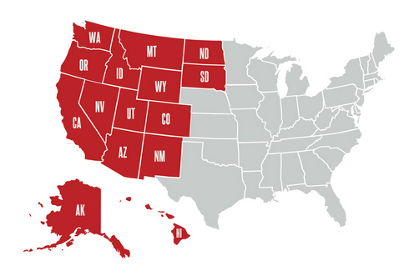
WUE Western Undergraduate Exchange https://www.wiche.edu/tuition-savings/wue/
Students can enroll in participating college programs at a reduced tuition rate
Considerably less than nonresident tuition
Apply for WUE through the school you plan to attend.
Some schools require that you complete a separate form, while others simply have you check a box on their general university application form.
Some schools exclude high-demand majors from participating in WUE.

Slide 12
Letters of Recommendation
Many colleges/universities will ask for a recommendation
Ask a staff member who knows you well
Teacher, Coach, Counselor, Administrator
Give 2 weeks advance notice
Many students ask the same people for recommendation letters, so you’ll need to give them time to complete them
Provide a resume/brag sheet about yourself
This gives the staff member information about you that you would like them to include in the letter

Slide 13
NCAA Clearinghouse https://web3.ncaa.org/ecwr3/
IS YOUR GOAL TO PLAY
COLLEGIATE SPORTS?
START PLANNING NOW!!
NAIA
www.naia.org
NAIA (National Association of Intercollegiate Athletics) to participate in athletics
2.3 GPA for recent graduates
or
Meet 2 of 3 following criteria:
2.0 GPA
Rank in top 50% of grad class
ACT- 18; SAT 970
Complete NAIA Profile
Upload transcripts to NAIA portal
NCAA (National Collegiate Athletic Association) clearinghouse to participate in Division I or II sports
16 Core credits
2.3 Core GPA
SAT combine score or ACT sum score matching core course GPA
Edgenuity is not accepted by the NCAA.

Slide 14
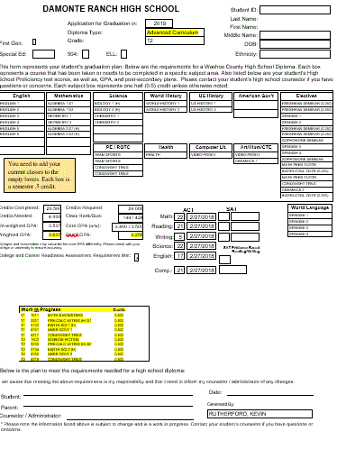
DRHS Graduation Plans

Slide 15
Have a GREAT YEAR!
See your counselor in the Counseling office or Mr. Cabada in the College & Career Center with any questions you may have!
Ms. Lazear
A-COP
Mr. Woodard
Cor-G
Ms. McColl
H-L
Ms. Barnard
M-PO
Ms. Moore
PR-S
Mr. Schreiner
T-Z
Mr. Cabada
College & Career Center
Mr. Hughes
Safe School Professional

