Slide 1
Global Prehistory 30,000-500 BCE

Slide 2
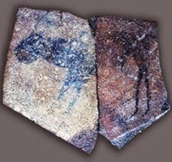
Apollo 11 Stones
Setting: Namibia
Medium: Charcoal on Stone

Slide 3
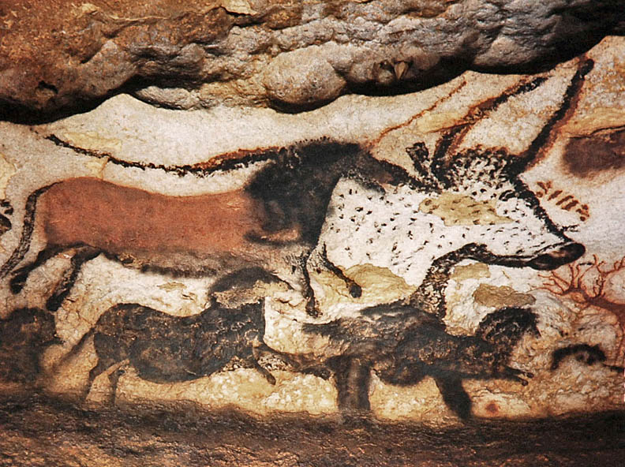
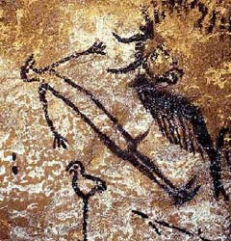
Great Hall of the Bulls
Setting: Lascaux, France
Medium: Rock painting

Slide 4
Camelid sacrum in the shape of a canine
Setting: Tequixquiac, central Mexico
Medium: Bone

Slide 5
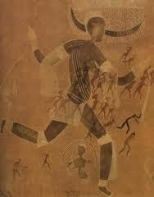
Running horned woman
Setting: Tassili n’Ajjer, Algeria
Medium: Pigment on rock

Slide 6
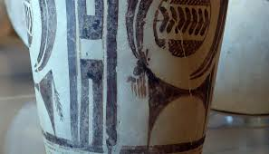
Bushel with ibex motifs
Setting: Susa, Iran
Medium: Painted terra cotta

Slide 7
Anthropomorphic stele
Setting: Arabian Peninsula
Medium: Sandstone

Slide 8
Jade cong
Setting: Liangzhu, China
Medium: Carved jade

Slide 9
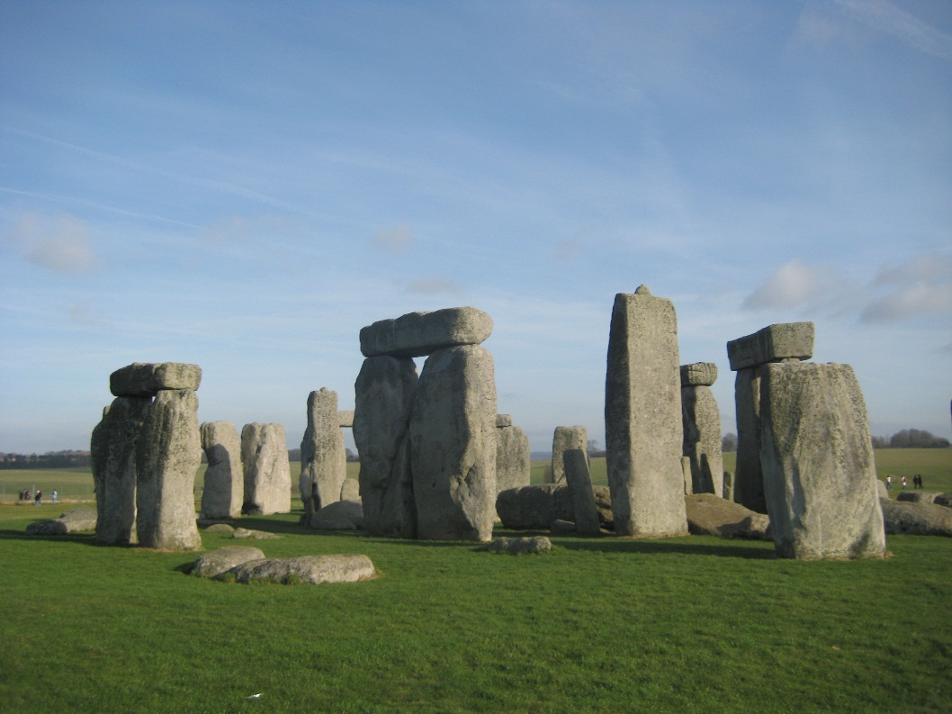
Stonehenge
Setting: Wiltshire, UK
Medium: Sandstone

Slide 10
The Ambum Stone
Setting; Ambum Valley, Enga Province, Papua New Guinea
Medium: Greywacke

Slide 11
Tlatilco female figurine
Setting: Central Mexico
Medium: Ceramic

Slide 12
Terra cotta fragment
Setting: Soloman Islands, Reef Islands
Medium: Terra cotta

