Slide 1
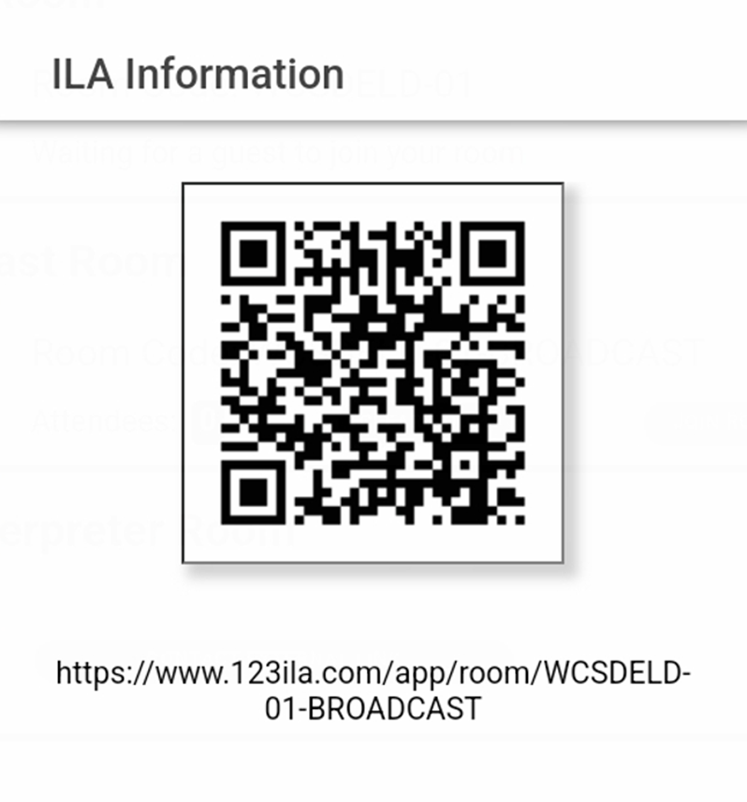
Title 1 Parent Information Mission & Vision School Performance Plan Goals Get in the Game!

Slide 2
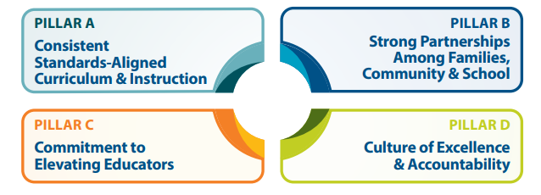
WCSD Strategic Plan
https://www.washoeschools.net/Page/19449

Slide 3
Dr. G – About Me
Grew up in Iowa City, IA IC West High 1990
Gymnastics, Diving, Music
BS Psychology Colorado State U 1995
MEd & PhD in Special Education UNR 2010
Resource Teacher WCSD 2006-2012
Instructional Coach Cannan ES 2012-2013
Dean of Students Hall ES 2013-2015
Assistant Principal Beasley ES 2015-2023
Booth ES Principal 2023
Mom to Levi & Lukas 2014 – present
Single mom
Loves playing and watching sports
West Coast travel

Slide 4
Title 1Program Funds
Fondos de Titulo I
Amount of Title I funds available for this year
$ 162,475.00
Title I budget consists of:
2 Teaching Assistants
iPads for iReady
Heggerty Decodable Books
Professional Development Extra Duty
Cantidad de fondos disponibles para este año
Los fondos del Titulo I consisten en:​
$ 162,475.00
2 Asistentes de Ensenanza
iPads para iReady
Heggerty Libros Decodificables
Servicio Extra de Desarrollo Profesional

Slide 5
Teaching Assistants – Title 1 Funded Positions
Prevention Intervention Team
Attendance, Family Reunification, Home Visits, MTSS
KELSEY FAJARDO (TA)
Elisa Moreno (Admin Secretary)
Shannon Pautler (Dean)
Candia Tolbert (Counselor)
Sharisse Lucas (Communities in Schools)
Booth English Language Team
New to Country, ELL services, Classroom support, Professional Development
JOSHUA WOOLEY (TA)
Brandi Carrico (Lead EL Teacher)
Kris Kelly (English Language Facilitator)

Slide 6
WHEREVER YOU LOOK, THERE YOU GO
Libby Booth Vision:
Libby Booth will be known as a school with an engaging and positive school culture; students and their families will choose to come back each year.
Libby Booth will achieve operational and academic excellence.
Libby Booth will provide exceptional support for students & families.
Libby Booth Mission:
The mission of Libby Booth Elementary School is to offer high-quality educational and social experiences that promote academic gains and improved outcomes for students and their families.

Slide 7
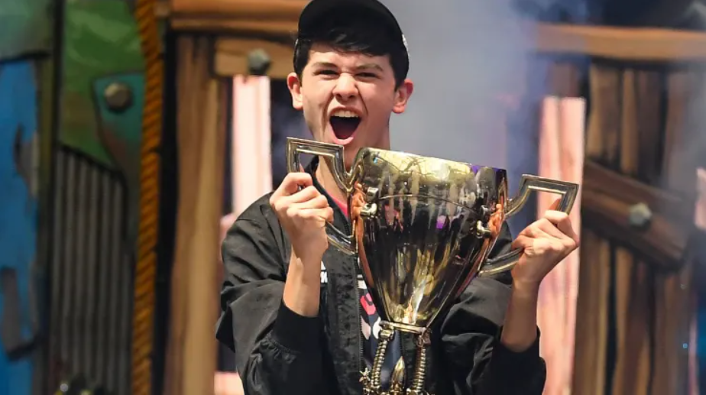
If you want to win…
You’ve got to get in the game!

Slide 8
Get in the Game @ Libby Booth
Attendance
Academics
Attitude

Slide 9
Attendance: SY 23-24
School Performance Plan Goal:
Results:
During the 2023-24 SY students at Libby Booth experiencing Moderate & Severe Chronic Absence will decrease by 5%.
2023-24 SY: Chronic Absenteeism decreased from 33% to 27%.

Slide 10
SPP Attendance Goal SY 24-25
During the 2024-25 SY students at Libby Booth experiencing Chronic Absenteeism will decrease by 10%. Overall Chronic Absenteeism will decrease from 29% to 19%.

Slide 11
Get in the Game!
Prevention Intervention Team Outreach
Individual Student Incentives
Small groups for students identified as approaching Chronic Absenteeism
Schoolwide incentives
Every student and family commits to 4 or less absences per quarter! (90% attendance)

Slide 12
SPP iReady Academic Goal SY 23-24
By the end of the academic year, individual students at Libby Booth will meet or exceed 100% of their Typical Growth measures on i-Ready Diagnostic testing in Reading and Math. As a school, by the end of the academic year, Libby Booth students will meet or exceed 100% median progress toward Typical Growth in Reading and Math.

Slide 13
iReady Academic Results SY 23-24 Reading
Notes:
37 students on or above grade level in reading @ BOY to 122 students on or above grade level in Reading by EOY

Slide 14
iReady Academic Results SY 23-24 Math
Notes:
15 students on or above grade level in math @ BOY to 99 students on or above grade level in Math by EOY

Slide 15
SPP iReady Academic Goal SY 24-25
By the end of the academic year, ALL students enrolled at Libby Booth will meet or exceed 100% of their Typical Growth target on i-Ready Diagnostic testing in Reading and Math. 40% of students who are two or more grade levels below on the BOY diagnostic will meet their stretch goal on the EOY diagnostic.

Slide 17
Ultimately, Grade Level Proficiency or higher is the goal for every student at Libby Booth. Students who perform at grade level have a firm foundation to achieve a bright future!

Slide 18
How can I Get in the Game?
Encourage your child to attend every day of school
Build academic stamina by reading for fun and practicing math facts
Join Libby Booth Class Dojo
Become a Libby Booth volunteer
Attend Libby Booth Concerts, PBL, Field Trips, & Special Events
APEX Leadership Fun Run

Slide 20
APEX Leadership Fun Run Thursday September 12th 9:30-12:30

Slide 21
There’s no place I’d rather be than Libby Booth… I hope you feel the same way! Your Principal, Dr. G

