Slide 1
Welcome LEOPARDS to BACK to School Night
Learners are
Valued and
Empowered to
Succeed

Slide 2
LVES PRIORITIES 24-25 SY
HIGH EXPECTATIONS FOR ALL STUDENTS
Providing Rigorous Tier 1Instruction: Grade Level standards-based learning
Bell-to-Bell Instruction
SEL & Positive Relationships
Standards-Based Grading
Attendance
Family and Community Involvement/Supports – supporting the needs of ALL our families and students
Parent Teacher Home Visit Program (PTHVP)
Parent Teacher Organization (PTO)
Parent Classes & Parent University Opportunities
Student Therapy

Slide 3
Prioridades en 23-24 año escolar
Altas Expectativas para Todos los Estudiantes
Proporcionar rigurosa instrucción de nivel 1: aprendizaje basado en estándares de nivel.
Instrucción campana a campana
SEL y relaciones positivas
Calificación basada en estándares
Asistencia
Apoyo/Participation de Familia y Comunidad– apoyando las necesidades de TODAS nuestras familias y estudiantes.
Organización de padres y maestros(PTO)
Clases y oportunidades de Universidad de Padres
Terapias estudiantiles
Equipo de SEL – 4^{to} & 5^{to} Grado
Programa de visitas domiciliaras de padres y maestros (PTHVP)
Mejoras de seguridad y escuela
Mejoras y Actualizaciones de instalaciones ecolares

Slide 4
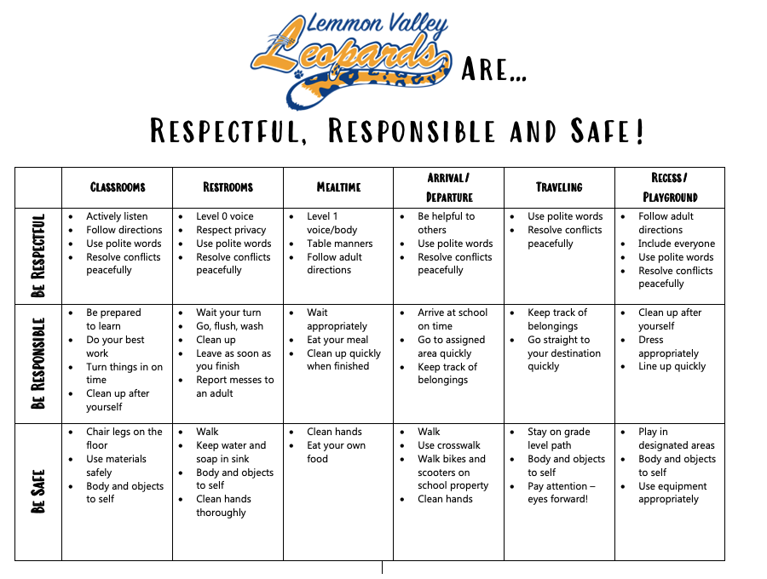
Notes:
Relationships Brain Dump Activity
Clip Boards

Slide 5
LVES Uniforms - Uniformes en LVES

Slide 6
Standards Based Grading
Fair and Consistent Grading | 4-Point Scale (Rubrics) | Rubric Rationale
Exceeds | 4 | Student understands and consistently applies concepts independently, can make connections, and can demonstrate critical thinking in a variety of ways.
Meets | 3.5 | Student understands and consistently applies concepts independently and is achieving at grade level standards.
Meets | 3.0
Approaches | 2.5 | Student understands most concepts taught but requires some support to apply concepts correctly.
Approaches | 2.0
Developing | 1.5 | Student inconsistently understands or applies concepts and requires extensive support.
Developing | 1.0 | Student is making limited progress and requires extensive support.
What is Standards-Based grading?
Standards-Based grade reporting is designed to inform parents about their child’s progress towards achieving specific learning standards. The Nevada Academic Content establish high and challenging performance expectations for all students. They describe what students should know and be able to do and serve as the basis for the for Washoe County School District’s curriculum, instruction and assessment model.

Slide 7
School Culture of Relationships Through
LVES

Slide 8
Getting to know our students’ interests and cultures helps us achieve equity in our classrooms.

Slide 9
Relationships Matter

Slide 10
September 16 - 21
We are dedicating the week of September 16-21 to observe home visits. Please share with us your hopes and dreams for your students.

Slide 11
Lemmon Valley ES
Home Visits

Slide 13
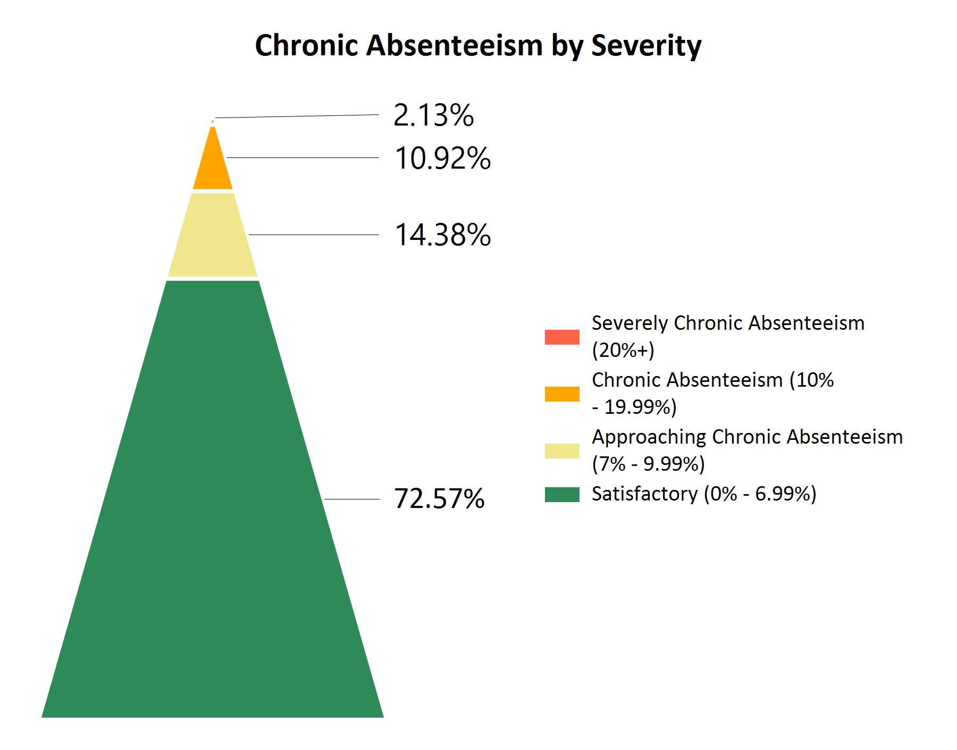
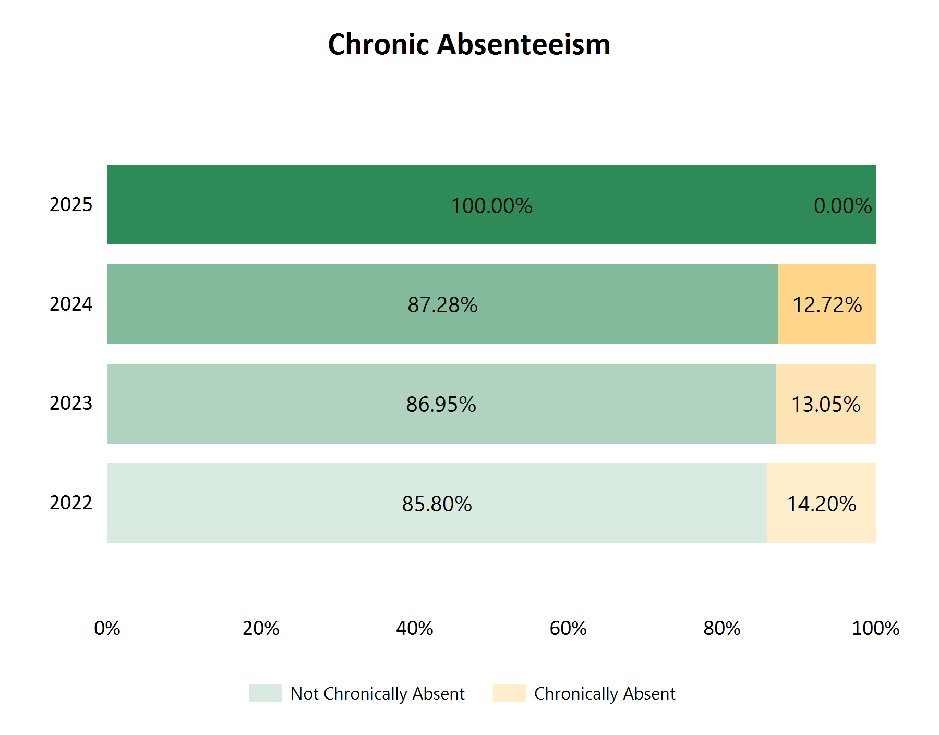
Percentage of Students Absent by School Day
Current Consecutive Absent Counts

Slide 14
Current Consecutive Absent Counts

Slide 16
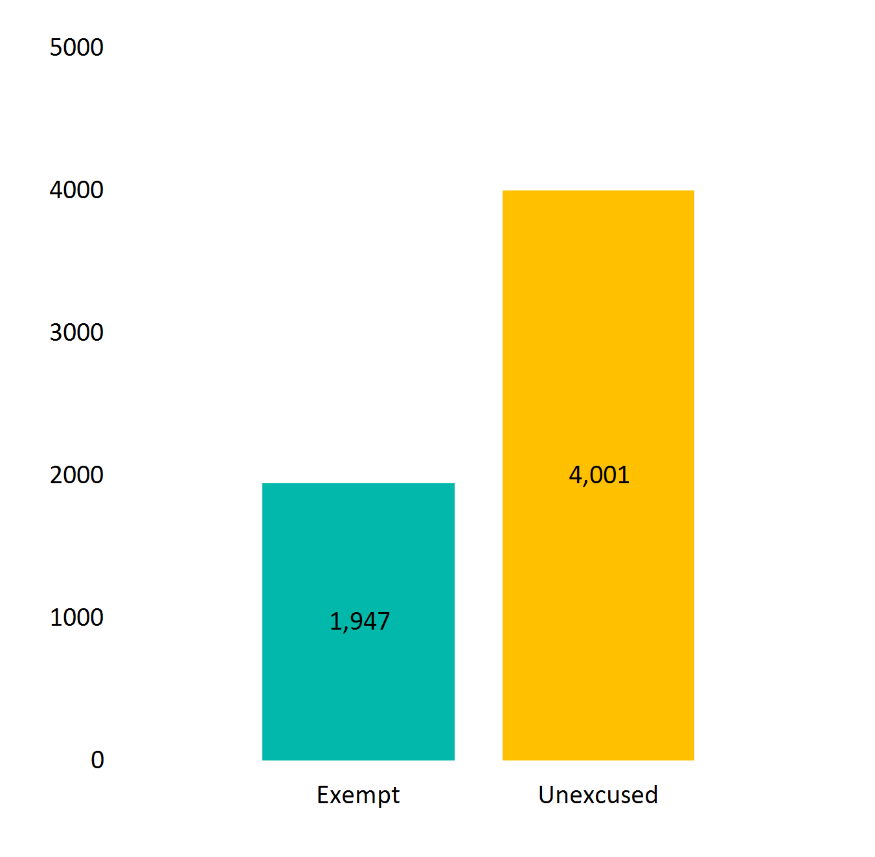
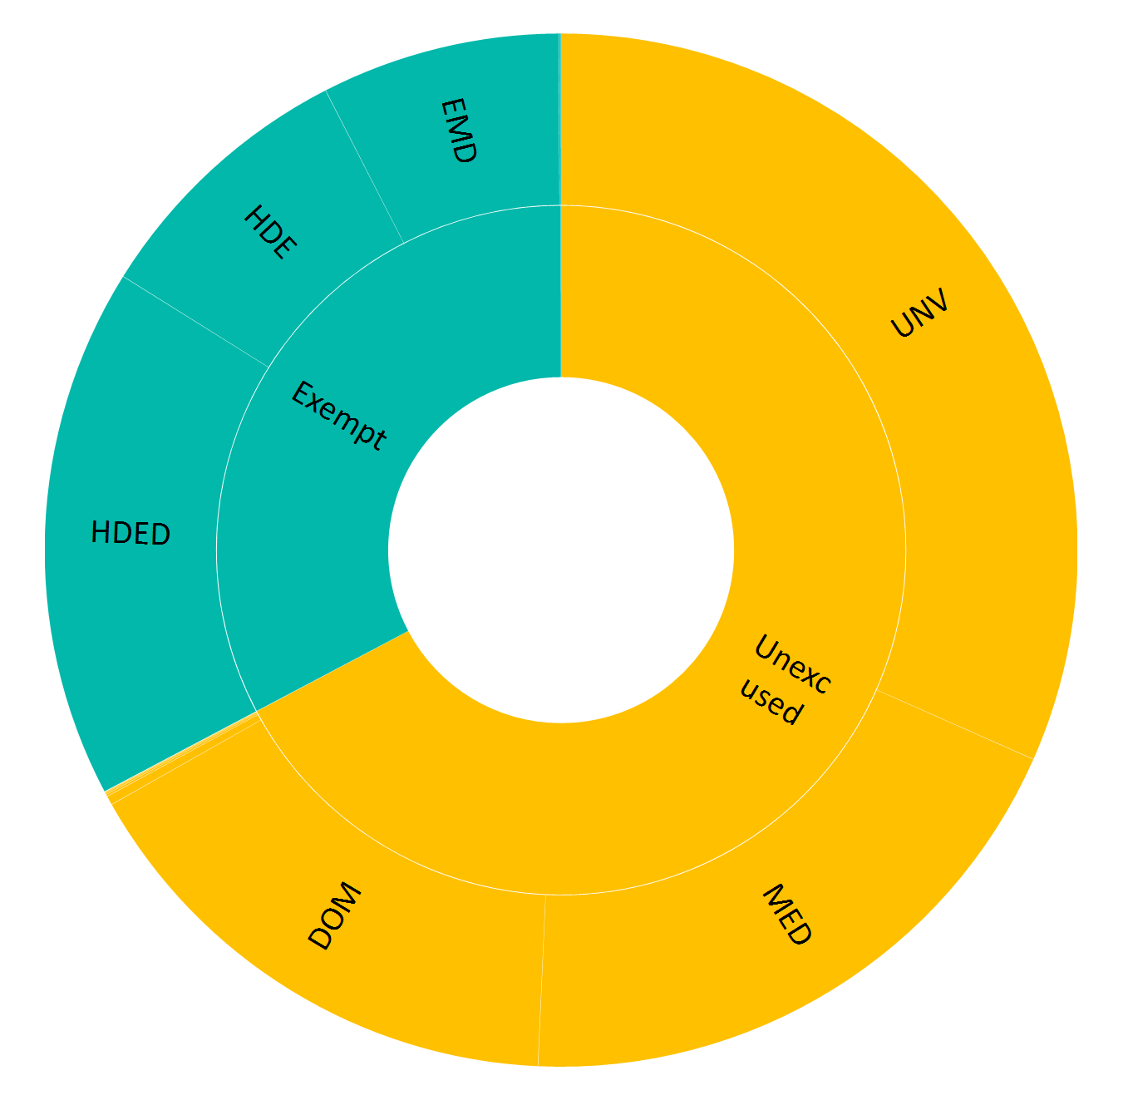
Summary by Absence Type and Code

Slide 17
Title I Annual Meeting Junta Anual de Título I​
What Every Family Needs to Know!
¡Lo que cada familia debe saber!​
Date/Fecha: August 27, 2024

Slide 18
Overview of Title I
Sinopsis del Título I
Title I is a federal-funded grant program that provides:
schools with additional academic support and learning to help students meet the state’s challenging academic standards.
opportunities for students at schools that have higher percentages of socioeconomically disadvantaged children
workshops and training opportunities for parents and families to increase their engagement in their children’s education.
Título I es un programa de subvenciones financiado por el gobierno federal que proporciona:
escuelas con apoyo académico adicional y aprendizaje para ayudar a los estudiantes a cumplir con los desafiantes estándares académicos del estado.
oportunidades para estudiantes en escuelas que tienen porcentajes más altos de niños desfavorecidos socioeconómicamente
talleres y oportunidades de capacitación para padres y familias para aumentar su participación en la educación de sus hijos.
Notes:
The purpose of Title I is to ensure ALL children have a fair, equitable and significant opportunity for a high-quality education and read, at a minimum, proficiency on state standards and assessments

Slide 19
Requirements of a Title I School
Requisitos de una Escuela de Título I
Annual Title I Parent Meeting
High Quality Curriculum
Academic Assistance to Students
Family Engagement and Input
Annual Survey of Title I Program
Timely Communication to Parents
Reunión Anual de Padres del Título I
Plan de Estudios de Alta Calidad
Asistencia Académica a Estudiantes
Participación y Aportes de la Familia
Encuesta Anual del Programa deTítulo I
Comunicación Oportuna a los Padres
Notes:
Title I schools must hold an Annual Title I meeting letting families know of their school’s participation in and explain the requirements of Title I, that there is a parent and family engagement policy, and that families have a right to be involved in the school. Teachers must meet state certification and licensure requirements. Parents can ask for information on policies regarding student participation in assessments. Teachers will provide information about the high-quality curriculum and the types of academic assistance provided at the school.

Slide 20
Participation
Participación
Schoolwide Basis - Funds used to serve all students in order to increase academic achievement.
Base de toda la Escuela​ - Los fondos solían servir a todos los estudiantes para poder incrementar los logros
Notes:
To be a “schoolwide” school the school must have a free/reduced lunch count of at least 40%, collect and analyze data that affects student achievement, and must develop a comprehensive site plan (School Performance Plan) and annually review its effectiveness.

Slide 21
Program Funds
Amount of Title I funds available for this year
$1750,150.00
Title I budget consists of:
Dean of Student
FACE Liaison
Intervention Subs – supporting class sized reduction
Instructional Supplies & Materials
Fondos de Titulo I
Cantidad de fondos disponibles para este año
Los fondos del Titulo I consisten en:​
Decano de estudiantes
FACE
$1750,150.00
Substitutos para reducer numero de alumnos en clase
Suministros y materiales instructivos
Notes:
Tailor this to your school. Can also show parents how to get to School Performance Plan Budget page.

Slide 22
Parent and Family Engagement Policy
Póliza de Involucramiento de Padres y Familia en Título I
Notes:
Parents and families are invited to participate in the development and revision of the parent and family engagement policy. The policy will be available on the website before October 1 and will be revised in May for the following year.

Slide 23
Parents’ Right-to-Know – School Level El Derecho a Saber de los Padres-Nivel Escolar
Individual report card on your child’s progress
Information on State and local assessments
Right of parents to become involved in the school’s programs and how to do so
Subject matter assessed
Purpose of the assessment
Volunteering
Flexible meetings
Monthly meetings
Other
Boleta de calificaciones individual sobre el progreso de su hijo
Informaciones sobre evaluaciones Estatales y locales
Materia evaluada
El propósito de la evaluación
El derecho que tienen los padres de participar en los programas de la escuela y como hacerlo
Ser voluntario
Juntas flexibles
Juntas mensuales
Otro
Notes:
Besides the information provided in the previous slides, parents can request information on any of these items and the school has to provide it in a timely manner. Report cards quarterly. Information on State and Local Assessments – parents can request more information on state and local assessments, i.e., practice tests, MAP, Brigrance, ACT, etc. What the participation policy is…

Slide 24
“Parents’ Right to Know”
The Washoe County School District is committed to following all guidelines as established under the Every Student Succeeds Act, which is in effect during the 2024-25 school year.
You have the right to:
Know the level of achievement their child attained on each of the state academic assessments
Request information on the professional qualifications of your student’s classroom teachers, which should include meeting applicable NV state certification and licensure requirements for the grade levels and subject areas in which the teacher provides instruction. This would include teaching under emergency or other provisional status and is teaching in the field of discipline of the certification.
Request Information on the paraprofessionals (teacher aides, teacher assistants, etc.) providing services to your child. Paraprofessionals should meet one of the minimum requirements, which is a minimum of 48 college credit hours, an associate degree (or higher), or score at least 460 on the Parapro Assessment.
Be provided timely notice that your child has been assigned or taught for 4 or more consecutive weeks by a teacher with limited State certification or licensure.
Be provided information on each assessment required by the state and the school district. The information must include: 1. Subject matter assessed 2. Purpose of the assessment 3. Source of the requirement, and if information that includes a) Length of time expected and schedule for the assessments b) Time and format for disseminating results.
Request information regarding any State or local educational agency policy regarding student participation in any mandated assessments. The information must include a policy, procedure, or parental right to opt the child out of such assessment, where applicable.
The information regarding teacher’s qualifications in accordance with the Every Student Succeeds Act may be obtained through the school district. Please feel free to contact the WCSD Title I office or The Human Resources Department if you have any questions.
Cer tificate No. 4143
Notes:
Families will be receiving a letter similar to this in English and Spanish. Please contact the school or district if you would like more information.

Slide 25
“DERECHOS DE CONOCIMIENTO DE PADRES”
El Distrito Escolar del Condado de Washoe está comprometido a seguir las pautas establecidas De la Ley Cada Estudiante Triunfa, la cual está vigente durante el año escolar 2024-2025.
Usted tiene derecho a:
Conocer el nivel de logro de su hijo en cada una de las evaluaciones del estado académico.
Solicitar información sobre las calificaciones profesionales de los maestros de su hijo en el salón de clases, las cuales deben incluir cumplir con los requisitos de certificación y licenciatura estatales de NV para los niveles de grado y áreas temáticas en las que el maestro proporciona instrucción. Esto incluye la enseñanza en estado de emergencia u otro estado provisional y está enseñando en el campo de la certificación de disciplina.
Solicitar información sobre los para-profesionales (auxiliares de maestros, asistentes de maestros, etc.) que proveen servicios a su hijo. Los para-profesionales deben cumplir con uno de los requisitos mínimos, que es un mínimo de 48 horas de crédito universitario, un título de asociado (o superior), o puntuación de al menos 460 en la Evaluación Parapro.
Recibir aviso oportuno de que su hijo ha sido asignado o enseñado por 4 o más semanas consecutivas por un maestro con una certificación o licencia limitada del Estado.
Proporcionar información sobre cada evaluación requerida por el estado y el distrito escolar. La información debe incluir: 1. Asunto evaluado 2. Propósito de la evaluación 3. Origen del requisito y si la información incluye a) Tiempo esperado y calendario para las evaluaciones b) Tiempo y formato para difundir los resultados.
Solicitar información sobre cualquier agencia educativa estatal o local con respecto a la participación de los estudiantes en cualquier evaluación obligatoria. La información debe incluir una política, procedimiento o derecho de los padres de optar al niño fuera de dicha evaluación, cuando sea aplicable.
La información con respecto a las calificaciones del maestro de acuerdo con la Ley Cada Estudiante Triunfa se puede obtener a través del distrito escolar. Por favor, no dude en ponerse en contacto con la Oficina del Título I del WCSD o El Departamento de Recursos Humanos si tiene alguna pregunta.
Cer tificate No. 41433

Slide 26
Questions/ Preguntas

