Slide 1
The Pacific
700-1980 C.E.

Slide 2
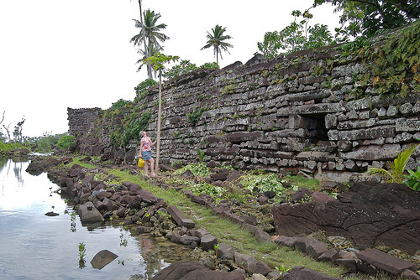
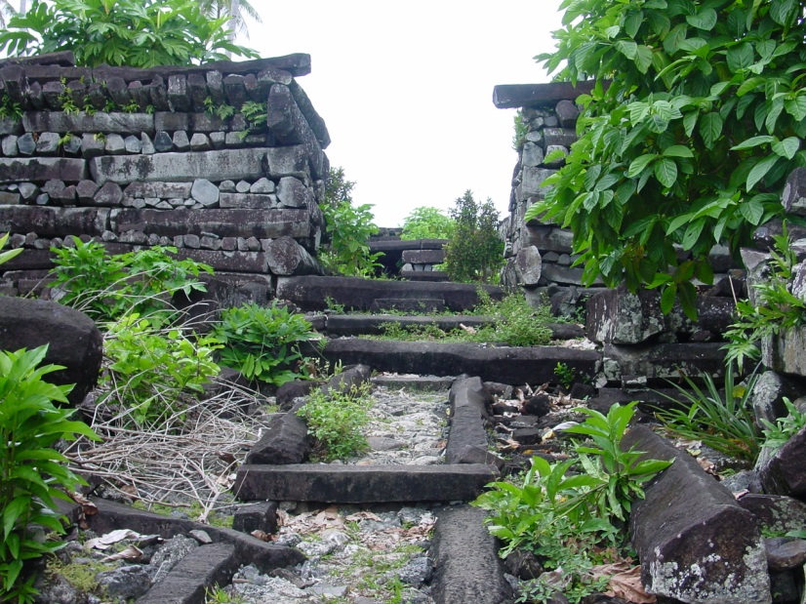
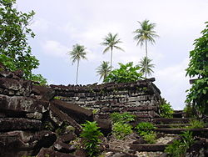
Nan Madol
Pohnpei, Micronesia
Saudeleur Dynasty
700-1600 C.E.
Basalt boulders and prismatic columns

Slide 3
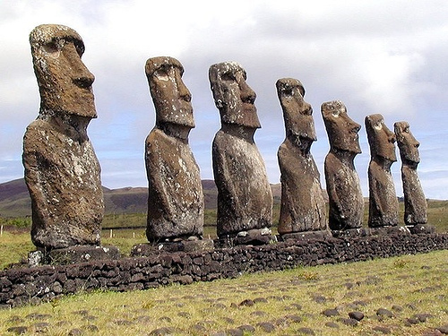
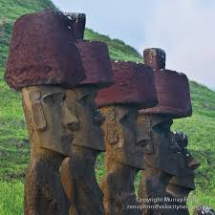
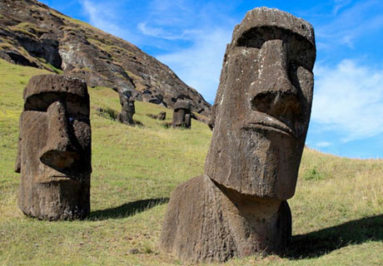
Moai on platform (ahu)
Rapa Nui (Easter Island)
1100-1600 C.E.
Volcanic tuff figures on basalt base
https://www.khanacademy.org/humanities/ap-art-history/the-pacific/a/easter-island-moai

Slide 4
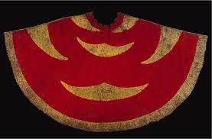
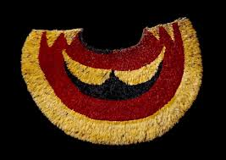
Ahu 'ula (feather cape)
https://www.khanacademy.org/humanities/ap-art-history/the-pacific/a/feather-cape
Hawaiian
Late 18th century C.E.
Feathers and fiber

Slide 5
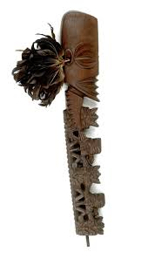
Staff god
Rarotonga, Cook Islands, Central Polynesia
Late 18th to early 19th century C.E.
Wood, tapa, fiber, and feathers.
https://www.khanacademy.org/humanities/ap-art-history/the-pacific/a/staff-god

Slide 6
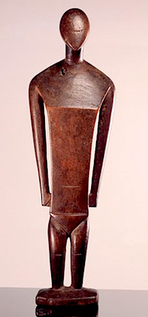
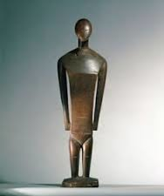
Female deity from Nukuoro
Nukuoro, Micronesia
18th to 19th century C.E.
Wood
https://www.khanacademy.org/humanities/ap-art-history/the-pacific/a/nukuoro-micronesia

Slide 7
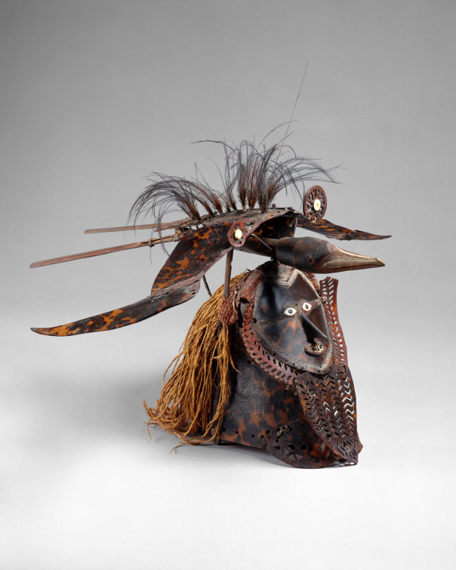
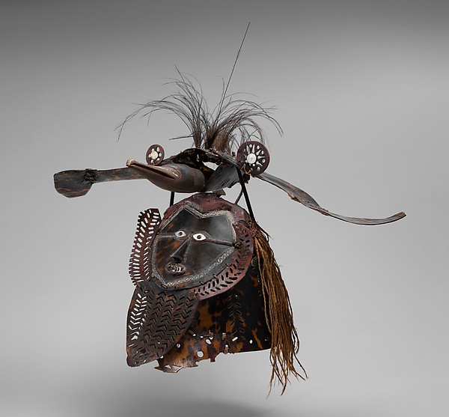
Buk mask
Torres Strait
Mid- to late 18th century C.E.
Turtle shell, wood, fiber, feathers, and shell
https://www.khanacademy.org/humanities/ap-art-history/the-pacific/v/buk-torres

Slide 8
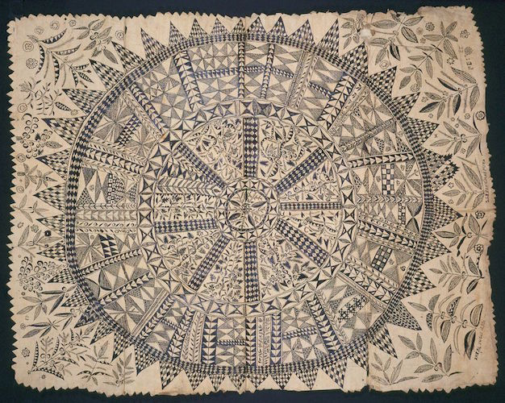
Hiapo (tapa)
Niue 1850-1900 C.E.
Tapa or bark cloth, freehand painting
https://www.khanacademy.org/humanities/ap-art-history/the-pacific/a/hiapo

Slide 9
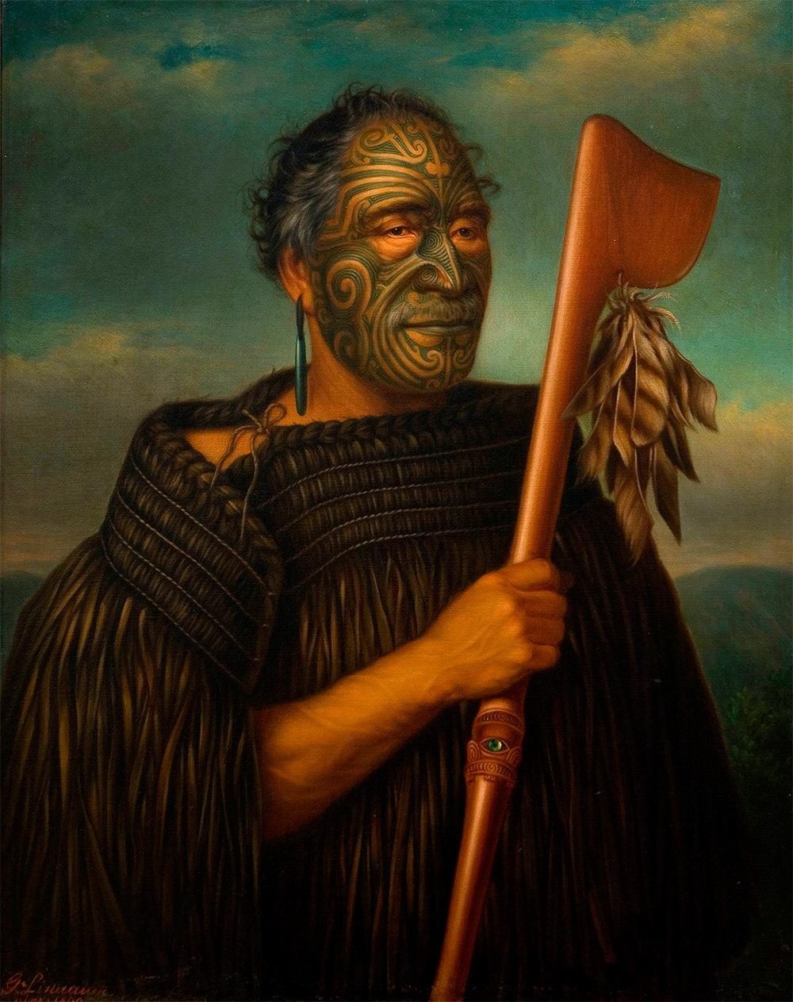
Tamati waka Nene, Gottfried Lindaur
1890 C.E.
Oil on Canvas
Gottfried Lindauer
https://www.khanacademy.org/humanities/ap-art-history/the-pacific/a/tamati-waka-nene

Slide 10
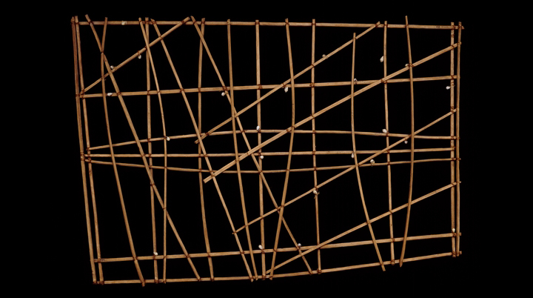
Navigation chart
Marshall Islands, Micronesia 19th to early 20th century C.E.
Wood and Fiber
https://www.khanacademy.org/humanities/ap-art-history/the-pacific/a/navigation-charts

Slide 11
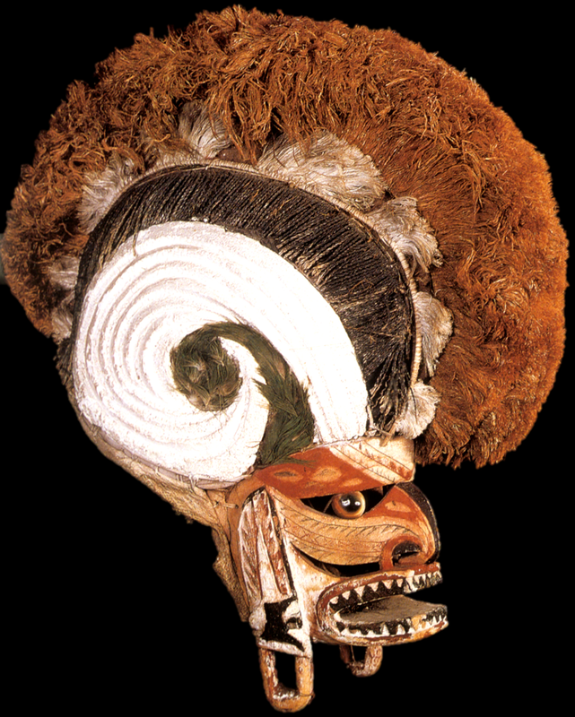
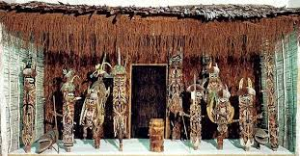
Malagan display and mask
New Ireland Province, Papua New Guinea
20th century C.E.
Wood, pigment, fiber, and shell
https://www.khanacademy.org/humanities/ap-art-history/the-pacific/a/malangan

Slide 12
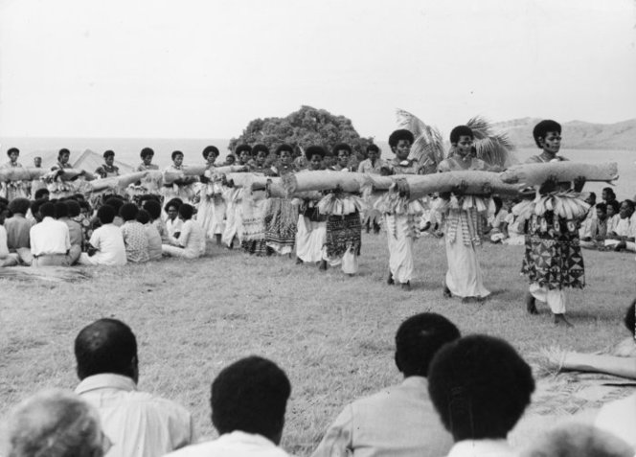
Presentation of Fijian mats and tapas cloths to Queen Elizabeth II
Fiji, Polynesia 1953 C.E.
Multimedia performance (costume; cosmetics, including scent; chant; movement; and pandanus fiber/hibiscus fiber mats), photographic documentation .
https://www.khanacademy.org/humanities/ap-art-history/the-pacific/a/presentation-of-fijian-mats-and-tapa-cloths-to-queen-elizabeth-ii

