Slide 1
Early Europe to Colonial America
200-1750 CE

Slide 2
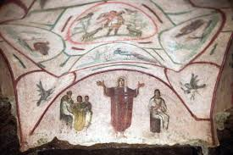
Catacomb of Priscilla
Setting: Rome, Italy. Early Christian
Medium: Fresco

Slide 3
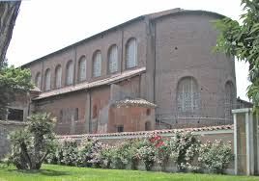
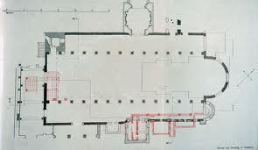
Santa Sabina
Setting: Rome, Italy. Early Christian
Medium: Brick and stone, wooden roof

Slide 4
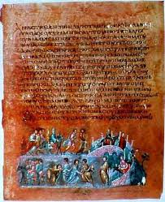
Rebecca and Eliezer at the Wall and Jacob Wrestling the Angel, from the Vienna
Setting: Byzantine
Medium: Illuminated manuscript (pigments on vellum)

Slide 5
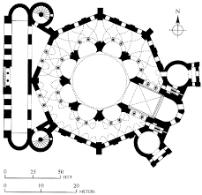
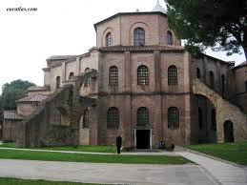
San Vitale
Setting: Ravenna, Italy. Byzantine
Medium: Brick, marble, stone veneer

Slide 6
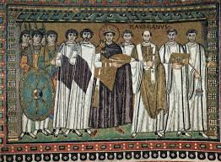
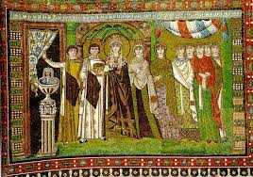
Justinian and Theodora panels (San Vitale)
Setting: Ravenna, Italy. Byzantine
Medium: Mosaic

Slide 7
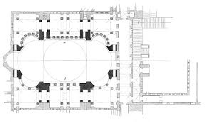
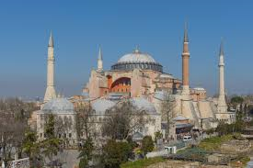
Hagia Sophia
Setting: Constantinople (Istanbul)
Medium: Brick and ceramic with stone and mosaic veneer

Slide 8
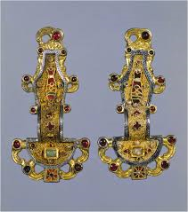
Merovingian looped fibula
Setting: Early medieval Europe (mid 1500s)
Medium: Silver gilt with stone inlays

Slide 9
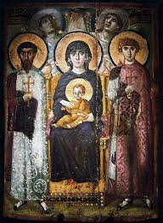
Virgin (Theotokos) and Child between Saints Theodore and George
Setting: Byzantine
Medium: Encaustic on wood

Slide 10
Lindisfarne Gospels: St. Matthew, cross-carpet page
Setting: Hiberno Saxon Europe
Medium: Illuminated manuscript (ink, pigments, and gold on vellum)

Slide 11
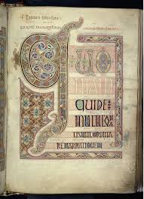
Lindisfarne Gospels: St. Luke portrait page and incipit page

Slide 12
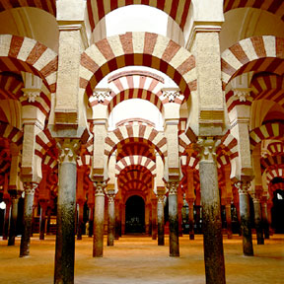
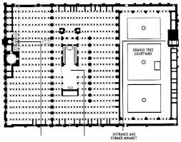
Great Mosque of Cordoba
Setting: Cordoba, Spain
Medium: Stone masonry

Slide 13
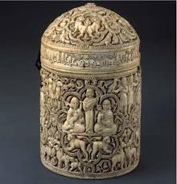
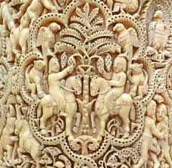
Pyxis of al-Mughira
Setting: Umayyad
Medium: Ivory

Slide 14
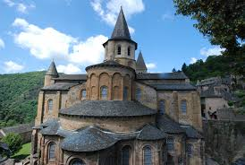
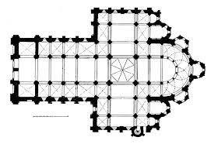
Church of Sainte-Foy
Setting: Conques, France. Romanesque
Medium: Stone

Slide 15
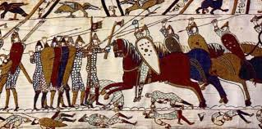
Bayeux Tapestry
Medium: Embroidery on linen

Slide 16
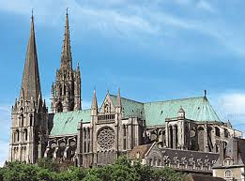
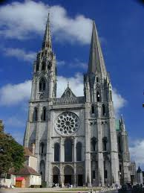
Chartres Cathedral
Setting: Chartres, France. Gothic
Medium: Limestone, stained glass

Slide 17
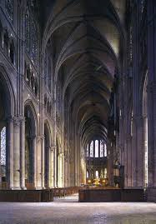
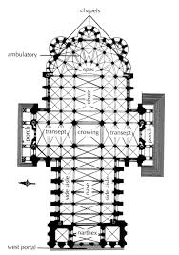
Chartres Cathedral (cont.)

Slide 18
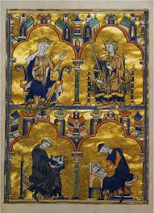
Dedication Page with Blanche of Castile and King Louis IX of France and scenes from the Apocalypse from a Bible moralisee
Medium: Illuminated manuscript

Slide 19
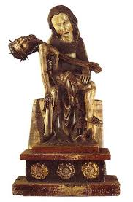
Rottgen Pieta
Medium: Painted wood

Slide 20
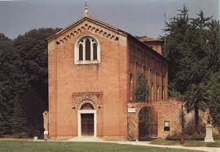
Arena (Scrovegni) Chapel
Setting: Padua, Italy
Medium: Brick (architecture), fresco
Architect: unknown
Painter: Giotto

Slide 21
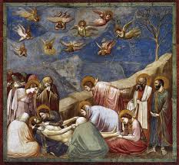
Lamentation (from Arena Chapel)

Slide 22
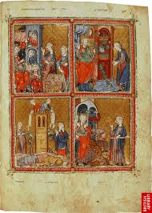
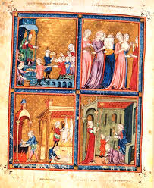
Golden Haggadah (The Plagues of Egypt, Scenes of Liberation, and Preparation for Passover)
Medium: Illuminated manuscript (pigments on vellum)

Slide 23
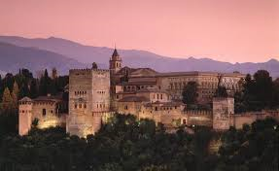
Alhambra Palace
Setting: Granada, Spain
Medium: Whitewashed adobe stone, wood, tile, paint, and giding

Slide 24
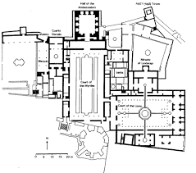
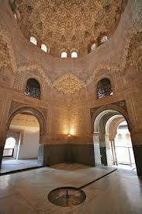
Alhambra Palace (cont.)

Slide 25
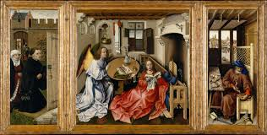
Annunciation Triptych (Merode Altarpiece)
Medium: Oil on wood
Artist: Robert Campin

Slide 26
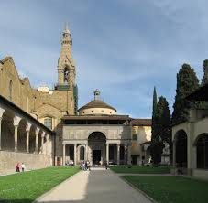
Pazzi Chapel
Setting: Florence, Italy
Medium: Masonry
Architect: Filippo Brunelleschi

Slide 27
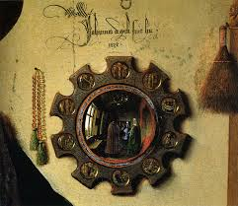
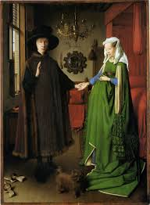
The Arnolfini Portrait (Wedding)
Medium: Oil on wood
Artist: Jan van Eyck

Slide 28
David
Medium: Bronze
Artist: Donatello

Slide 29
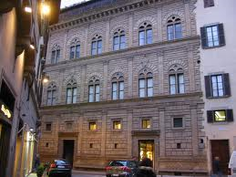
Palazzo Rucellai
Setting: Florence, Italy
Medium: Stone, masonry
Architect: Leon Battista Alberti

Slide 30
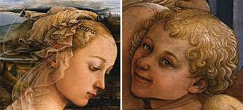
Madonna and Child with Two Angels
Medium: Tempera on wood
Artist: Fra Filippo Lippi

Slide 31
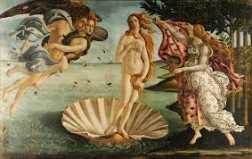
Birth of Venus
Medium: Tempera on Canvas
Artist: Sandro Botticelli

Slide 32
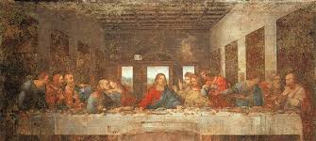
Last Supper
Medium: Oil and tempera
Artist: Leonardo da Vinci

Slide 33
Adam and Eve
Medium: Engraving
Artist: Albrecht Durer

Slide 34
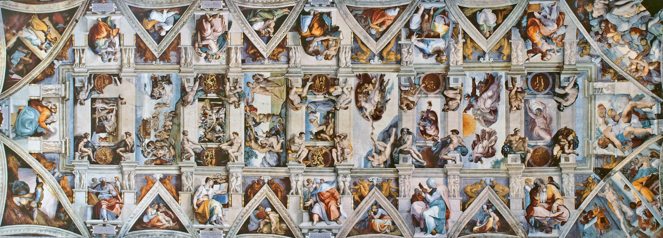
Sistine Chapel ceiling and altar frescos
Setting: Vatican City, Italy
Medium: fresco
Artist: Michelangelo

Slide 35
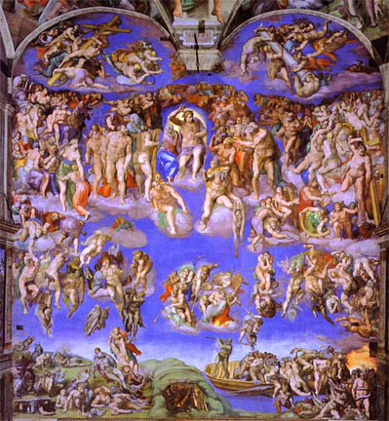
Sistine Chapel ceiling and altar frescos (cont.)

Slide 36
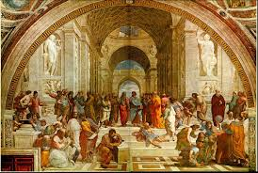
School of Athens
Medium: fresco
Artist: Raphael

Slide 37
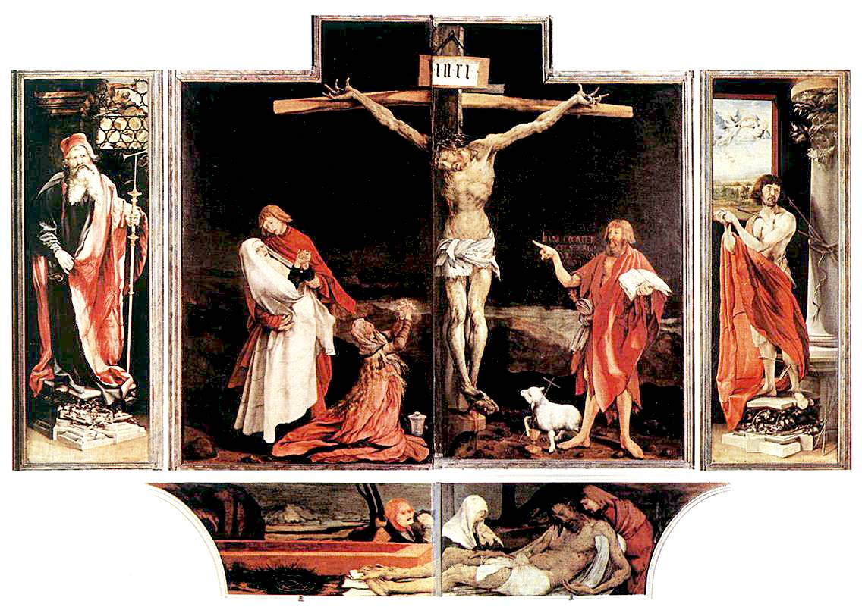
Isenheim altarpiece (closed)
Medium: oil on wood
Artist: Matthias Grunewald

Slide 38
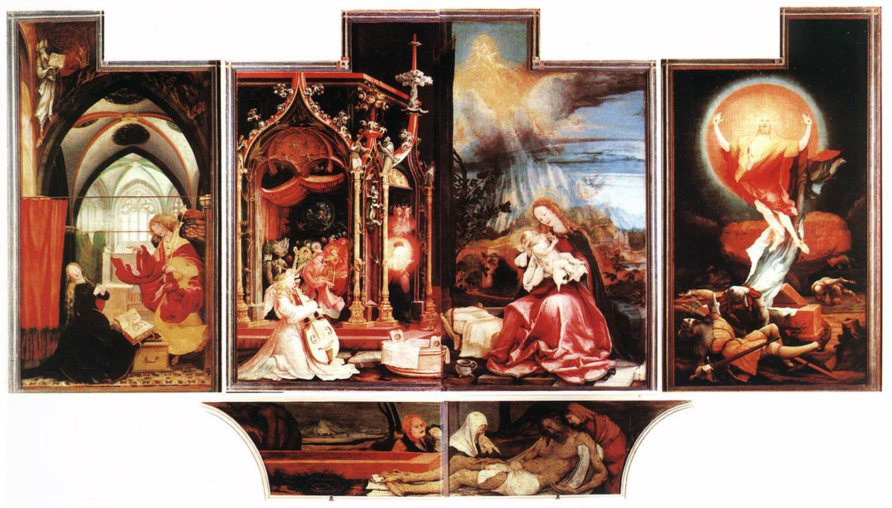
Isenheim altarpiece (open)

Slide 39
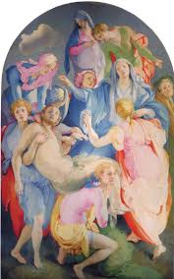
Entombment of Christ
Medium: oil on wood
Artist: Pontormo

Slide 40
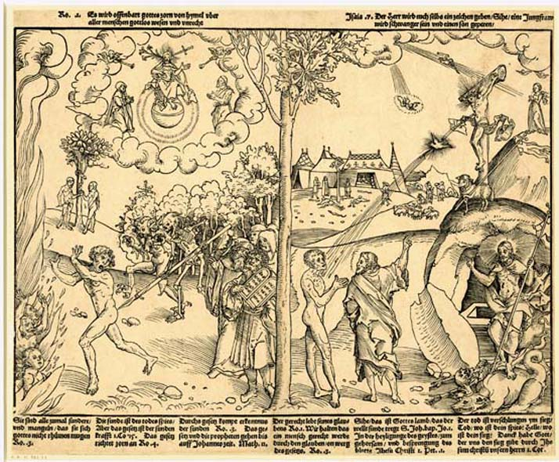
Allegory of Law and Grace
Medium: woodcut
Artist: Lucas Cranach the Elder

Slide 41
Venus of Urbino
Medium: oil on canvas
Artist: Titian

Slide 42
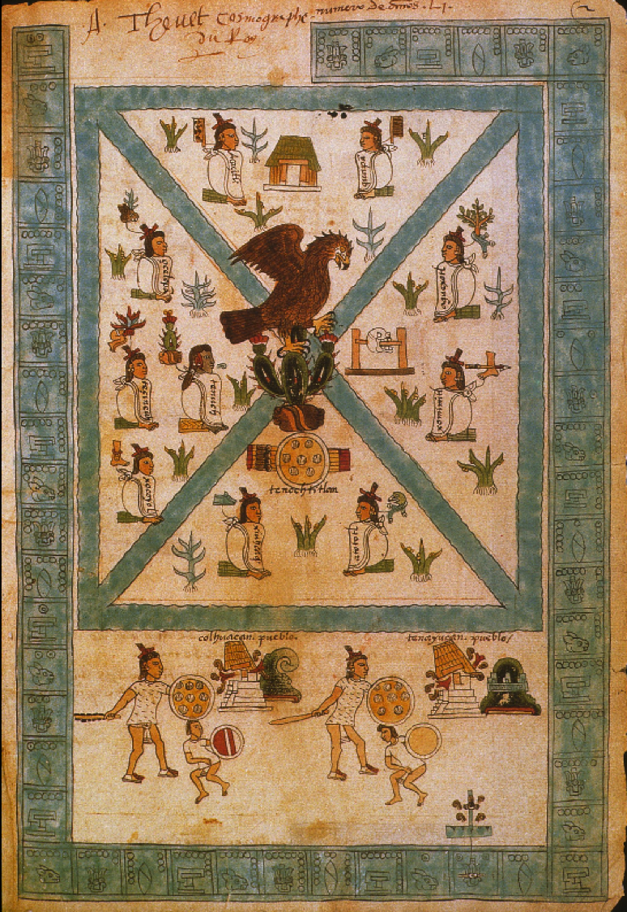
Frontispiece of the Codex Mendoza
Medium: Pigment on paper

Slide 43
Il Gesu
Setting: Rome
Architect: Giacomo della Porta

Slide 44
Triumph of the Name of Jesus (ceiling of Il Gesu)
Medium: fresco
Artist: Giovanni Battista Gaulli

Slide 45
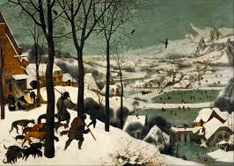
Hunters in the Snow
Medium: oil on wood
Artist: Pieter Bruegel the Elder

Slide 46
Mosque of Selim II
Setting: Edirne, Turkey
Medium: Brick and stone
Architect: Sinan

Slide 47
Calling of Saint Matthew
Medium: oil on canvas
Artist: Caravaggio

Slide 48
Henri IV Receives the Portrait of Marie de Medici (from the Medici Cycle)
Medium: oil on canvas
Artist: Peter Paul Rubens

Slide 49
Self-Portrait with Saskia
Medium: Etching
Artist: Rembrandt

Slide 50
San Carlo alle Quattro Fontane
Setting: Rome
Medium: Stone and stucco
Architect: Borromini

Slide 51
Ecstasy of Saint Teresa
Setting: Church of Santa Maria della Vittoria, Rome.
Medium: stucco and gilt bronze
Artist: Bernini

Slide 52
Angel with Arquebus, Asiel Timor Dei
Medium: oil on canvas
Artist: Master of Calamarca

Slide 53
Las Meninas
Medium: oil on canvas
Artist: Diego Velazquez

Slide 54
Woman Holding a Balance
Medium: oil on canvas
Artist: Vermeer

Slide 55
The Palace at Versailles
Setting: Versailles, France
Mediums: masonry, stone, wood, iron, gold leaf, marble, bronze

Slide 56
The Palace at Versailles (cont.)

Slide 57
The Palace at Versailles (cont.)

Slide 58
Screen with the Siege of Belgrade and hunting scene
Medium: Tempera and resin on wood, shell inlay
Artist: Circle of the Gonzalez Family

Slide 59
The Virgin of Guadalupe (Virgen de Guadalupe)
Medium: oil on canvas on wood, inlaid with mother-of-pearl
Artist: Miguel Gonzalez
Setting: Basilica of Guadalupe, Mexico City

Slide 60
Fruit and Insects
Medium: oil on wood
Artist: Rachel Ruysch

Slide 61
Spaniard and Indian Produce a Mestizo
Medium: oil on canvas
Attributed to Juan Rodrigues

Slide 62
The Tete a Tete, from Marriage a la Mode
Medium: oil on canvas
Artist: William Hogarth

