Slide 1
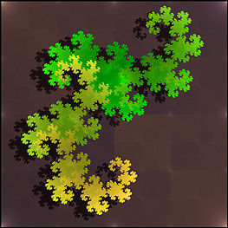
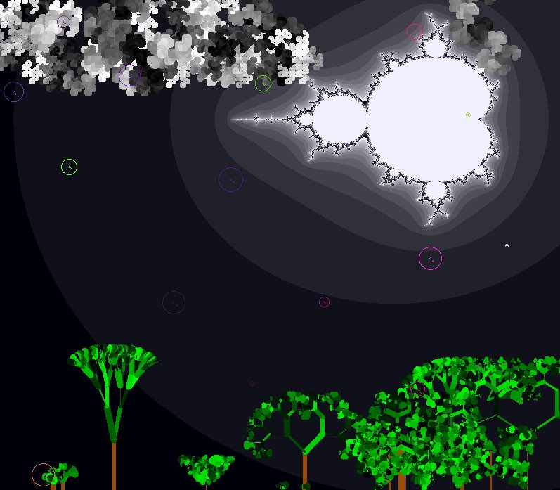
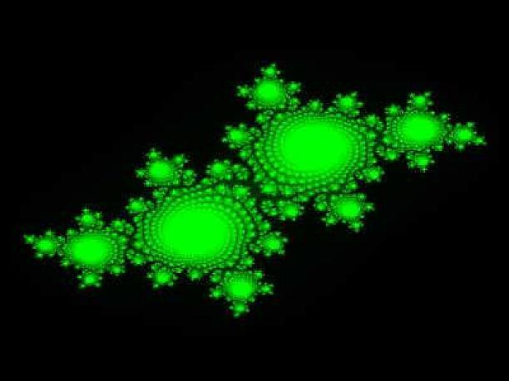
More With Fractals

Slide 2
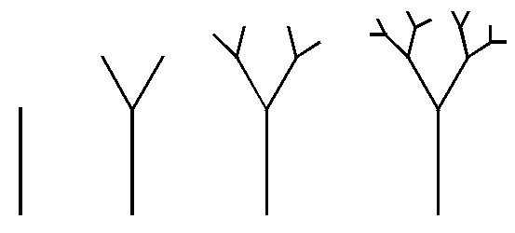
Drawing a Fractal Tree

Slide 4
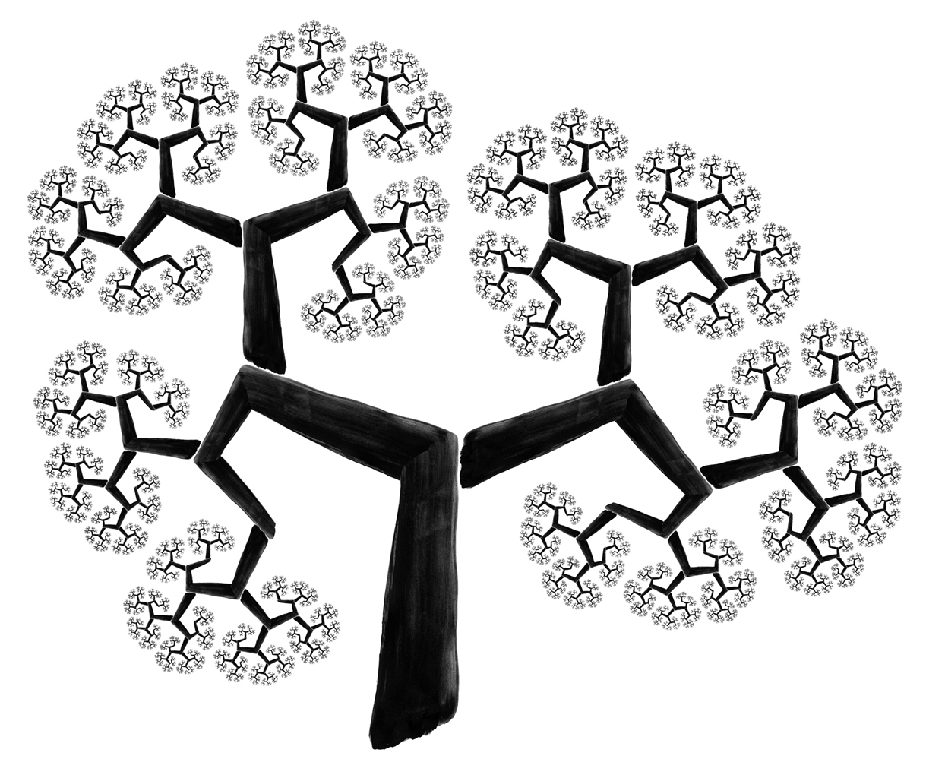

Slide 5
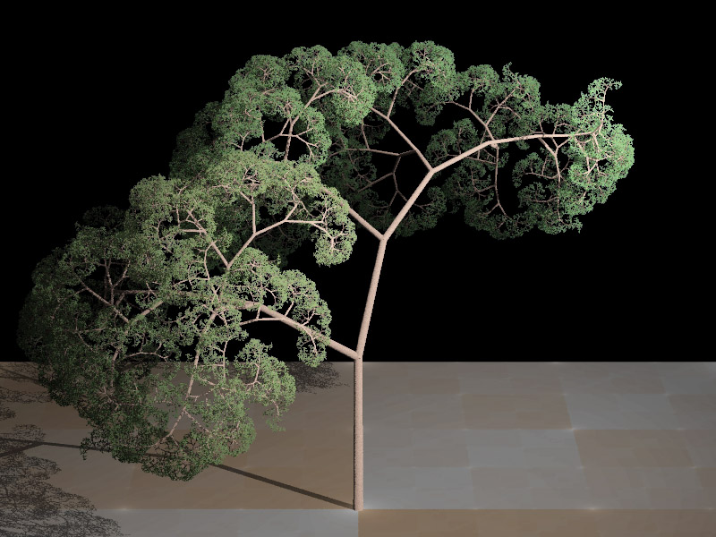

Slide 6
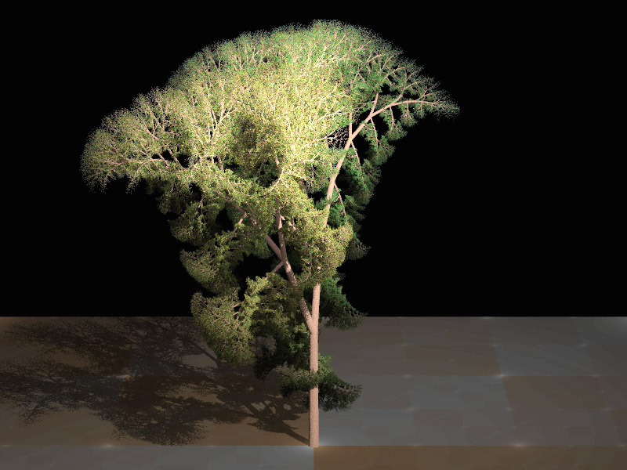

Slide 7
Fractal Coastlines

Slide 8
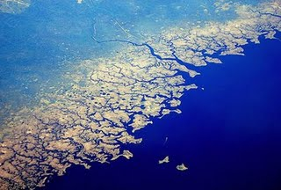
Real

Slide 9
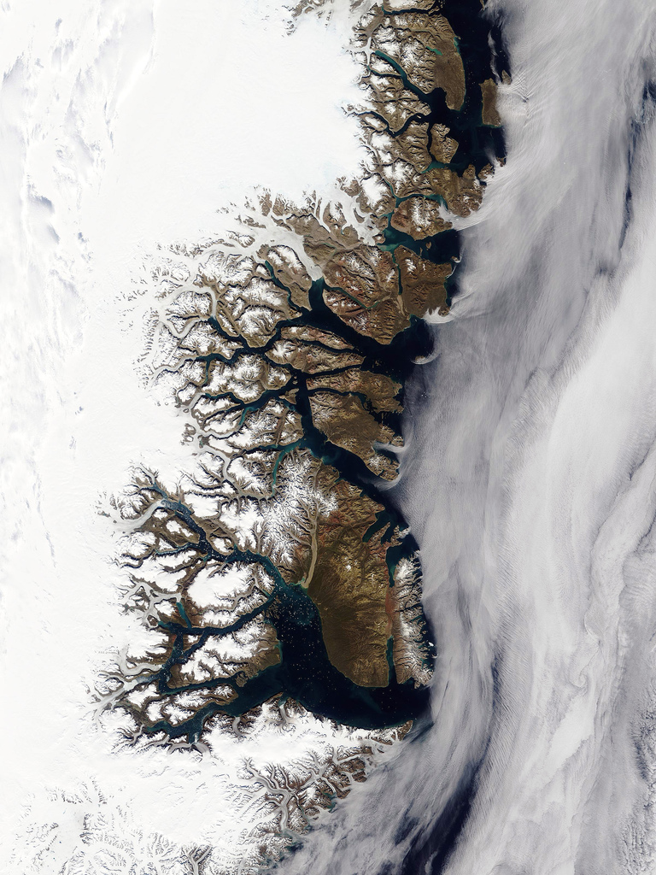
Real

Slide 10
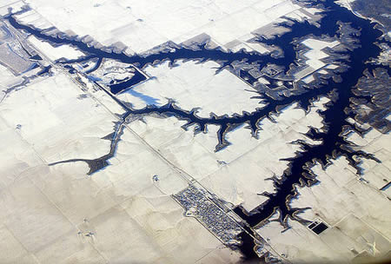
Real

Slide 11
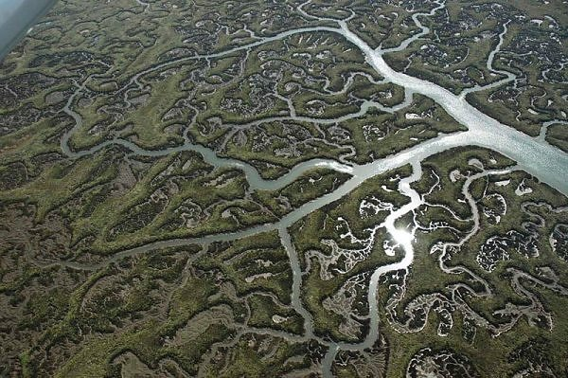
Real

Slide 12
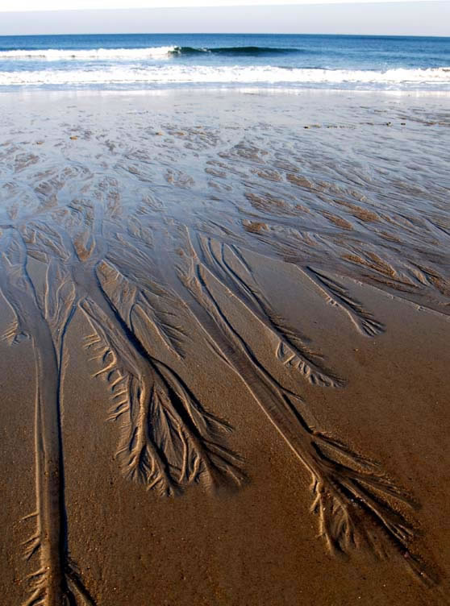
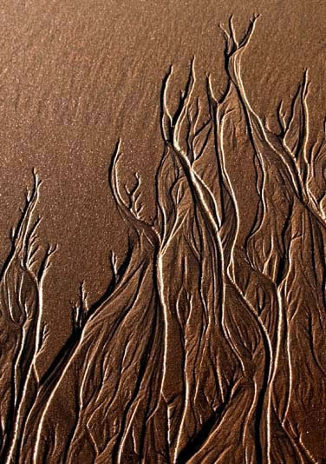
Real

Slide 13
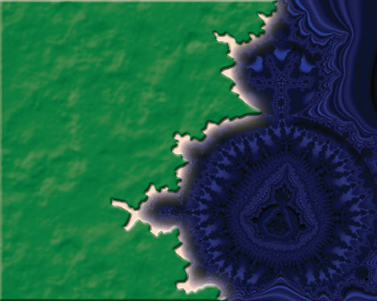
Fractal Generated

Slide 14
Fractal Landscapes
These images are all computer generated with fractal equations

Slide 15
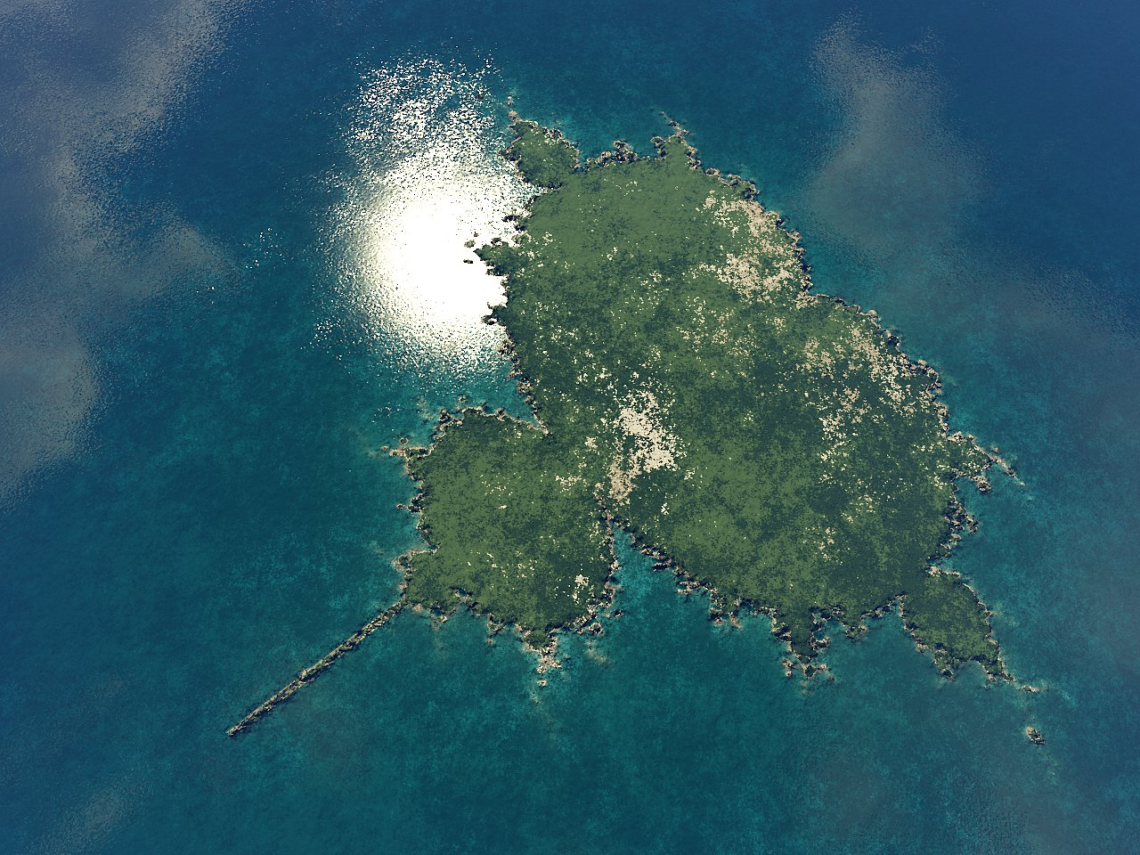

Slide 16
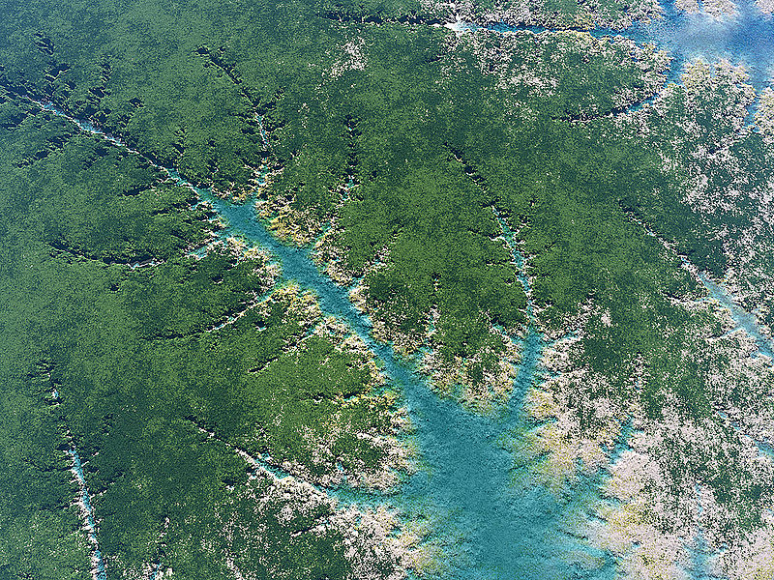

Slide 17
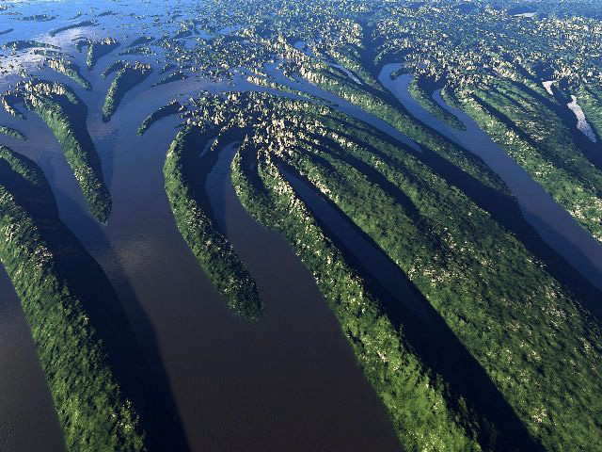

Slide 18
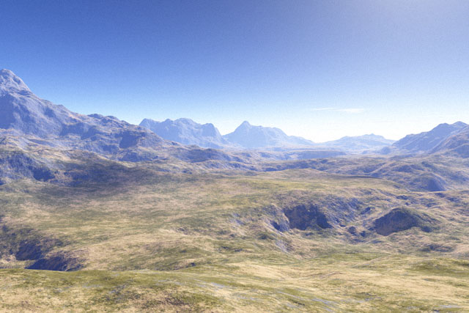

Slide 19
Hurricane

Slide 20
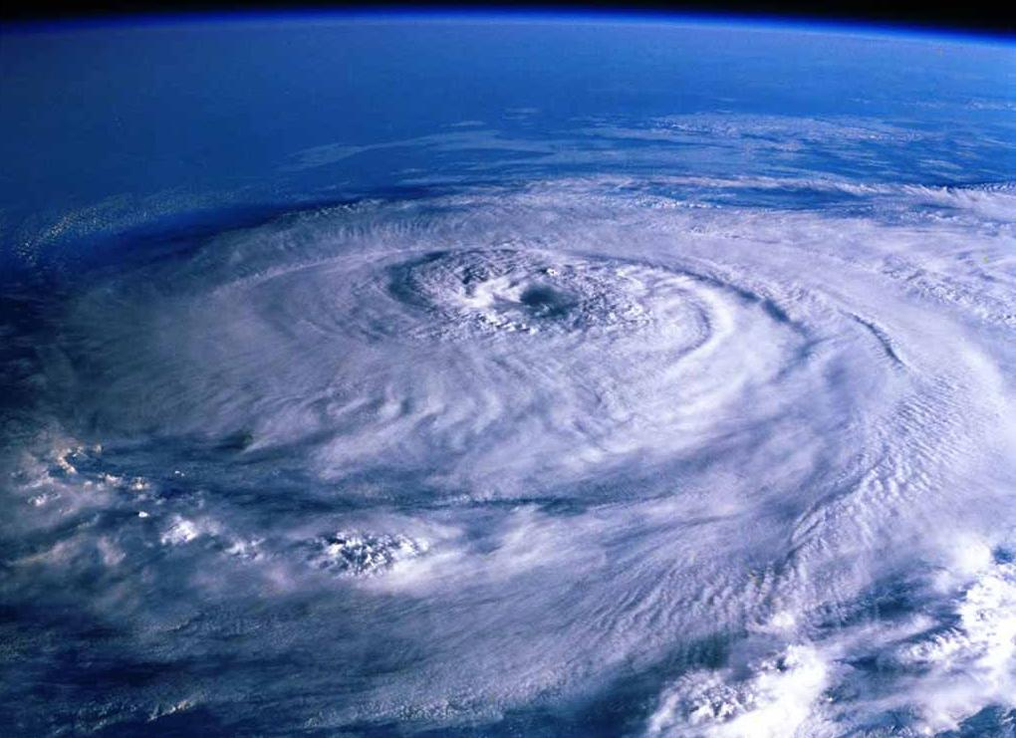

Slide 21
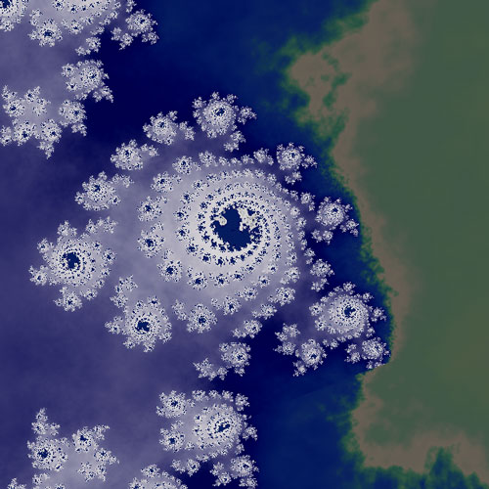

Slide 22
Circle Packing

Slide 23
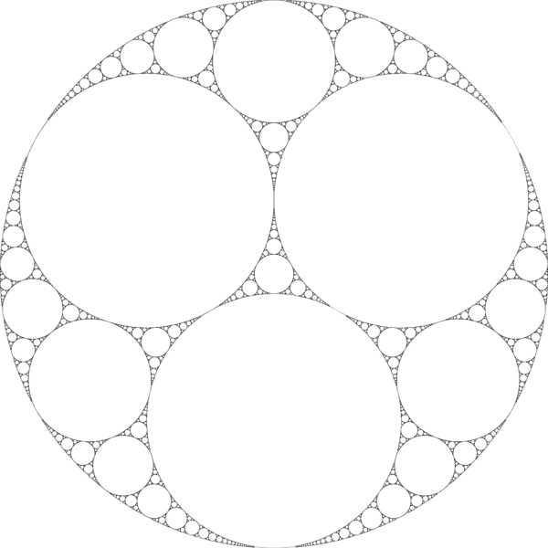
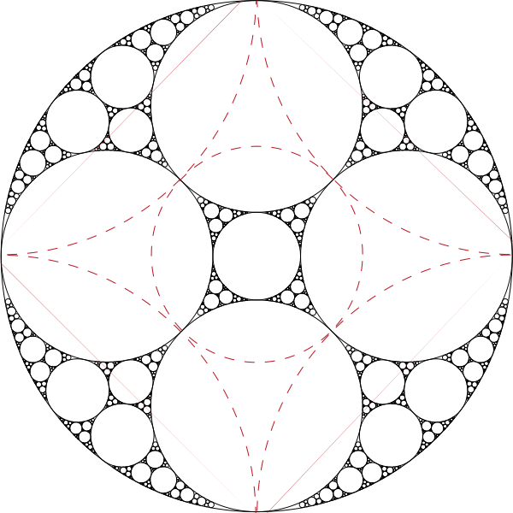

Slide 24
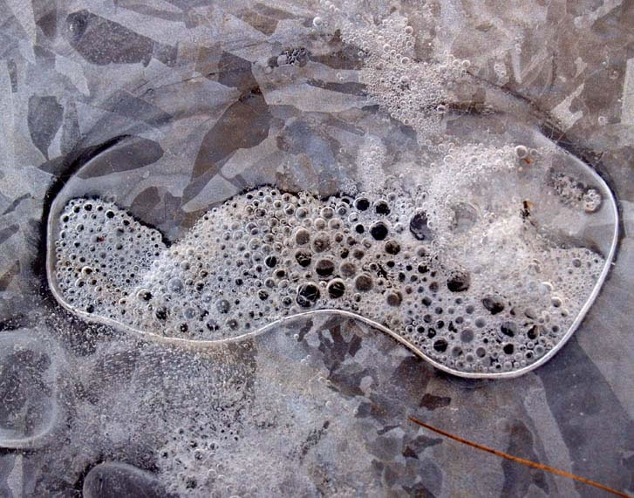

Slide 25
Mapping the Human Brain

Slide 26
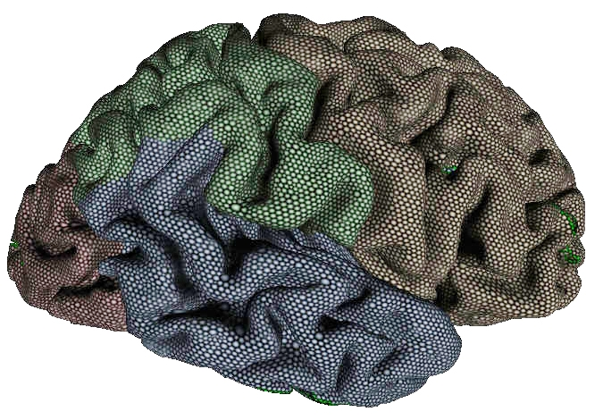

Slide 27
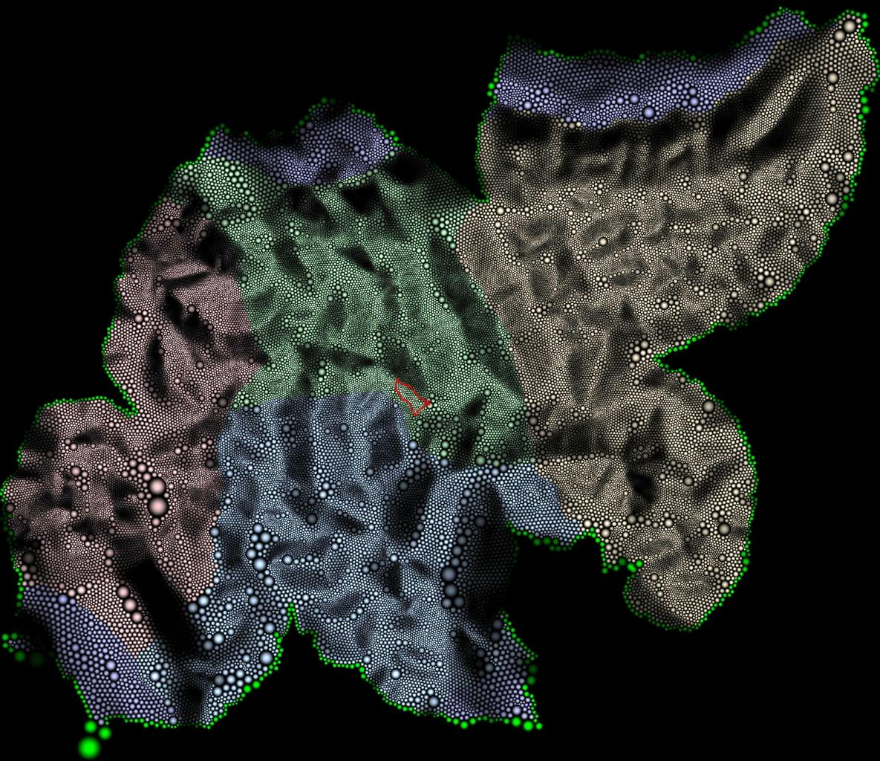

Slide 28
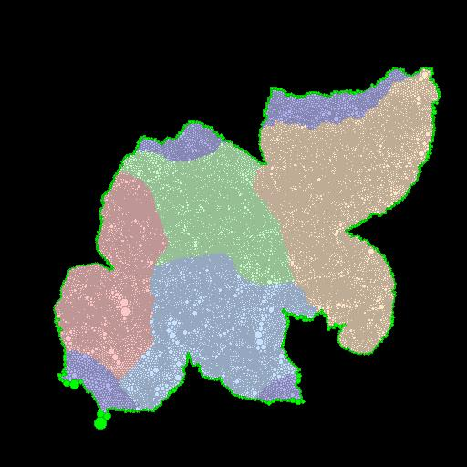

Slide 29
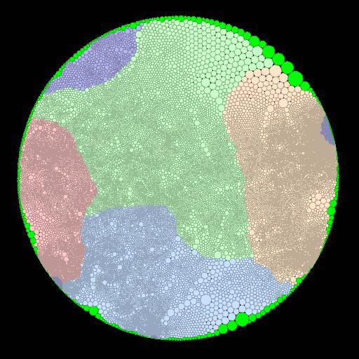
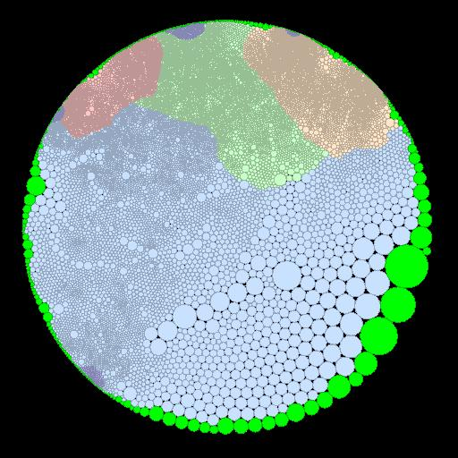

Slide 30
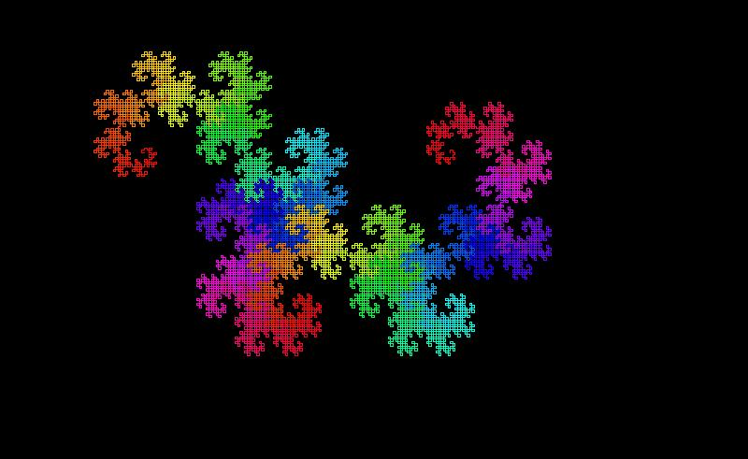
The Dragon Curve

Slide 31
Making the Dragon Curve
Paper Folding

Slide 33
Making the Dragon Curve
Drawing

Slide 34
Rules
1: Left Turn 0: Right Turn
Start with a line.
The first move is 1
The next move is found by:
Appending a 1 to the end.
Appending the string of preceding digits to the end with the middle digit complemented.

Slide 35
Dragon Curve
Computer Simulation

