Slide 1
West and Central Asia
500 BCE-1980 CE

Slide 2
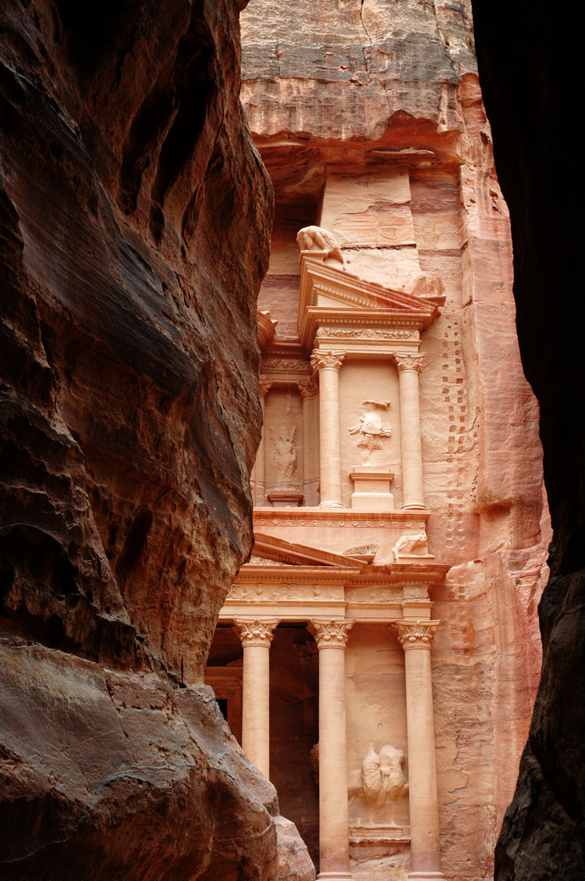
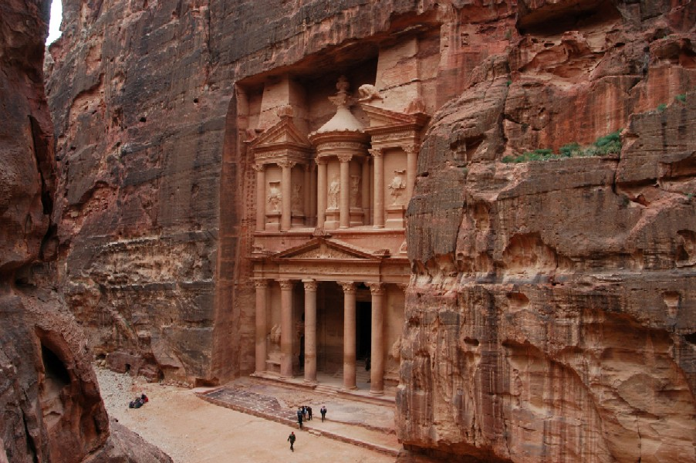
Petra, Jordan: Treasury and Great Temple
2nd century C.E.
Hellenistic Architecture/ Rock-Cut façade
Petra, Jordan

Slide 3
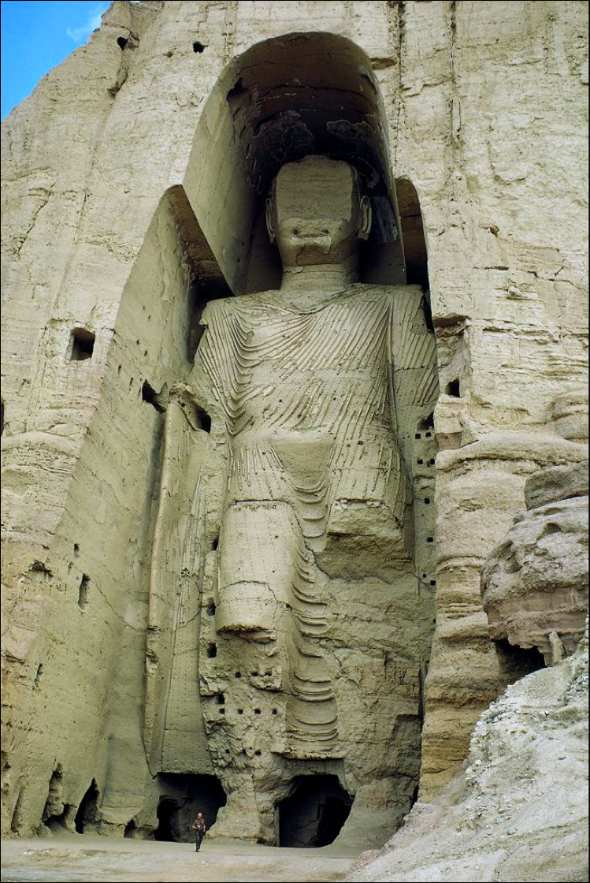
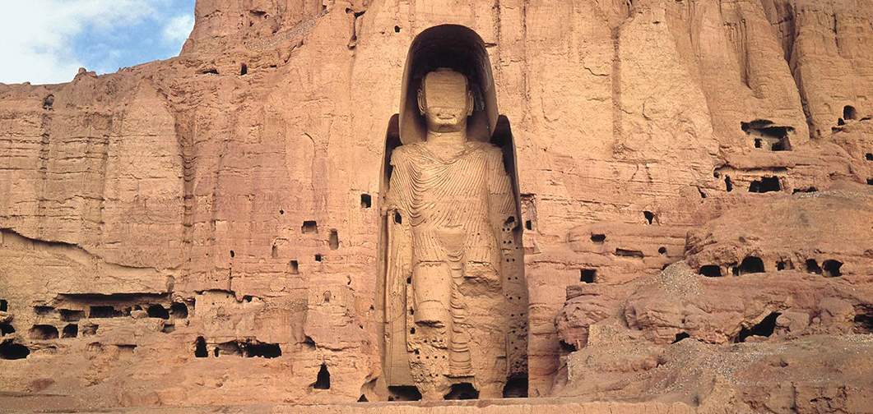
Buddha, Bamiyan
Located on the Silk Road; Bamiyan valley
507 CE and 554 CE
Sandstone, mud mixed with straw, coated with stucco

Slide 4
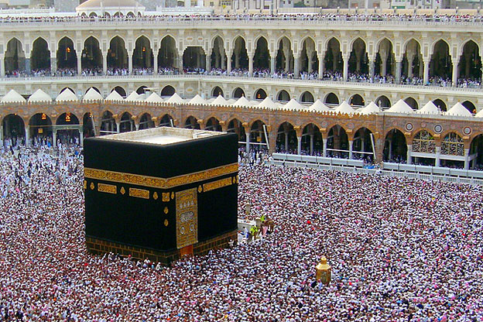
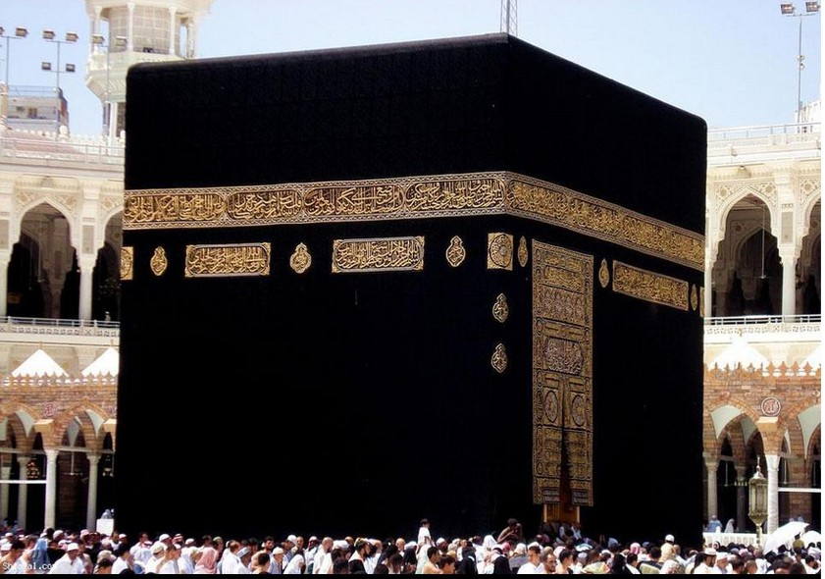
The Kaaba
Pre-Islamic monument
Masjid el Haram
631-32 C.E.
Granite masonry, covered with silk curtain and calligraphy in gold and silver-wrapped thread.

Slide 5
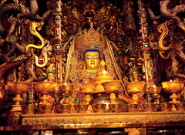
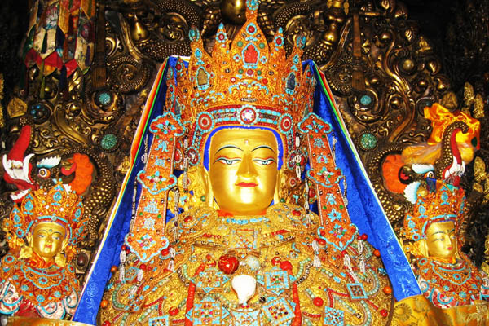
Jowo Rinpoche, enshrined in the Jokhang Temple
Lhasa, Tibet, Yarlung Dynasty
Gilt metals with semiprecious stones, pearls, and paint
Early to middle 7th century C.E.

Slide 6
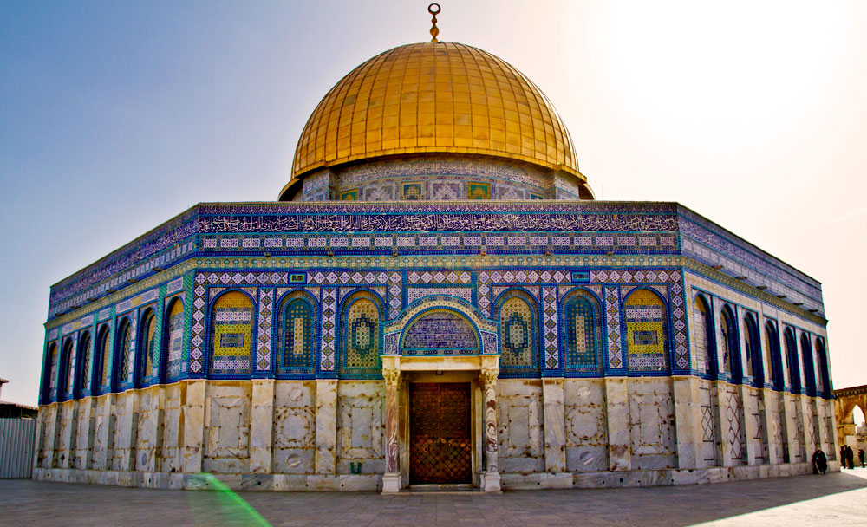
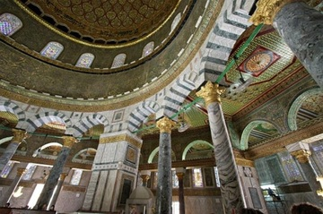
Dome of the Rock
Umayyad, Jerusalem 691 AD
Stone masonry, wooden roof, decorated with glazed ceramic tile, mosaics, and gilt aluminum and bronze dome
Architect: Abd al-Malik

Slide 7
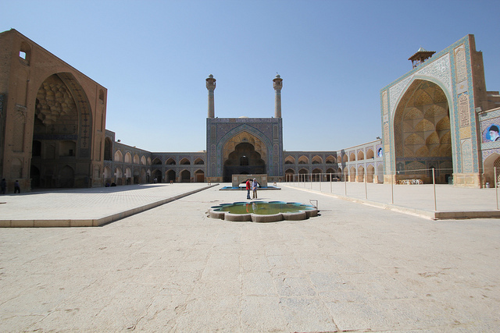
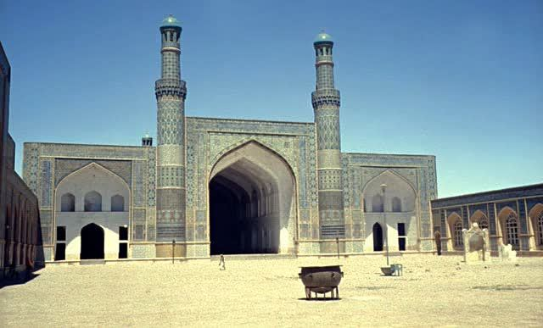
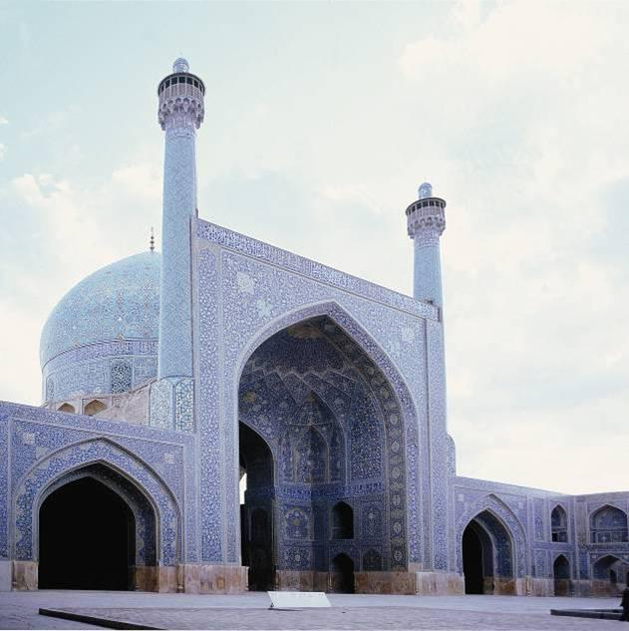
Great Mosque (Masjid-e Jameh), Isfahan
Iran
Bricks, intricate motifs in stucco, and sumptuous tile-work
8th through the 20th centuries

Slide 8
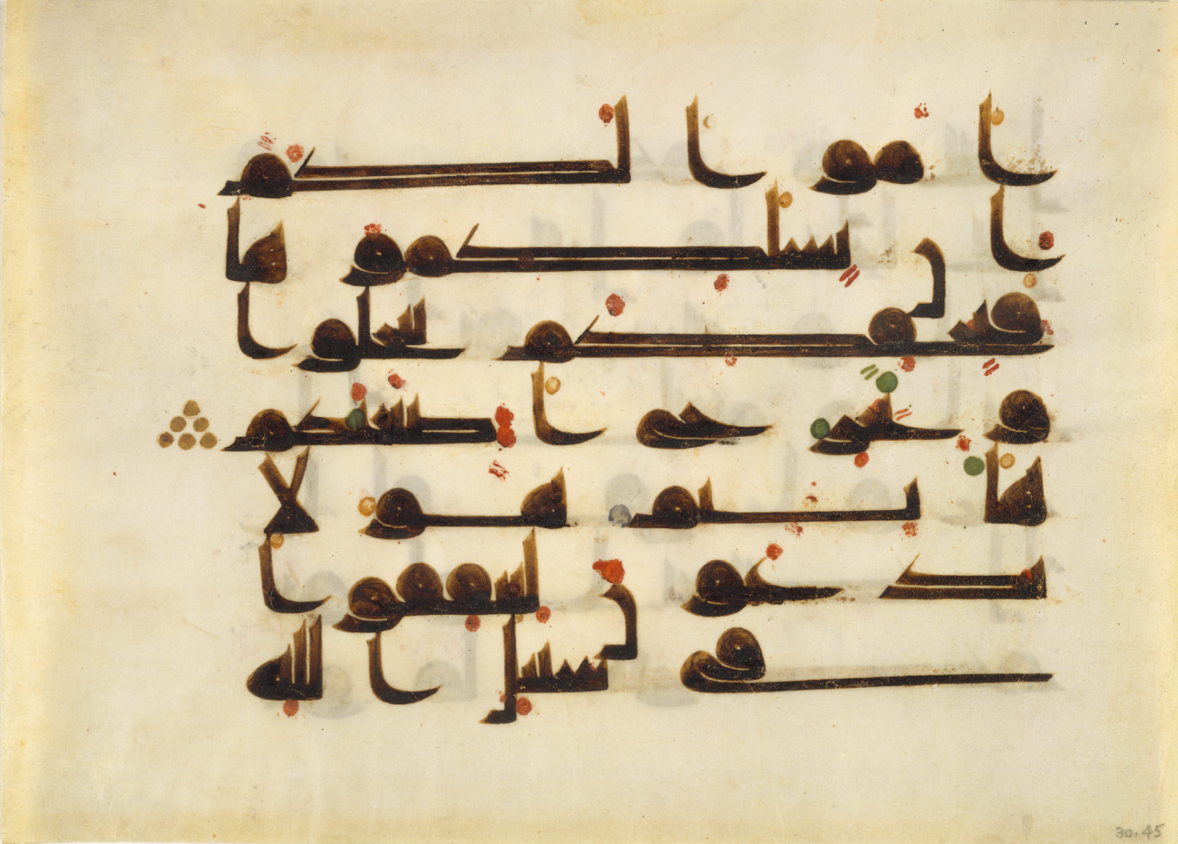
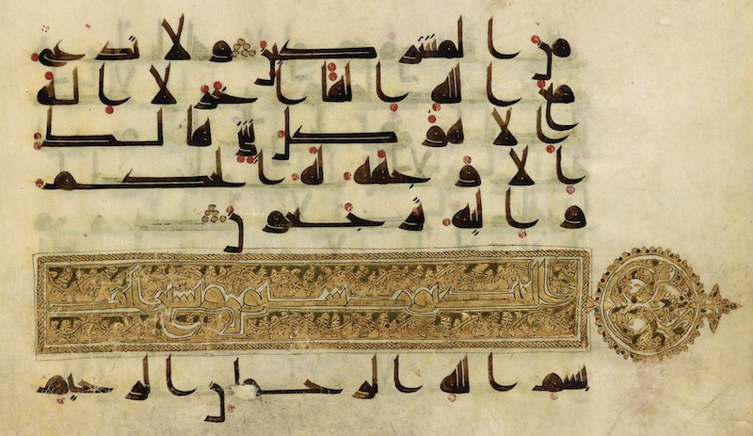
Folio from a Qur'an
Qu'ran fragment, in Arabic
Vellum
750 and 1000 C.E

Slide 9
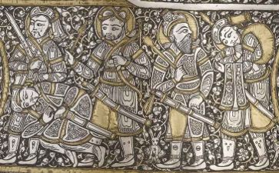
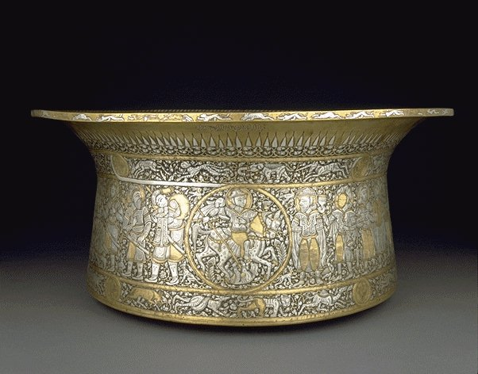
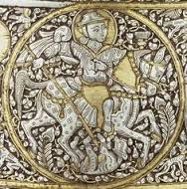
Basin (Baptistère de Saint Louis), Mohammed ibn al-Zain
Egypt or Syria Circa 1320-1340
Hammered brass, gold, silver, and niello inlay

Slide 10
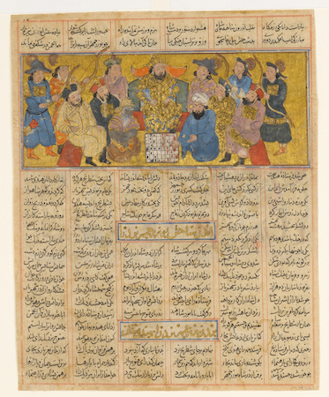
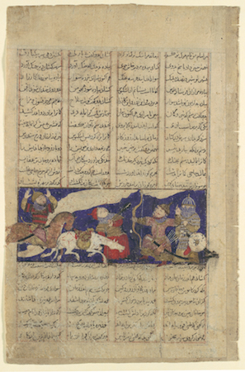
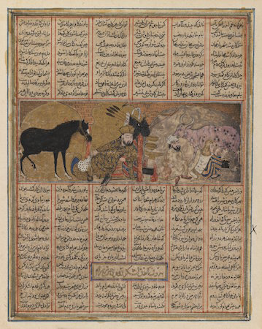
Bahram Gur Fights the Karg, folio from the Great Il-Khanid Shahnama
Iran, Mongol dynasty: 1330-40
Ink, opaque watercolor, gold, and silver on paper

Slide 11
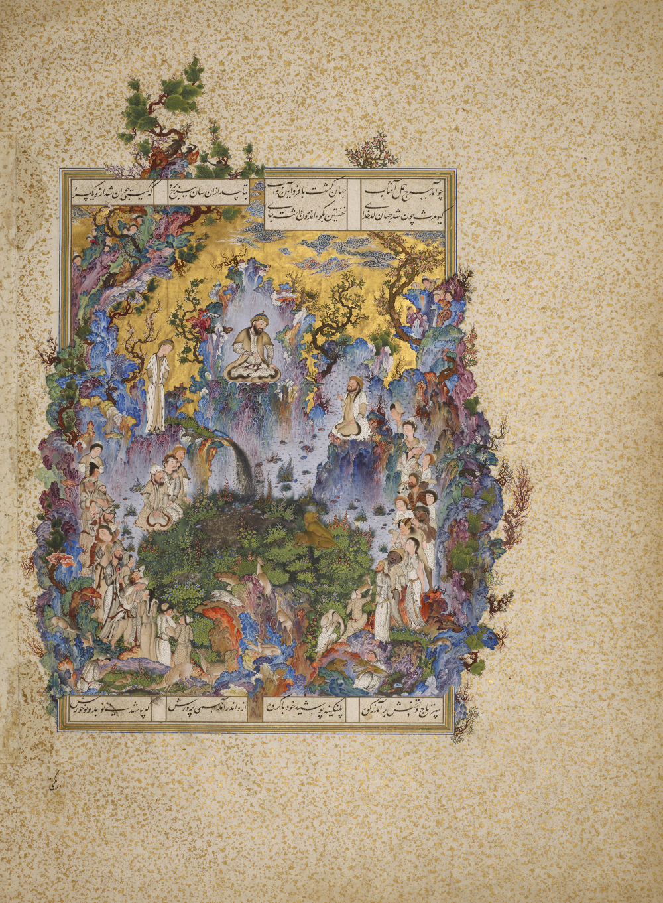
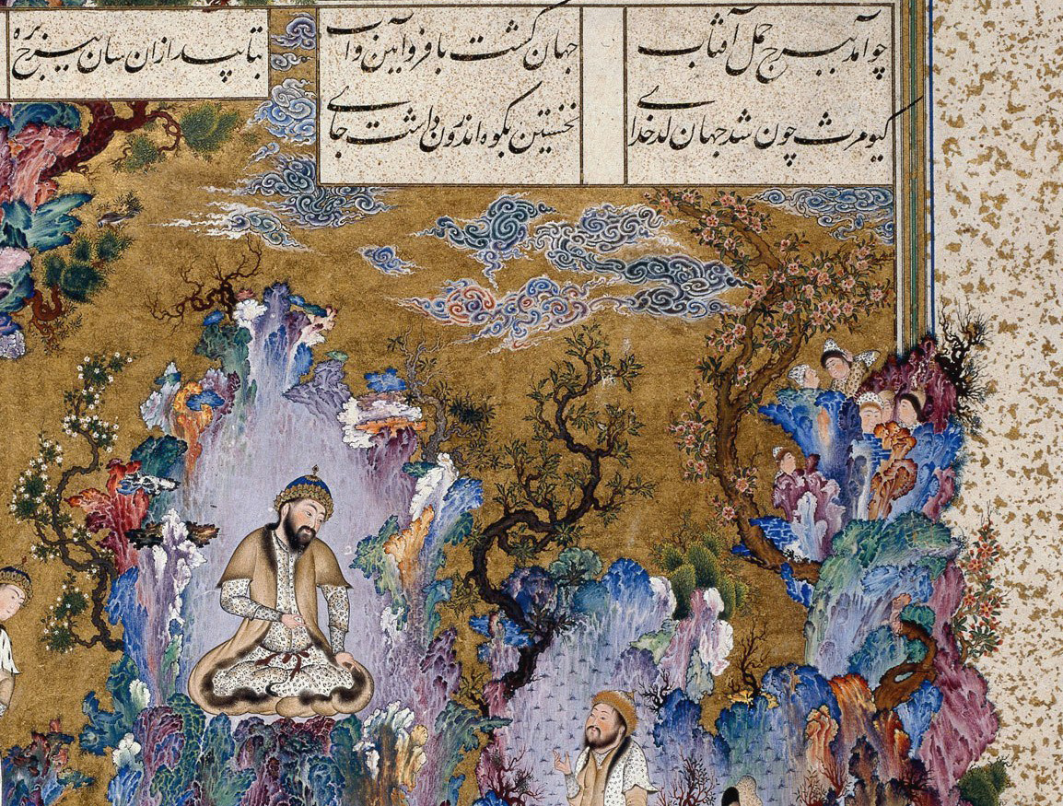
The Court of Gayumars, folio from Shah Tahmasp's Shahnama
Tabriz, Iran: 1522
Artist: Sultan Muhammad
Manuscript

Slide 12
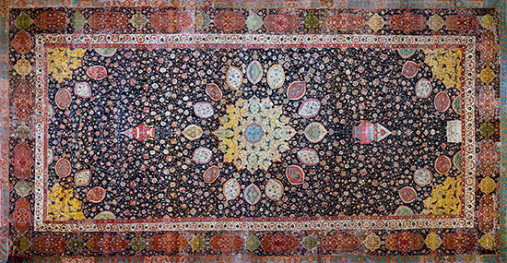
The Ardabil Carpet
Persian: Safavid Dynasty
Silk warps and wefts with wool pile
1539-40 C.E

